Slide 1

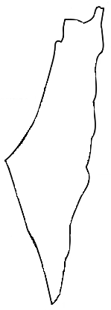
Learning About Qur’anic Places

Slide 2
The Prophet Muhammed, peace be upon him visited the place with the green dot. Do you know its name?
Gaza
Palestine
Al Quds
Bethlehem

Slide 3
The Prophet Muhammed, peace be upon him visited the place with the green dot. Do you know its name?
Gaza
Palestine
Al Quds
Bethlehem

Slide 4
Do you know what this country was called for thousands of years?
Jordan
Palestine
Egypt
Lebanon

Slide 5
Do you know what this country was called for thousands of years?
Jordan
Palestine
Egypt
Lebanon

Slide 6
Which dot shows Al Quds?
red
yellow
orange
green
blue

Slide 7
Which dot shows Al Quds?
red
yellow
orange
green
blue

Slide 8
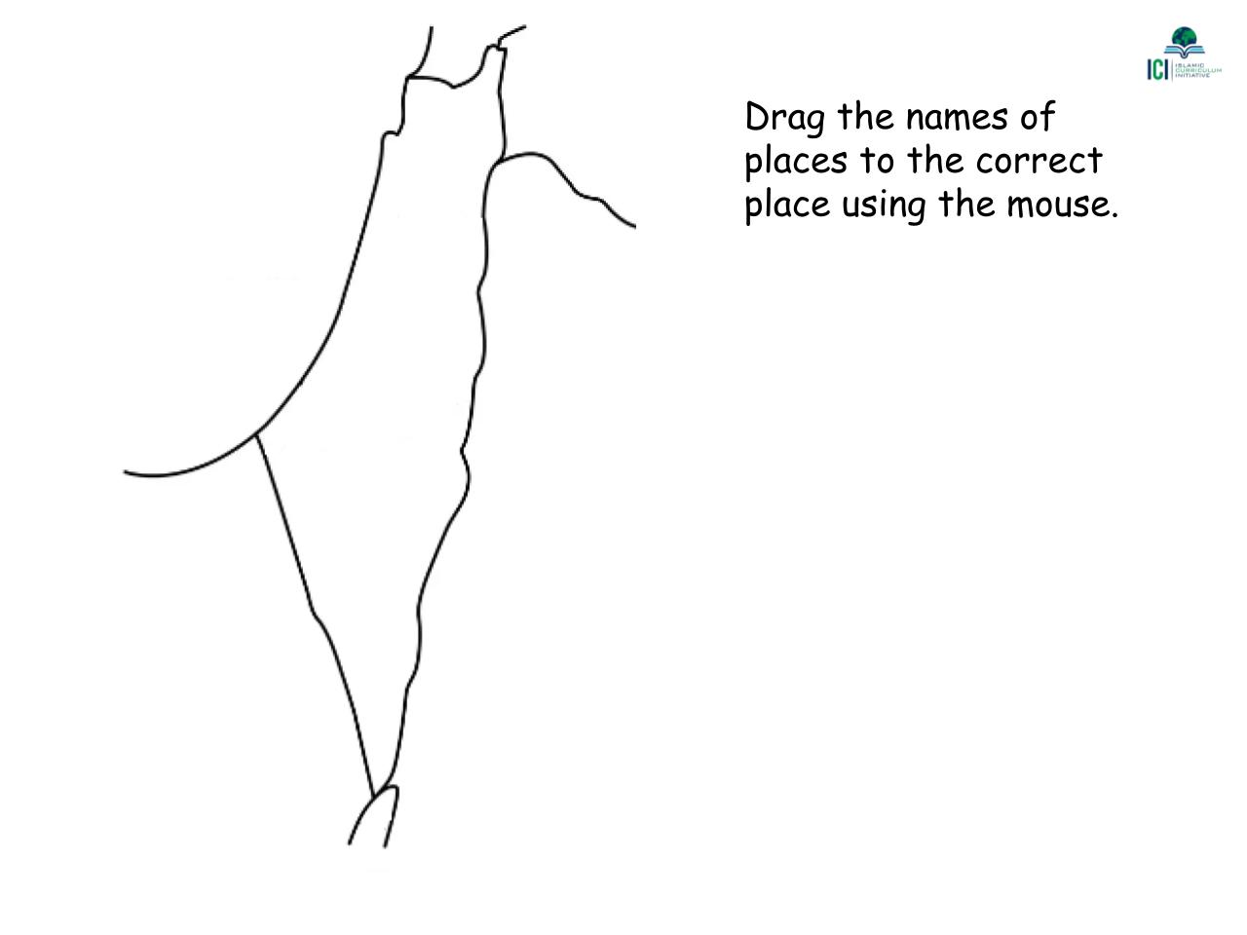
Syria
Gulf of Aqaba
Mediterranean Sea
Jordan
Palestine
Lebanon
Egypt

Slide 9
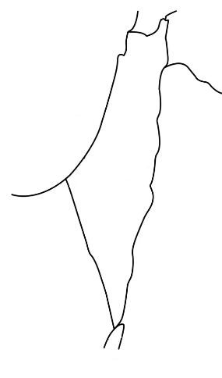
Lebanon
Move the names of places to the correct place using the mouse.
Syria
Mediterranean Sea
Palestine
Jordan
Egypt
Gulf of Aqaba

Slide 10
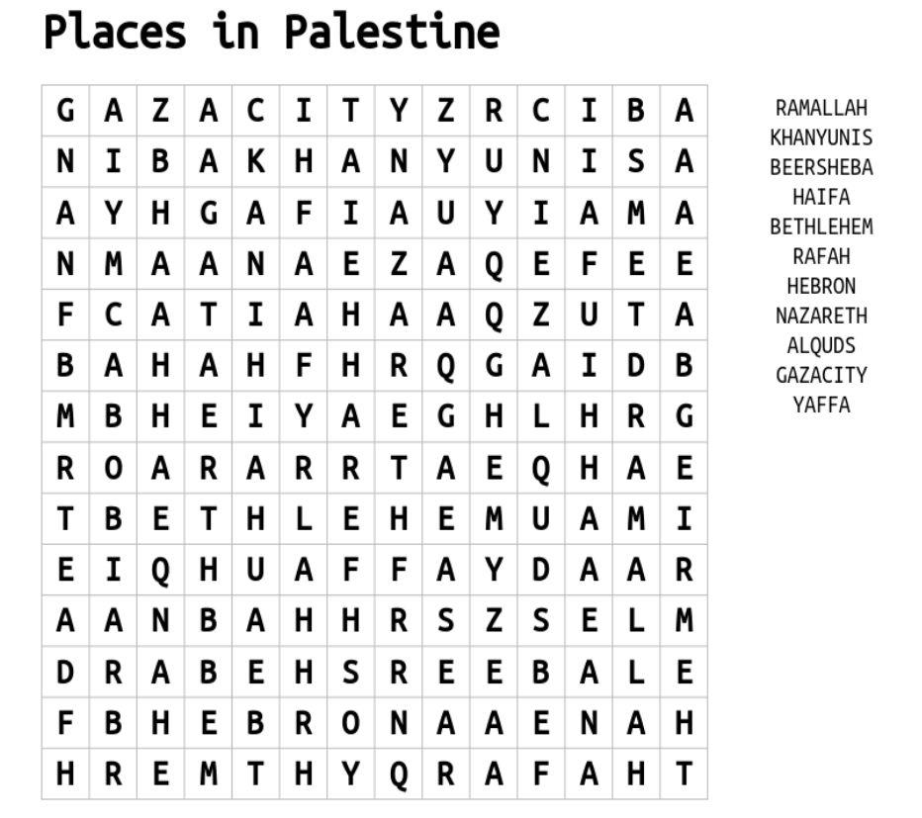

Slide 11
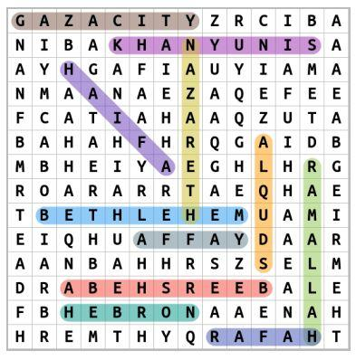

Slide 12
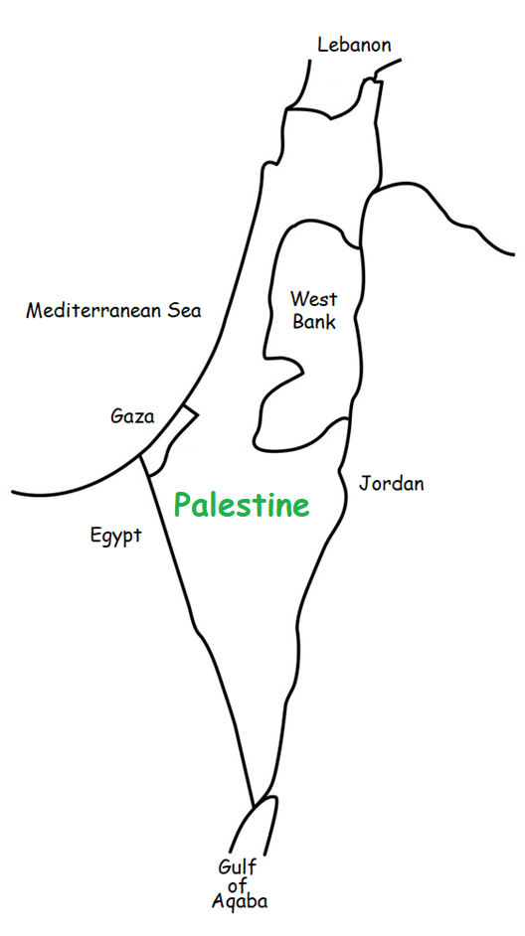

Slide 13
We hope you had fun learning about Palestine.

