Slide 1
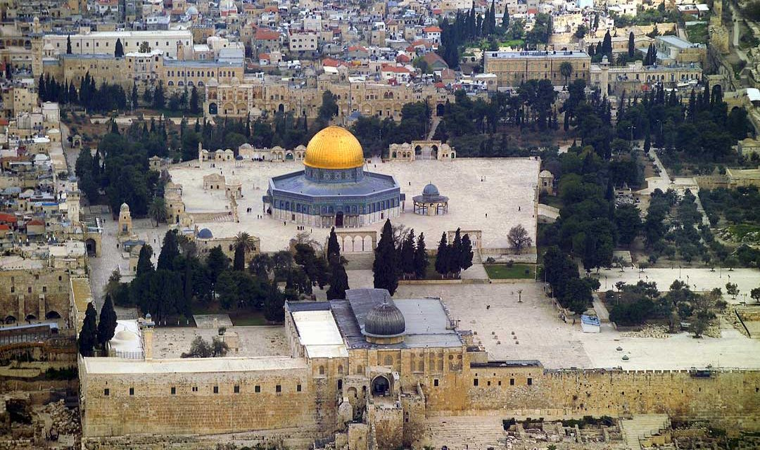
Learning About Palestinian Places

Slide 2
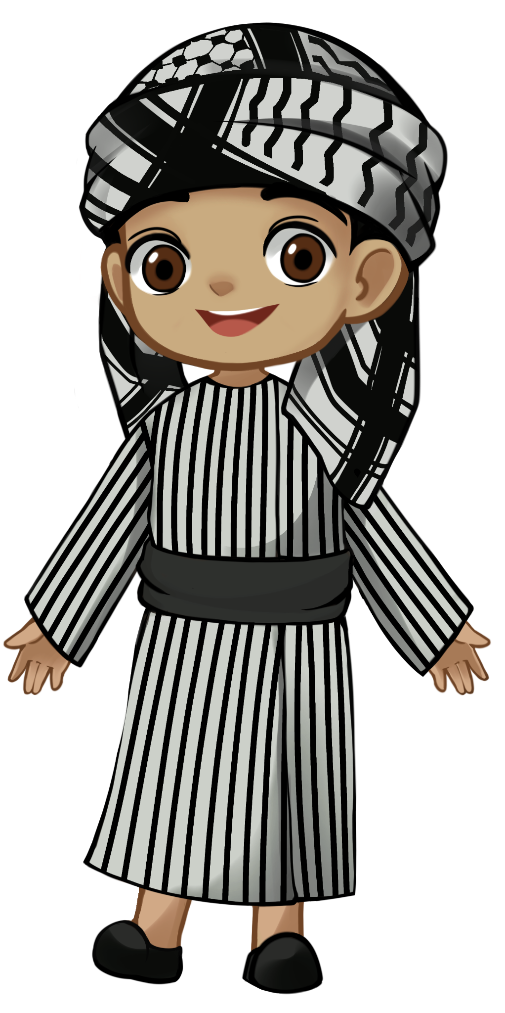

As Salaamu Alaikum! My name is Motaz.
I am from Palestine.
Let me show you around Palestine.

Slide 3
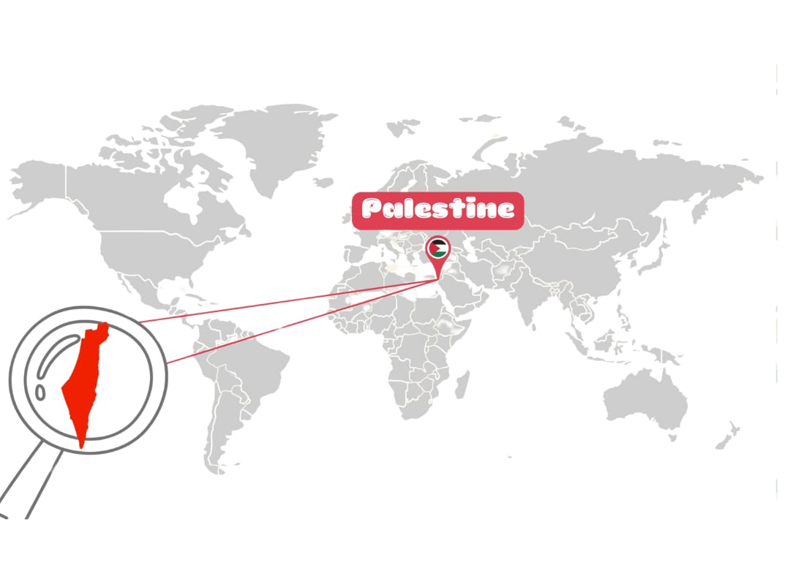

Slide 4
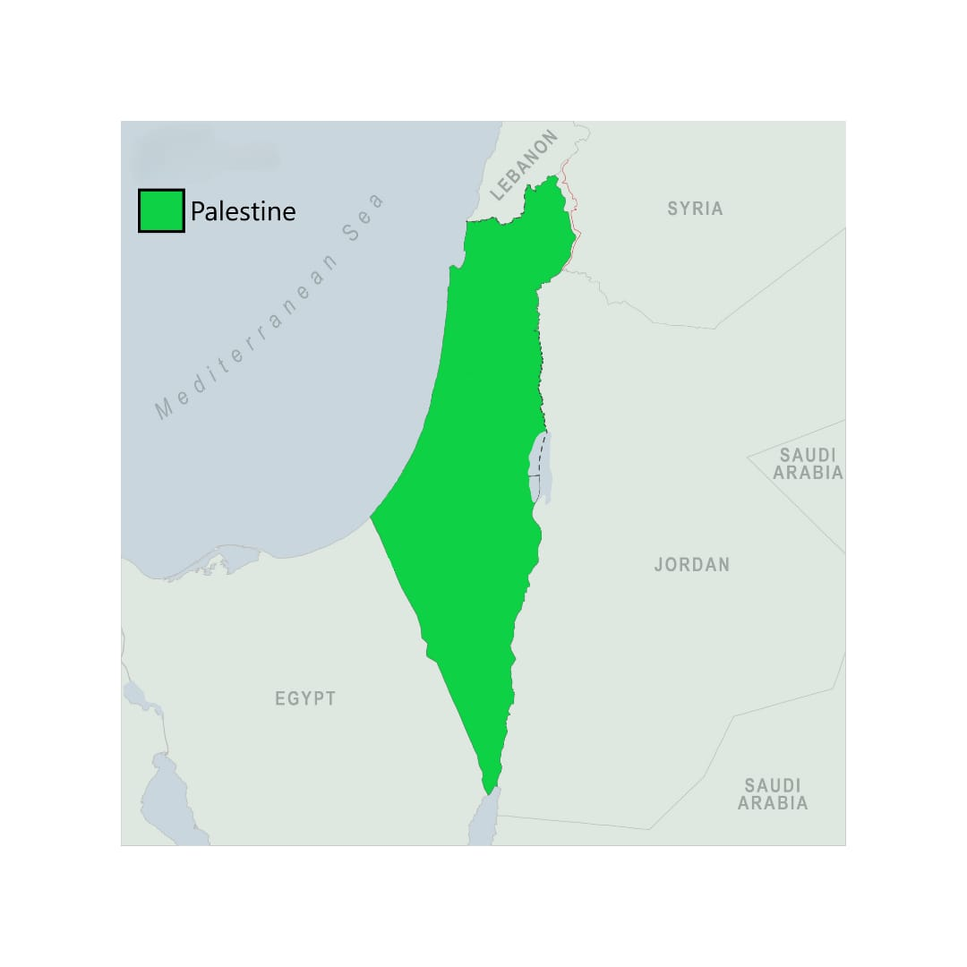

Slide 5
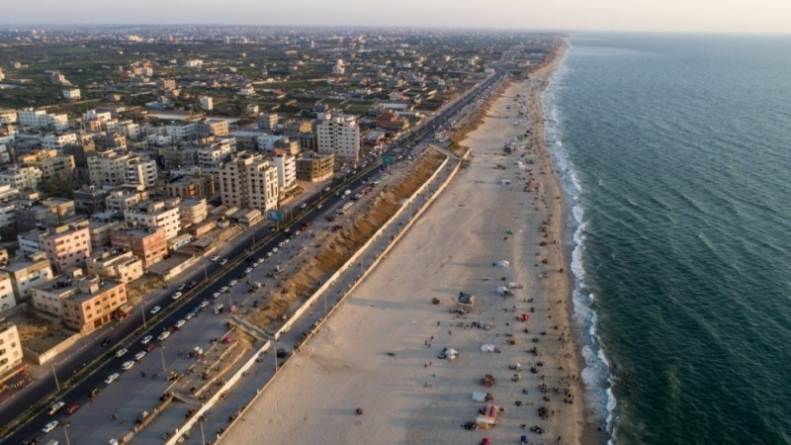
This is the Mediterranean Sea and Gaza Strip.

Slide 6

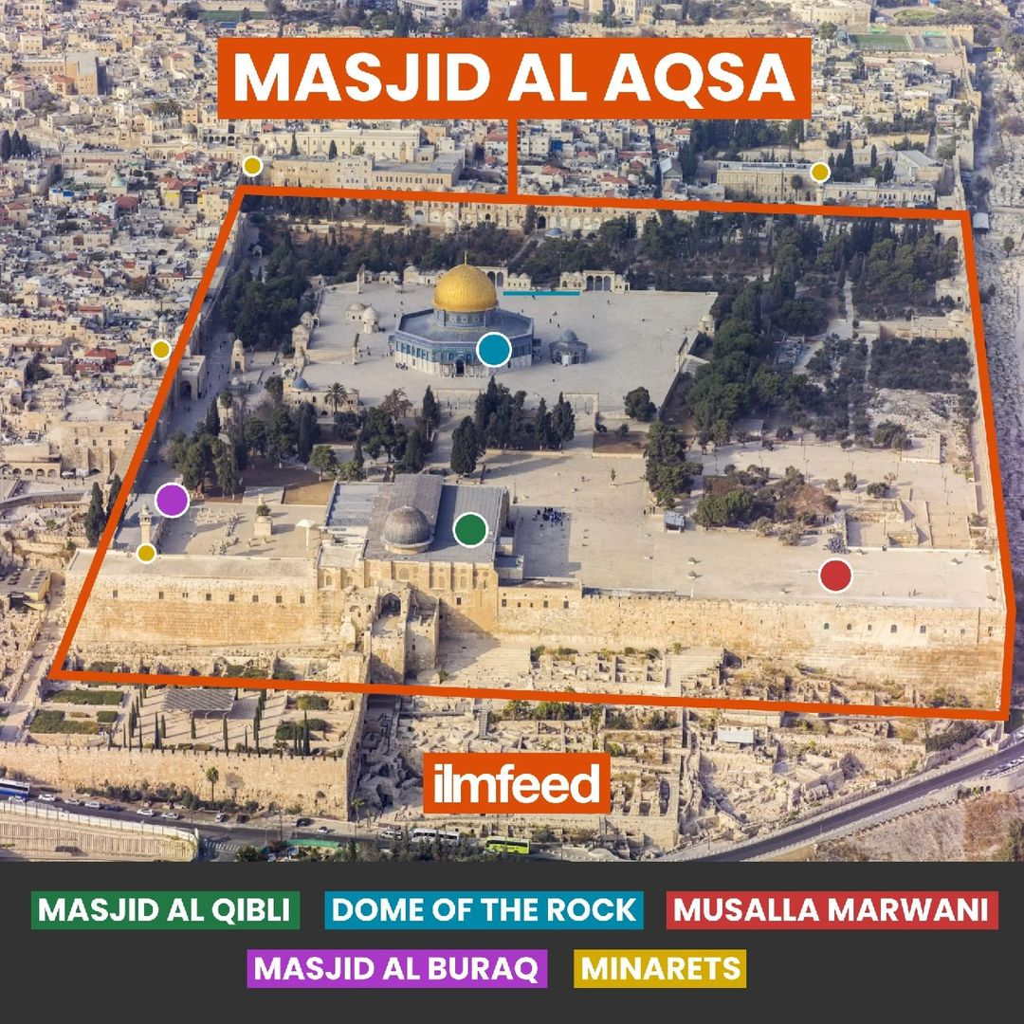
AL AQSA COMPOUND

Slide 7
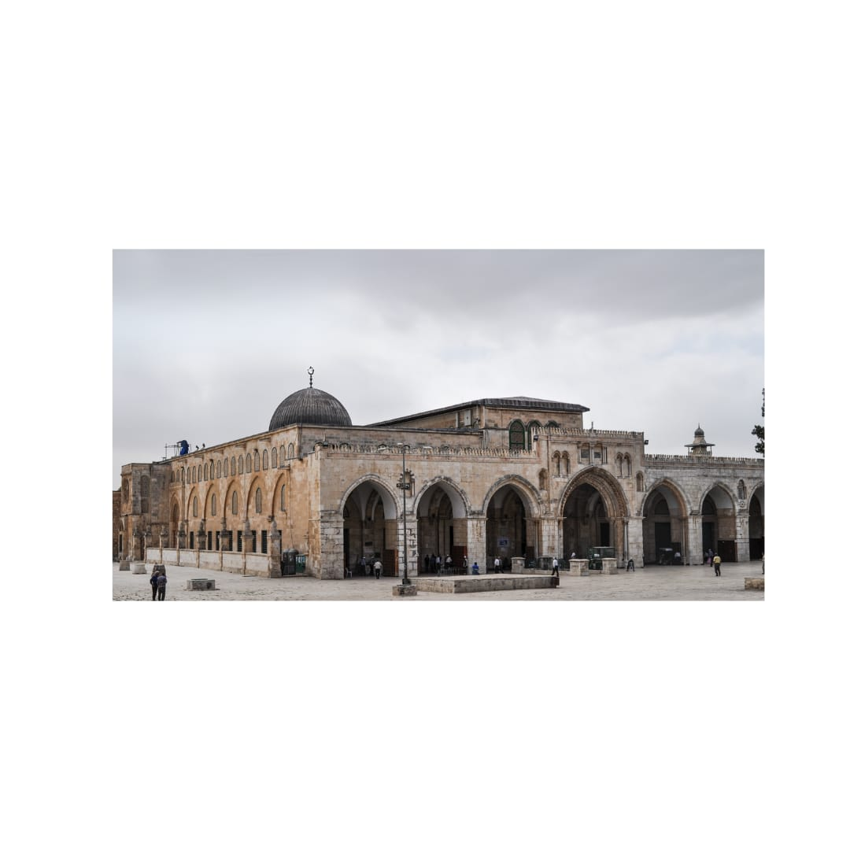
This is Masjid Al Qibli.

Slide 8
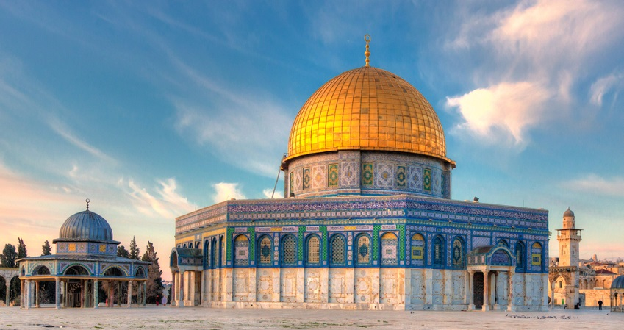
This is Qubbat al Sakhra, the Dome of the Rock.

Slide 9
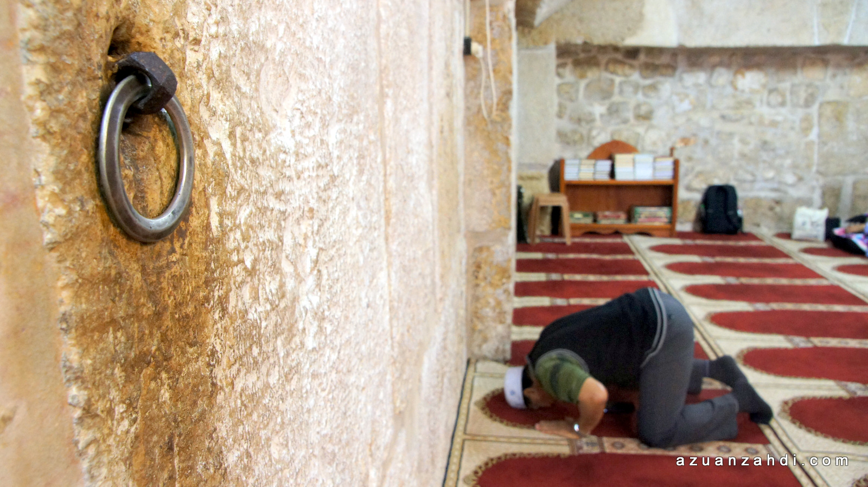
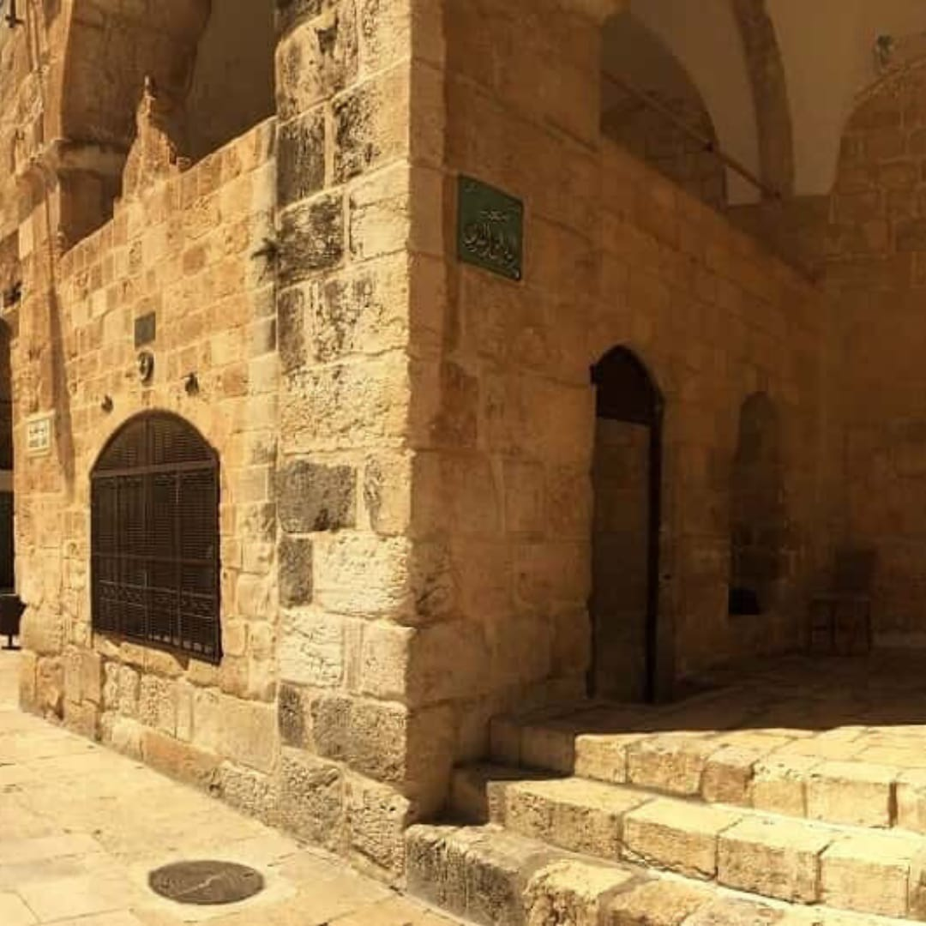
This is Masjid al Buraq in Jerusalem.

Slide 10
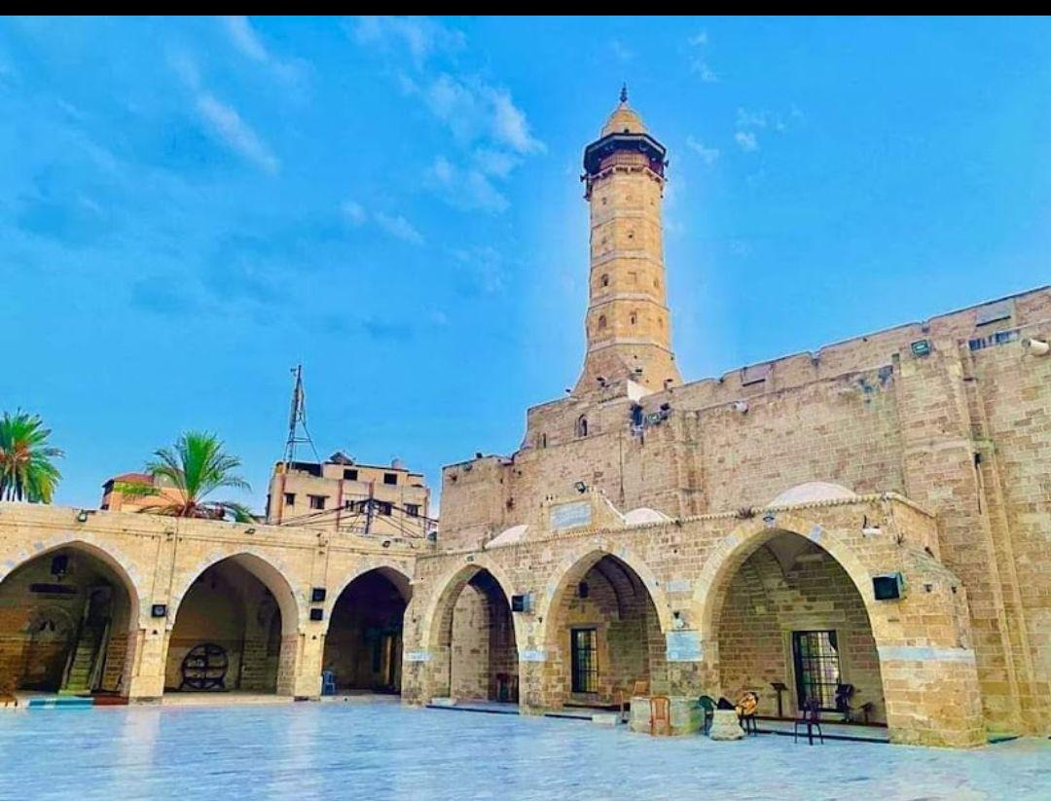
This is al-Masjid al-ʿUmari al Kabeer
in Gaza.

Slide 11
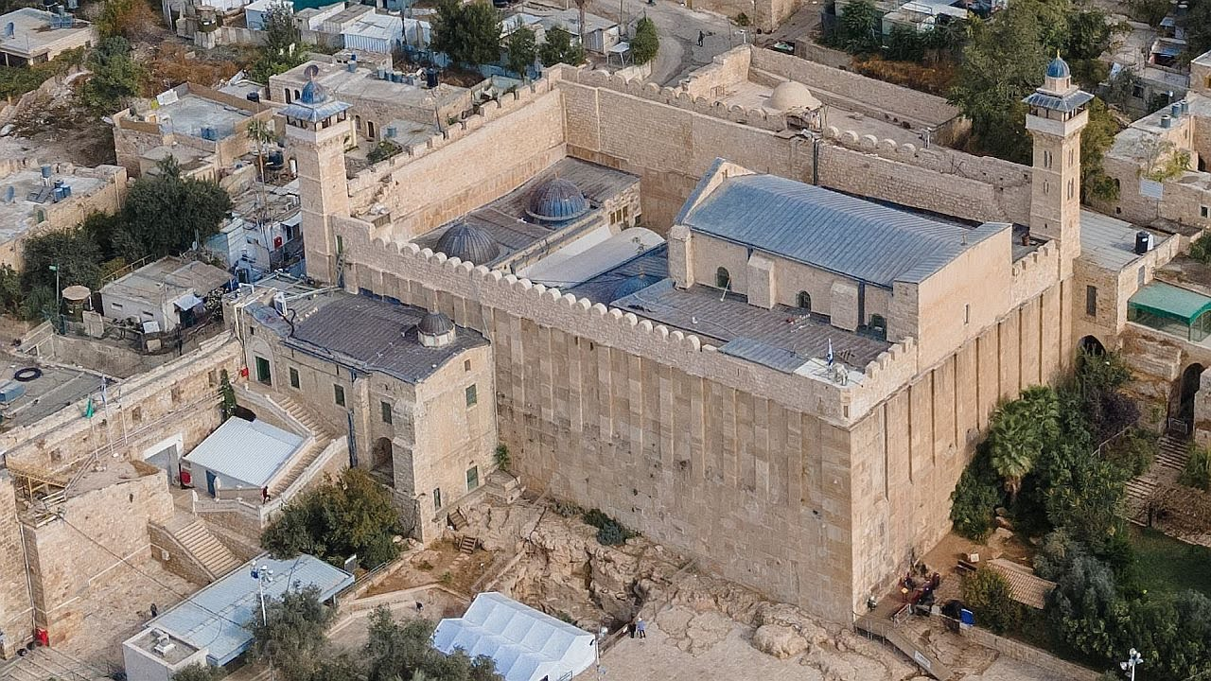
This is Al Ibrahimi Mosque in Hebron.

Slide 12
Meet you in the next book to show you what we eat. Until then,
Asalaamu alaikum!

