Slide 1

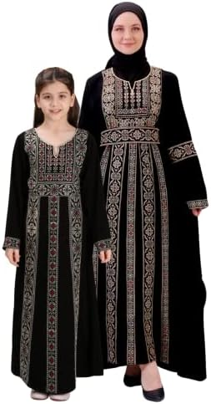
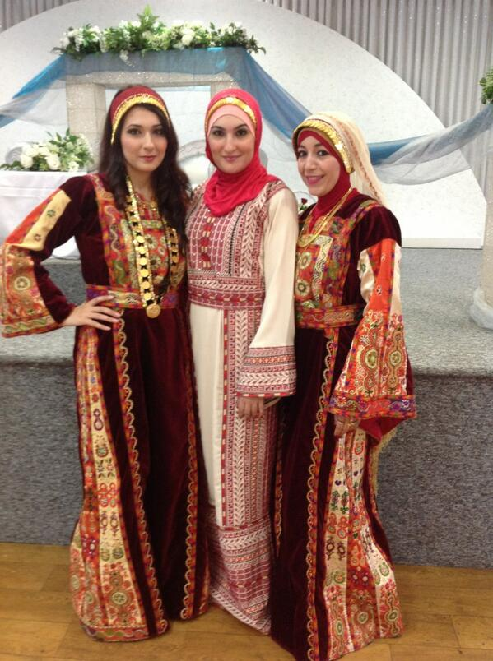
Learning About Palestinian
Traditional Dress

Slide 2
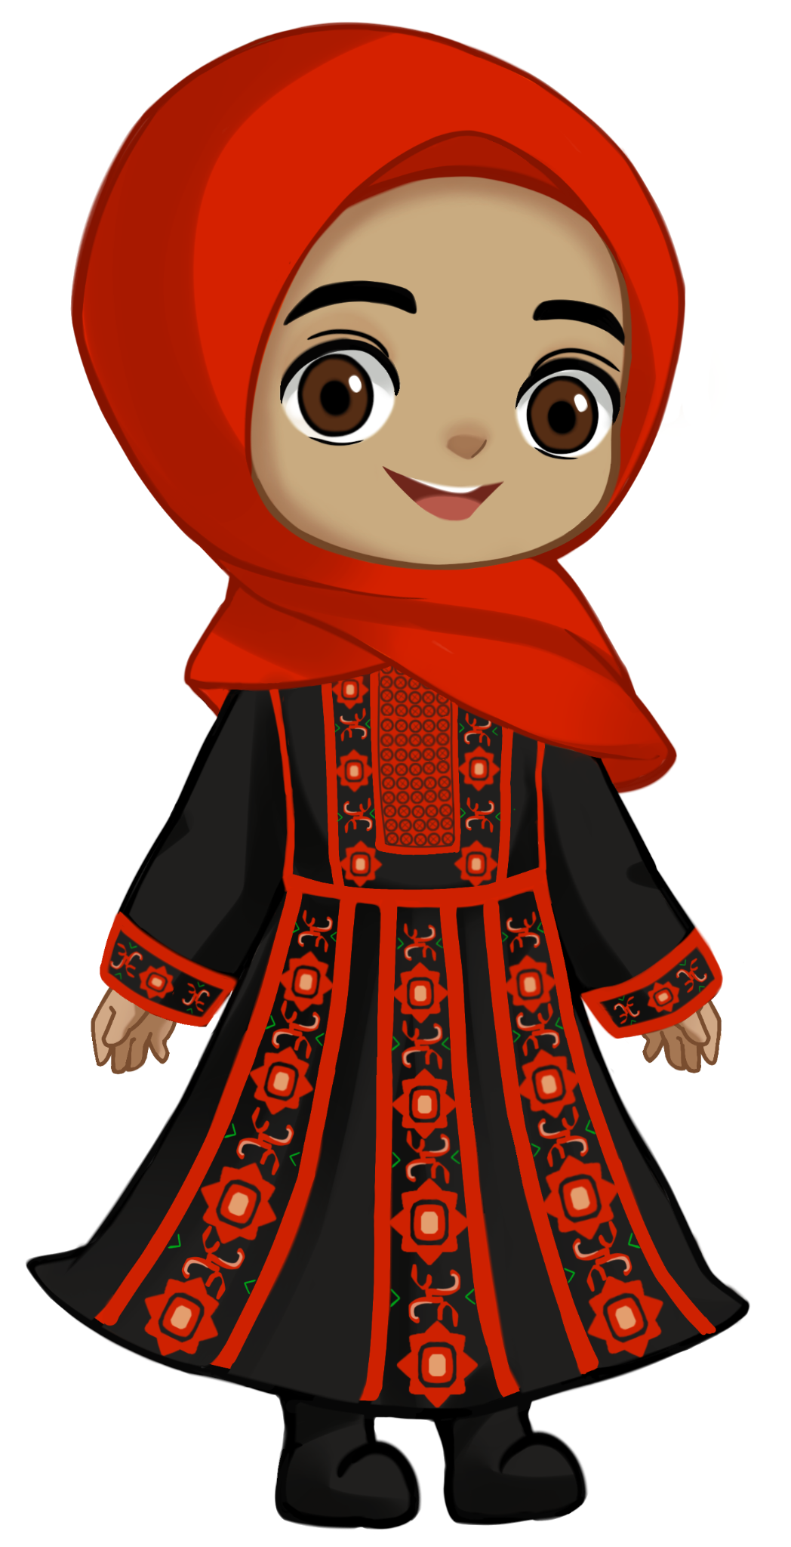
Asalaamu alaikum! My name is Afaf. I am a Palestinian. Let me show you our beautiful clothes.

Slide 3
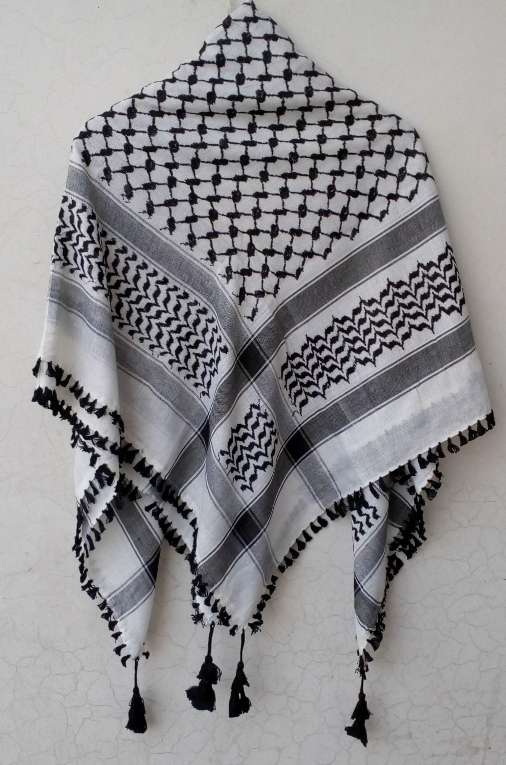
This is keffiyeh

Slide 4
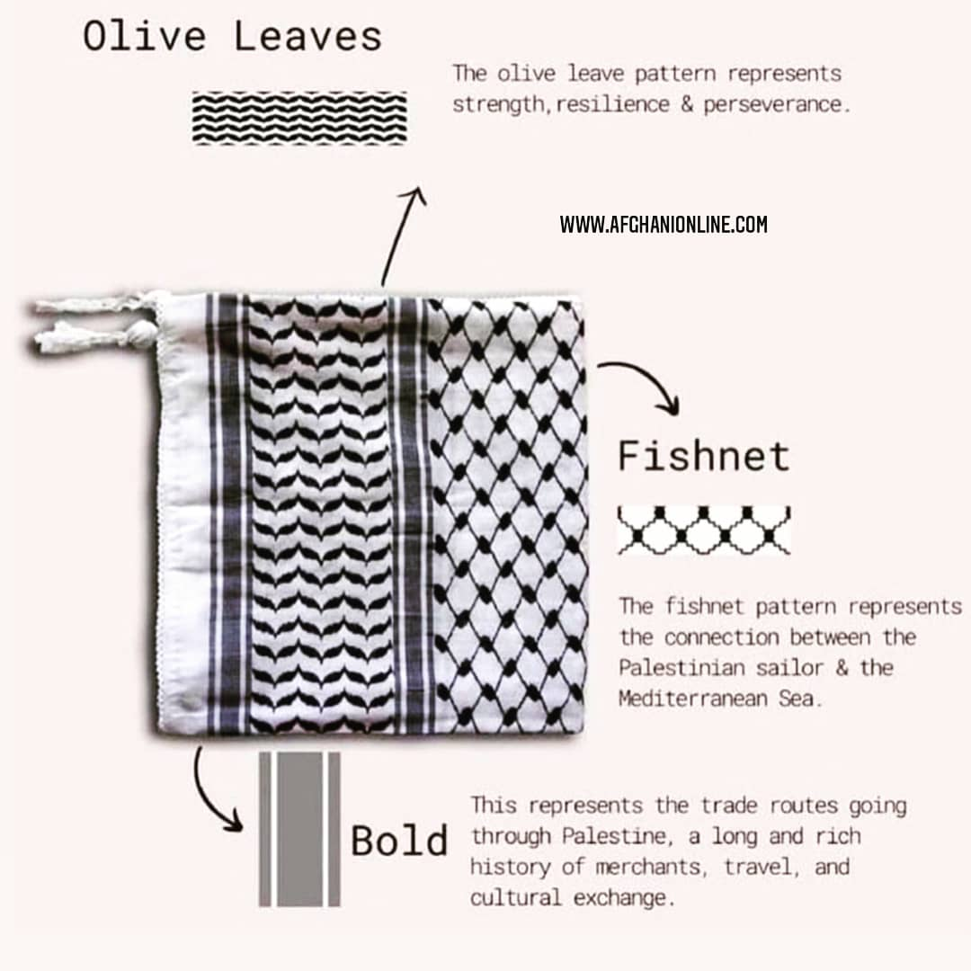

Slide 5
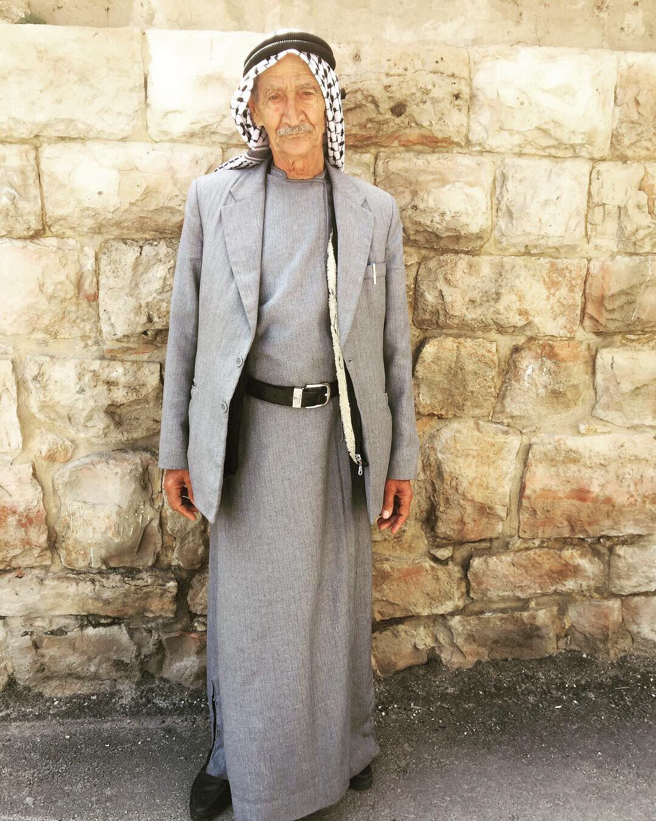
This is a men’s thobe and keffiyeh

Slide 6
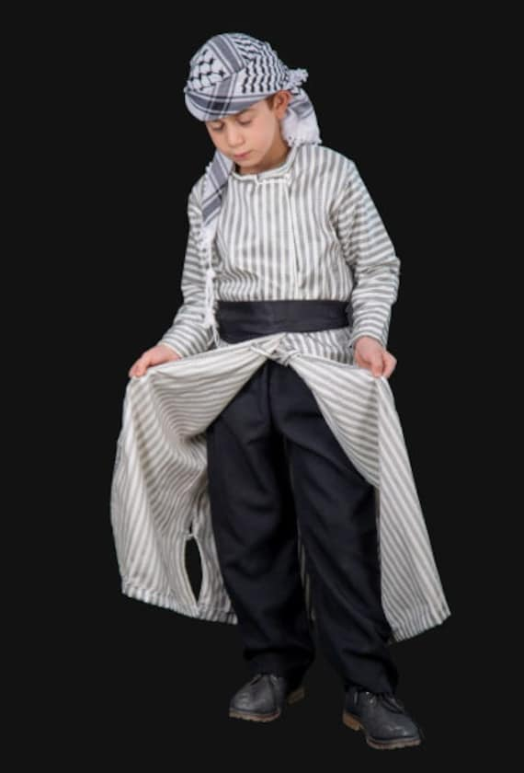
This is kids dress thobe with serwal and shemagh.

Slide 7
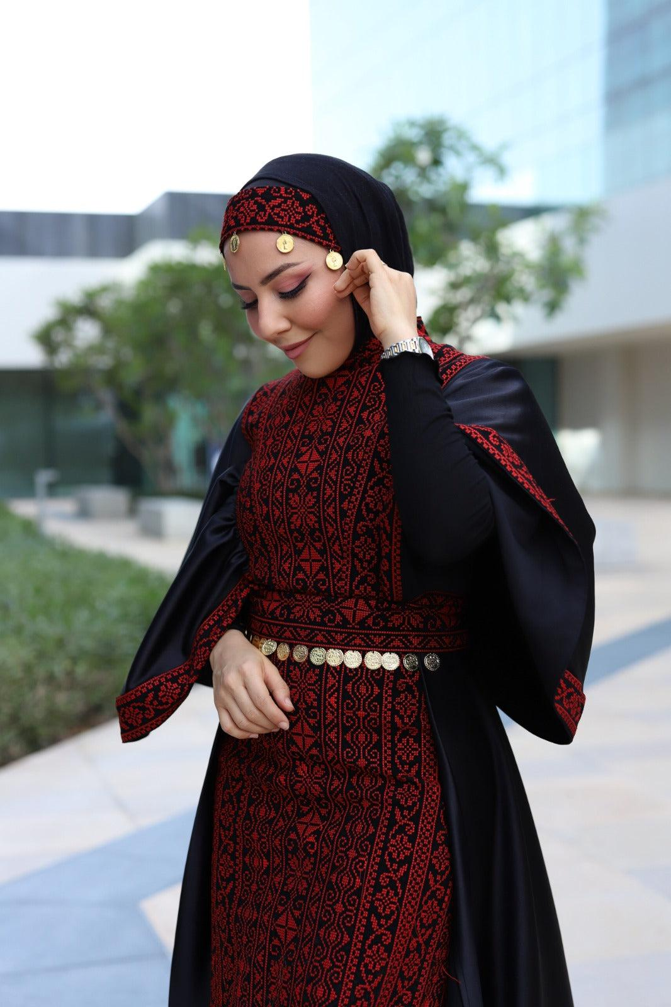
Tatreez is most famously used on the Palestinian dress which is called the “thobe”. The thobe is also known as “malliaia”.

Slide 8
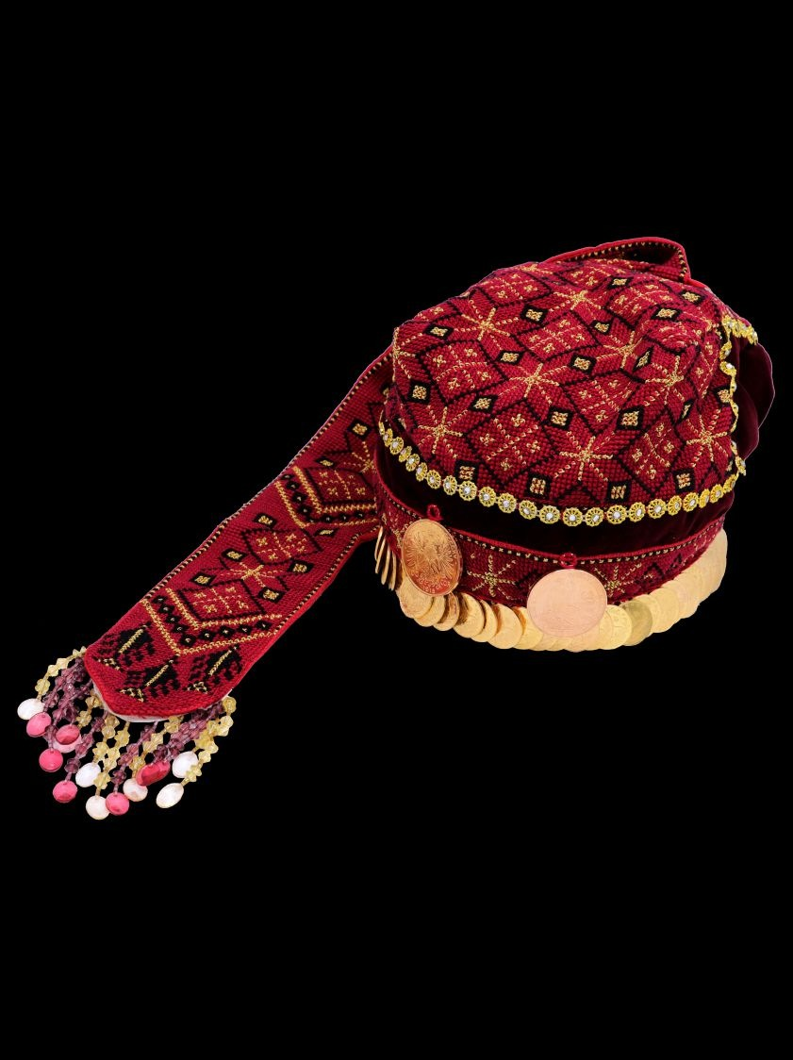
This is a gold coin hat.

Slide 9
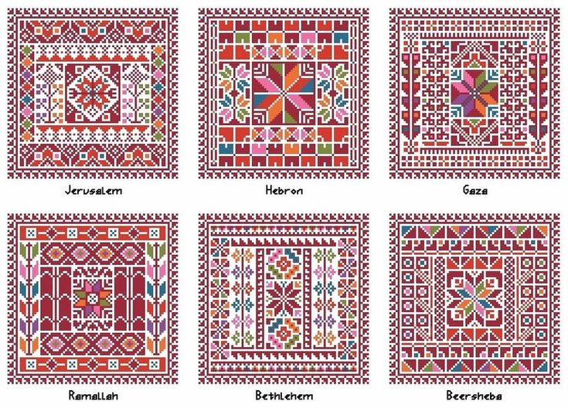

Slide 10
Meet me in the next book to see our symbols. Until then Asalaamu alaikum!

