Slide 1

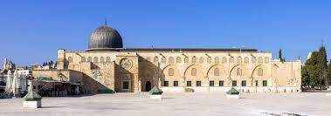
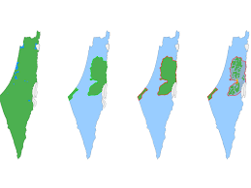
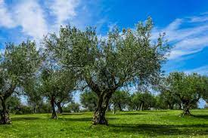
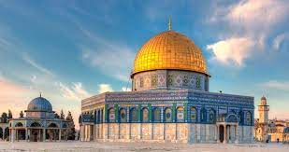
Learning About Palestinian
Symbols

Slide 2
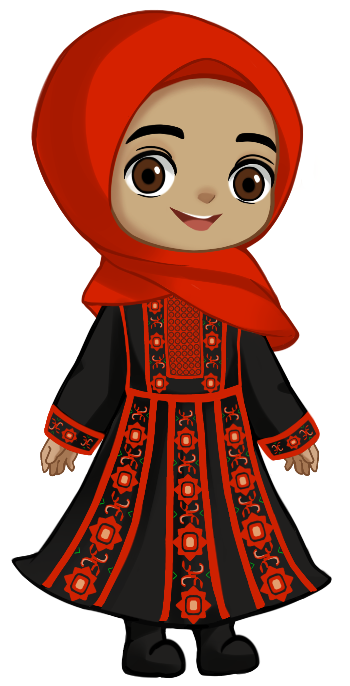
Asalaamu alaikum!
My name is Afaf.

Slide 3
I am a Palestinian.
Let me show you some of our symbols.
A symbol is something that has a special meaning.

Slide 4
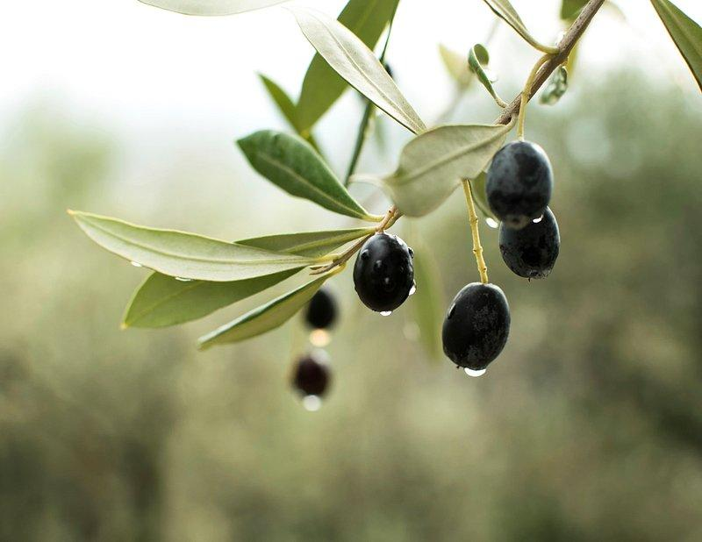
This is an olive branch.
It means peace. Alhamdulilah.

Slide 5
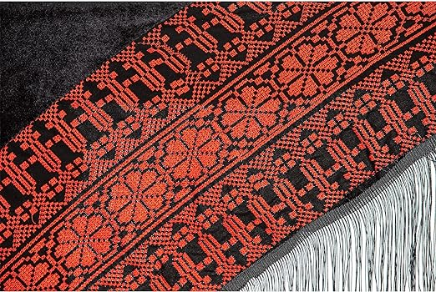
These are patterns that we make on cloth. MashAllah.
What shapes can you see?

Slide 6
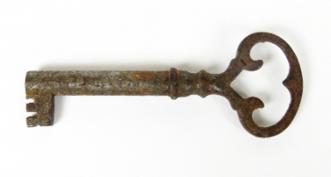
A key shows that our homes were stolen from us. InshaAllah we will get our homes back.

Slide 7
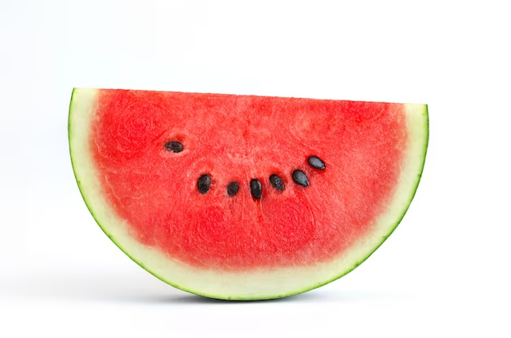
The Palestinian flag was not allowed so the people used the watermelon to be their flag. Alhamdulilah.

Slide 8
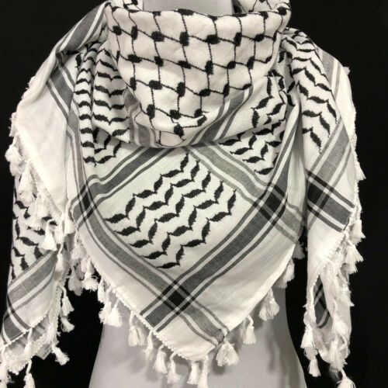
This is a Keffiyeh.
It means freedom.
Bismillah.

Slide 9
Thank you for being on this journey with us.
Ma as Salaamah.

