Slide 1
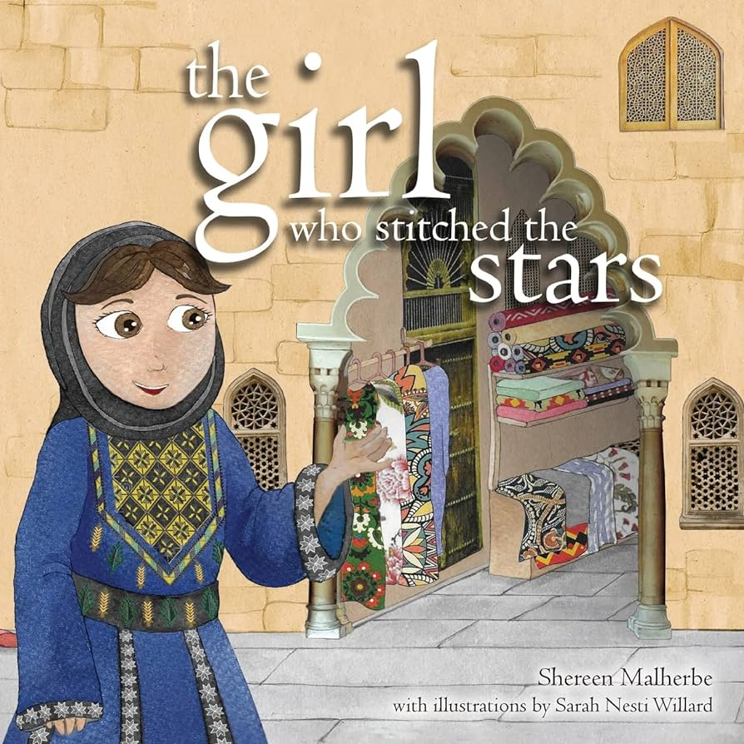

A Palestinian Story
by Shereen Malherbe
Illustrated by
Sarah Nesti Willard
Question
Time

Slide 2
What is the name of the author of The Girl Who Stitched the Stars?
Sarah Shereen
Shereen Malharbe
Nesti Malherbe

Slide 3
2. What is the name of the illustrator of The Girl Who Stitched the Stars?
Sarah Nesti Willard
Shereen Malharbe
Noor Willard

Slide 4
3. Which country is Noor associated with?
Malaysia
UAE
Palestine

Slide 5
4. Why is Noor wearing a Palestinian dress at school?
It’s Eid
It’s National Day
It’s Non-Uniform Day

Slide 6
5. What is tatreez?
embroidery
knitting
sewing

Slide 7
6. What were the names of two children in Noor’s class?
Hind and Hasan
Hannah and Haris
Handa and Hisam

Slide 8
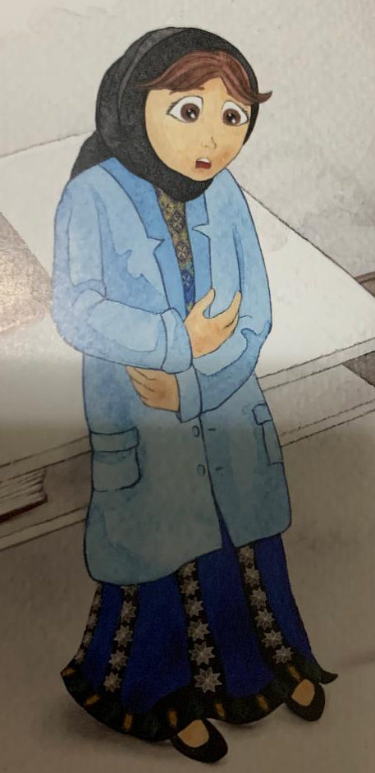
7. Why was Noor upset at school?
She had a tummy ache.
She missed her mom.
Someone laughed at her.

Slide 9
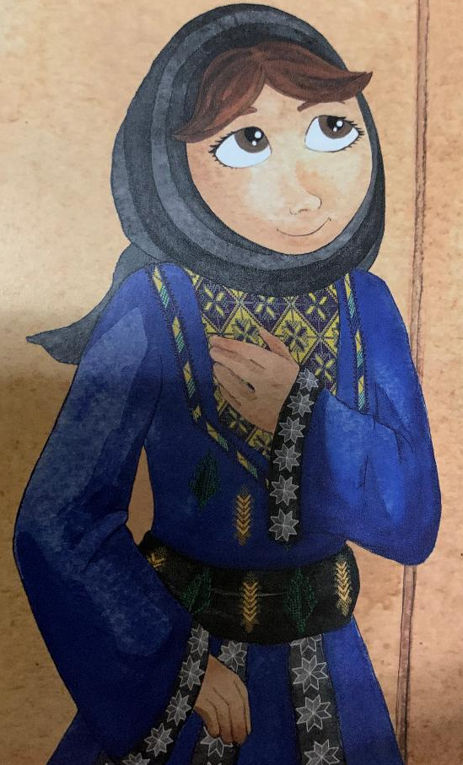
8. How did Noor find her strength?
She thought of her dress.
She thought of Allah.
She thought of her teacher.

Slide 10
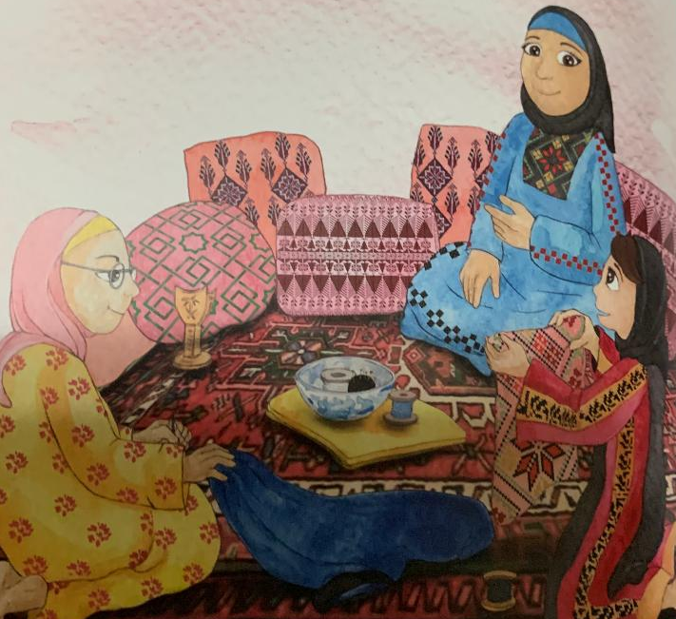
9. When Noor stood in front of her class and talked about her dress, she said that each village had
their own threads
their own designs
their own dresses

Slide 11
10. What do you think souk means?

Slide 12
11. Noor’s family is from Palestine. Write a dua or make a dua for the people of Palestine.

Slide 13
Activity Time!

Slide 14
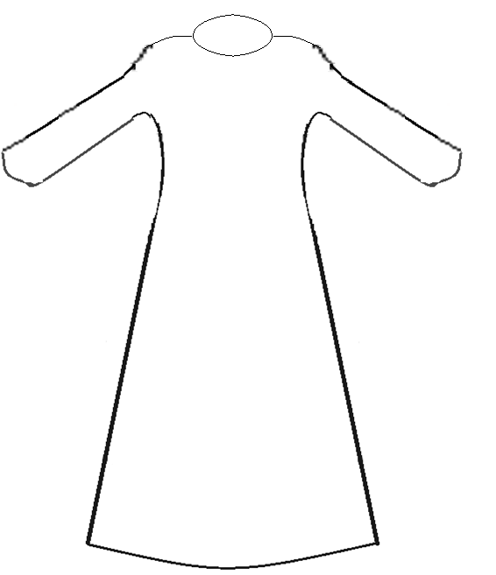
Design a Palestinian Dress

Slide 15
Song Time

Slide 16
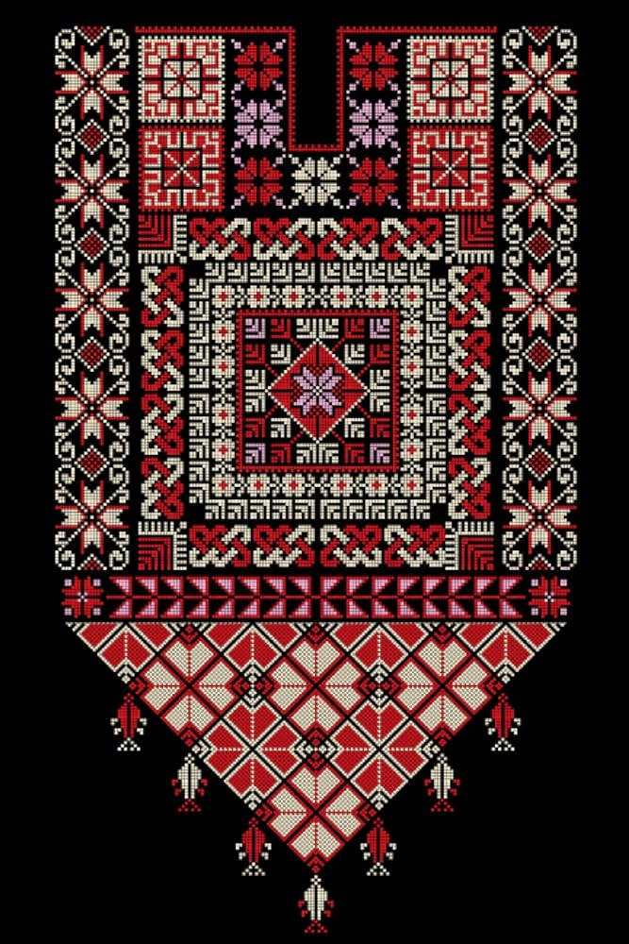
Noor Knows How To Do Tatreez
(Tune London Bridge is Falling Down)
Noor knows how to do tatreez,
Do tatreez.
Do tatreez.
Noor knows how to do tatreez,
You can do it too!
By Fawzia Gilani

Slide 17
Little Noor She Loved Allah
(Tune Old MacDonald)
Little Noor she loved Allah,
And prayed for Palestine,
To show her love she did salah,
And prayed for Palestine,
With a bless them here and bless them there,
Here a bless, there a bless,
Everywhere a bless, bless,
Little Noor she loved Allah,
And prayed for Palestine!
By Fawzia Gilani

Slide 18


