Slide 1

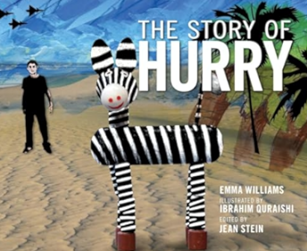
A Palestinian Story
by Emma Williams
Illustrated by
Ibrahim Quraishi
Question
Time

Slide 2
What is the name of the author of
The Story of Hurry.
Emma Williams
Hurry Williams
Ibrahim Quraishi

Slide 3
2. What is the name of the illustrator of The Story of Hurry.
Emma Williams
Hurry Williams
Ibrahim Quraishi

Slide 4
3. What kind of animal is Hurry?
zebra
horse
donkey

Slide 5
4. How did Hurry get his name?
He was always in a rush.
He was always slow.
He was always late.

Slide 6
5. Hurry’s favorite boy was called
Mattan
Hattan
Wattan

Slide 7
6. The children were often
hungry, thirsty and afraid
happy, content, strong
singing, laughing, playing

Slide 8
7. What was the name of the zoo man?
Roody
Foody
Moody

Slide 9
8. Moody was
always thinking up new games.
always playing with the bear.
always sleeping.

Slide 10
9. The animals in the zoo were
thin and sad
full and happy
sleepy and tired

Slide 11
10. Sumood wanted to go to school
never
once a week
every day

Slide 12
11. Many of the animals in the zoo
had died
run away
had been sold

Slide 13
12. What does Wattan bring to Hurry?
a basket of apples
a basket of dates
a basket of olives

Slide 14
13. The Happy Land Zoo is in
Gaza
Al Khalil
Ramallah

Slide 15
Activity Time!

Slide 16
Make a Model of Hurry
You will need: | Steps:
a kitchen roll black paint white paint paint brush 4 x popsicle sticks glue black and white yarn | Paint the kitchen roll in stripes. When dry cut the roll into two parts: the body and head. Glue the popsicle sticks to the body Attach the head. Glue the tail to the back of the toilet roll.

Slide 17
Song Time

Slide 18
Land of the Date and Sun
(Tune: Land of the Silver Birch)
Land of the olive tree,
Home of Sumood,
Where still the people share,
With every one,
Dark skies and prison walls
Hurry is sad,
Allah Kareem,
Allah Kareem,
Allah Kareem!
By Fawzia Gilani

Slide 19
I Hear Hurry!
(I Hear Thunder)
I hear Hurry,
I hear Hurry,
Do you too?
Do you too?
La ilaha ilal lah!
La ilaha ilal lah!
The children were sad,
Hurry made them glad!
By Fawzia Gilani

Slide 20
I’m in Gaza
(I Hear Thunder)
I’m in Gaza,
I’m in Gaza,
Pray for me,
Pray for me,
La ilaha ilal lah!
La ilaha ilal lah!
We stay strong,
Please right the wrong!
By Fawzia Gilani

Slide 21
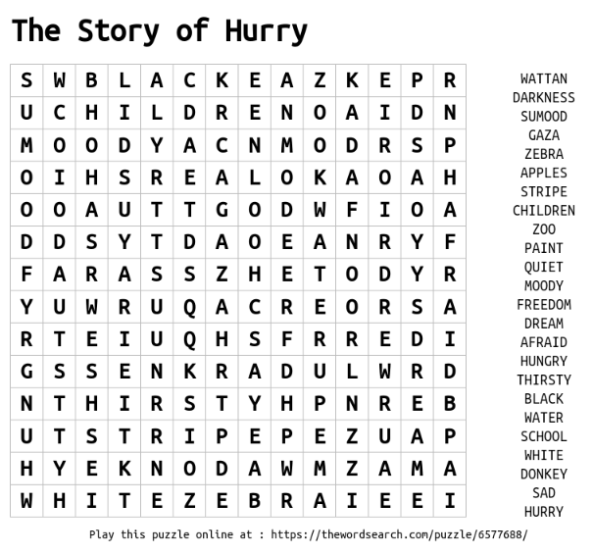

Slide 22
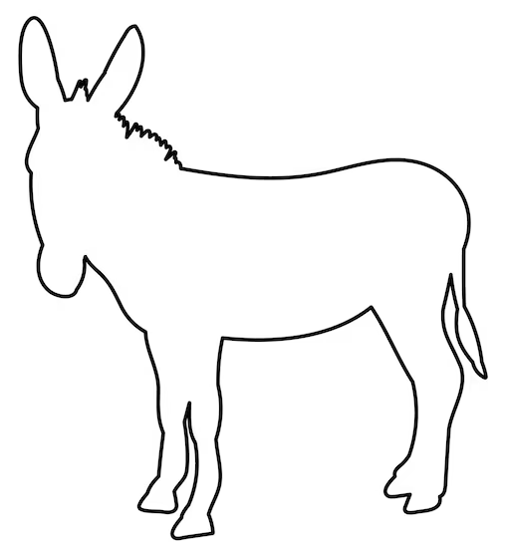
This is Hurry. Can you color him in stripes to make him look like a zebra?

Slide 23


