Slide 1
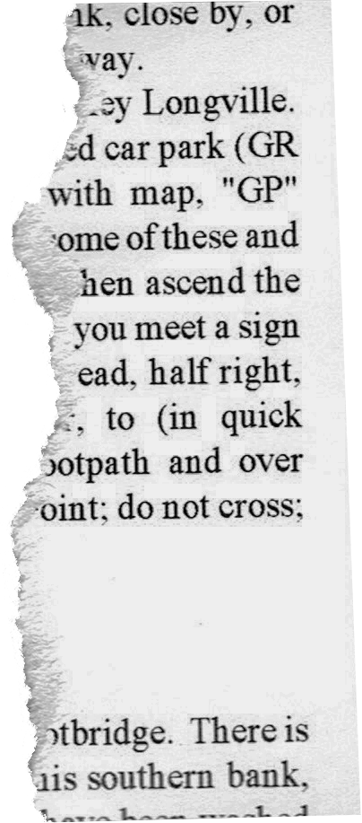
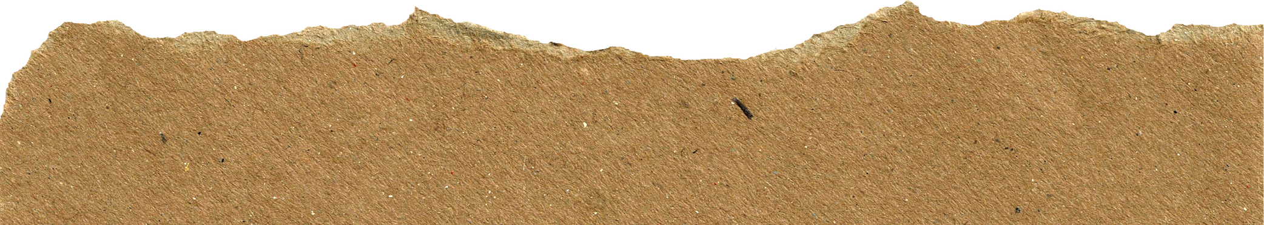
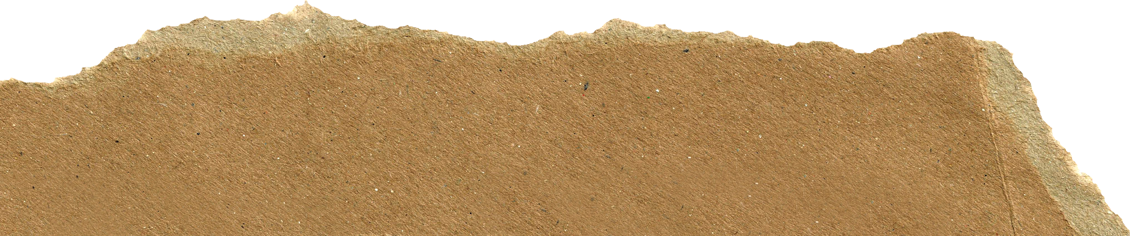
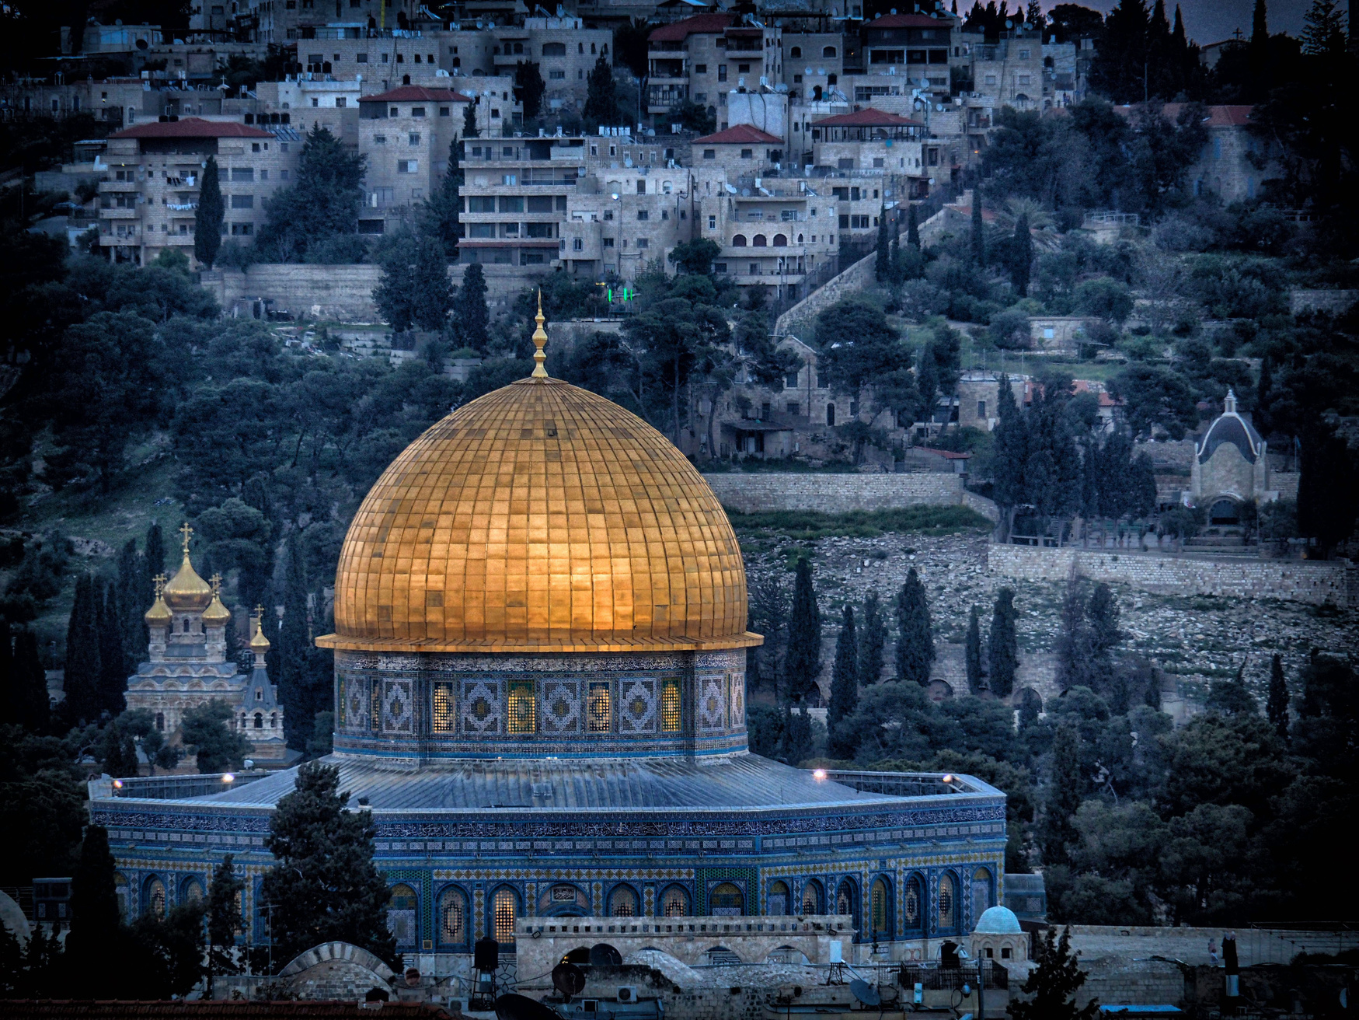


WHAT EXACTLY IS AL AQSA?

Slide 2
SOMETIMES, WE ARE TOO “ZOOMED IN”
TO SEE THE REAL PICTURE
Let me show some examples

Slide 3
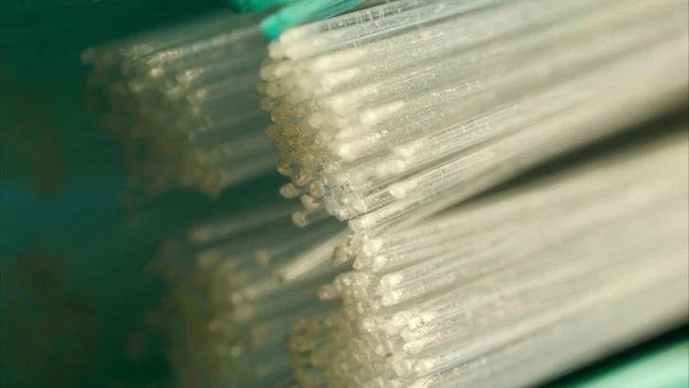

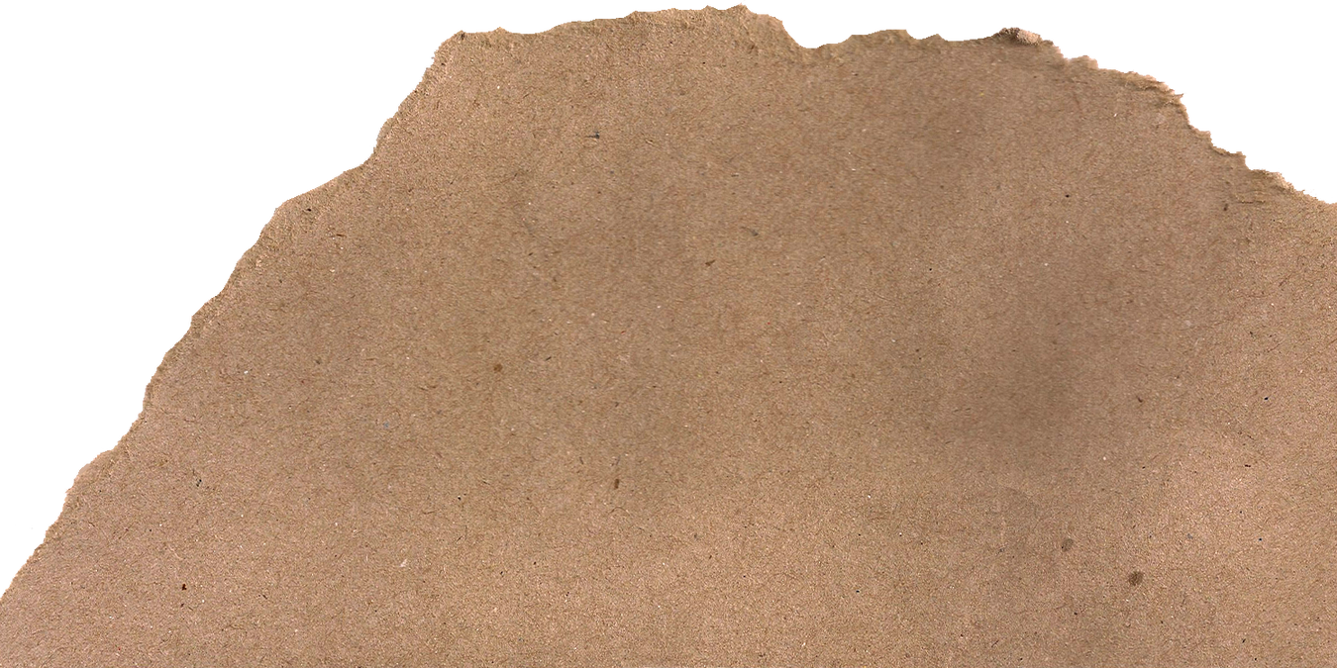
What is this?
Hint: You should be using it twice as day!

Slide 4
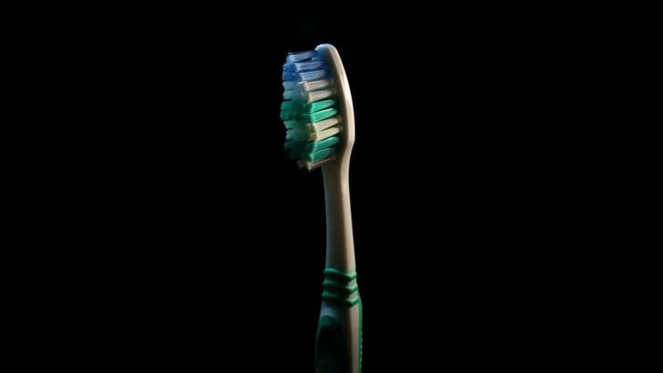
What is this?
It’s a...

Slide 5
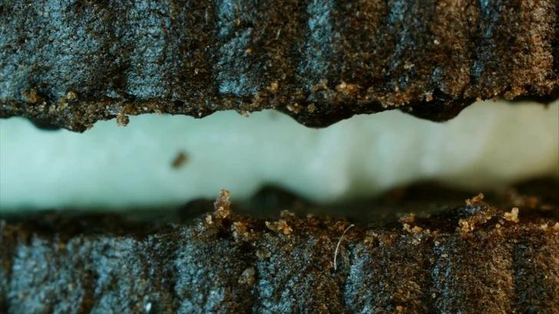
What is this?
Hint: If you eat these, you will need a toothbrush!

Slide 6
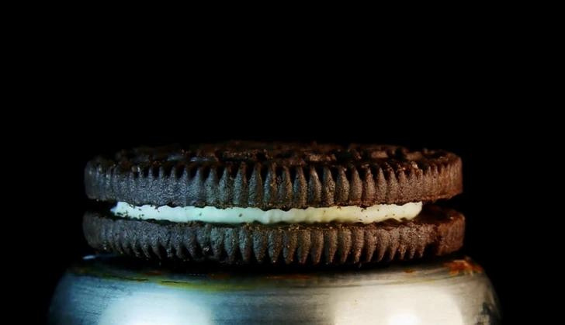
What is this?
It’s a...

Slide 7
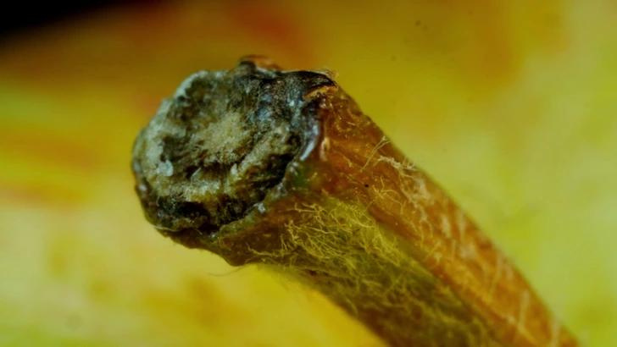
What is this?
Hint: It’s a better alternative to the cookie!

Slide 8
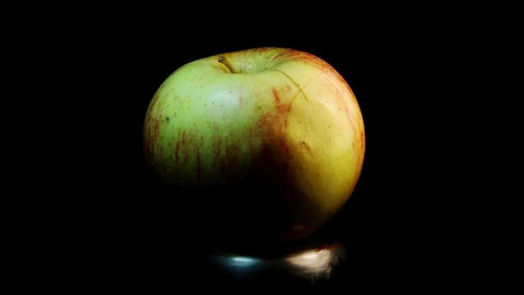
What is this?
It’s a...

Slide 9
What is this?
Hint: It might not be what you think!

Slide 10
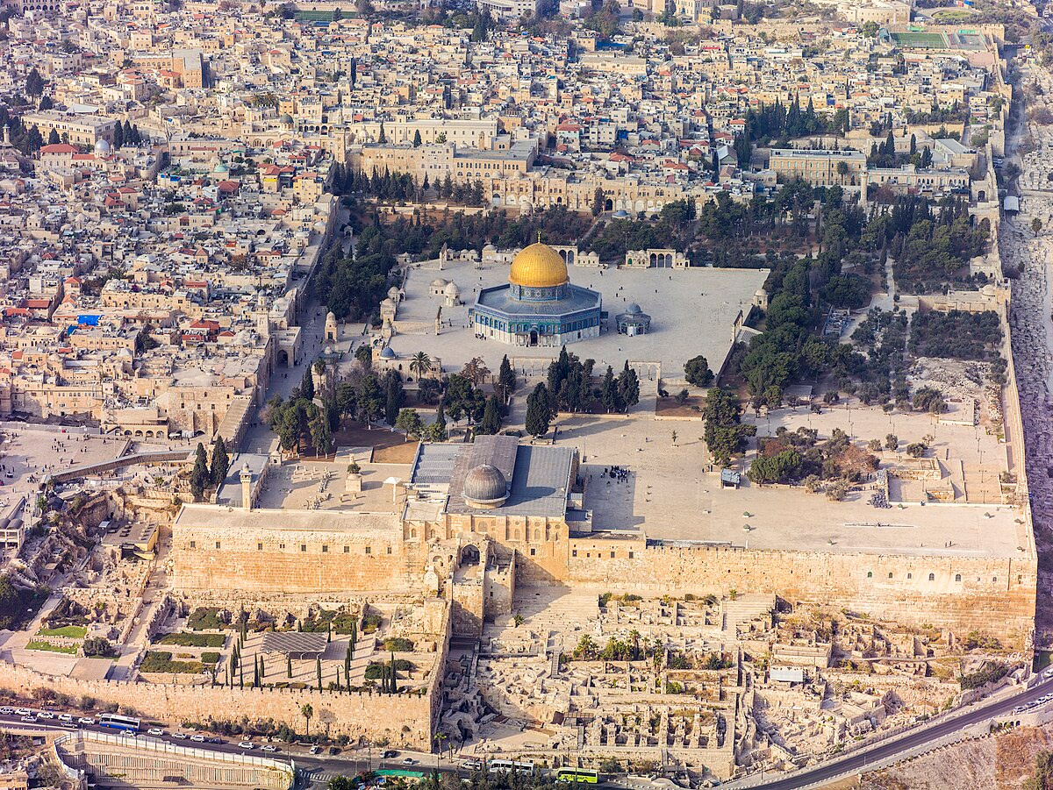
Each rakah in Masjid Al Aqsa is worth 500 noraml rakahs.
Who can identify Masjid Al-Aqsa?

Slide 11
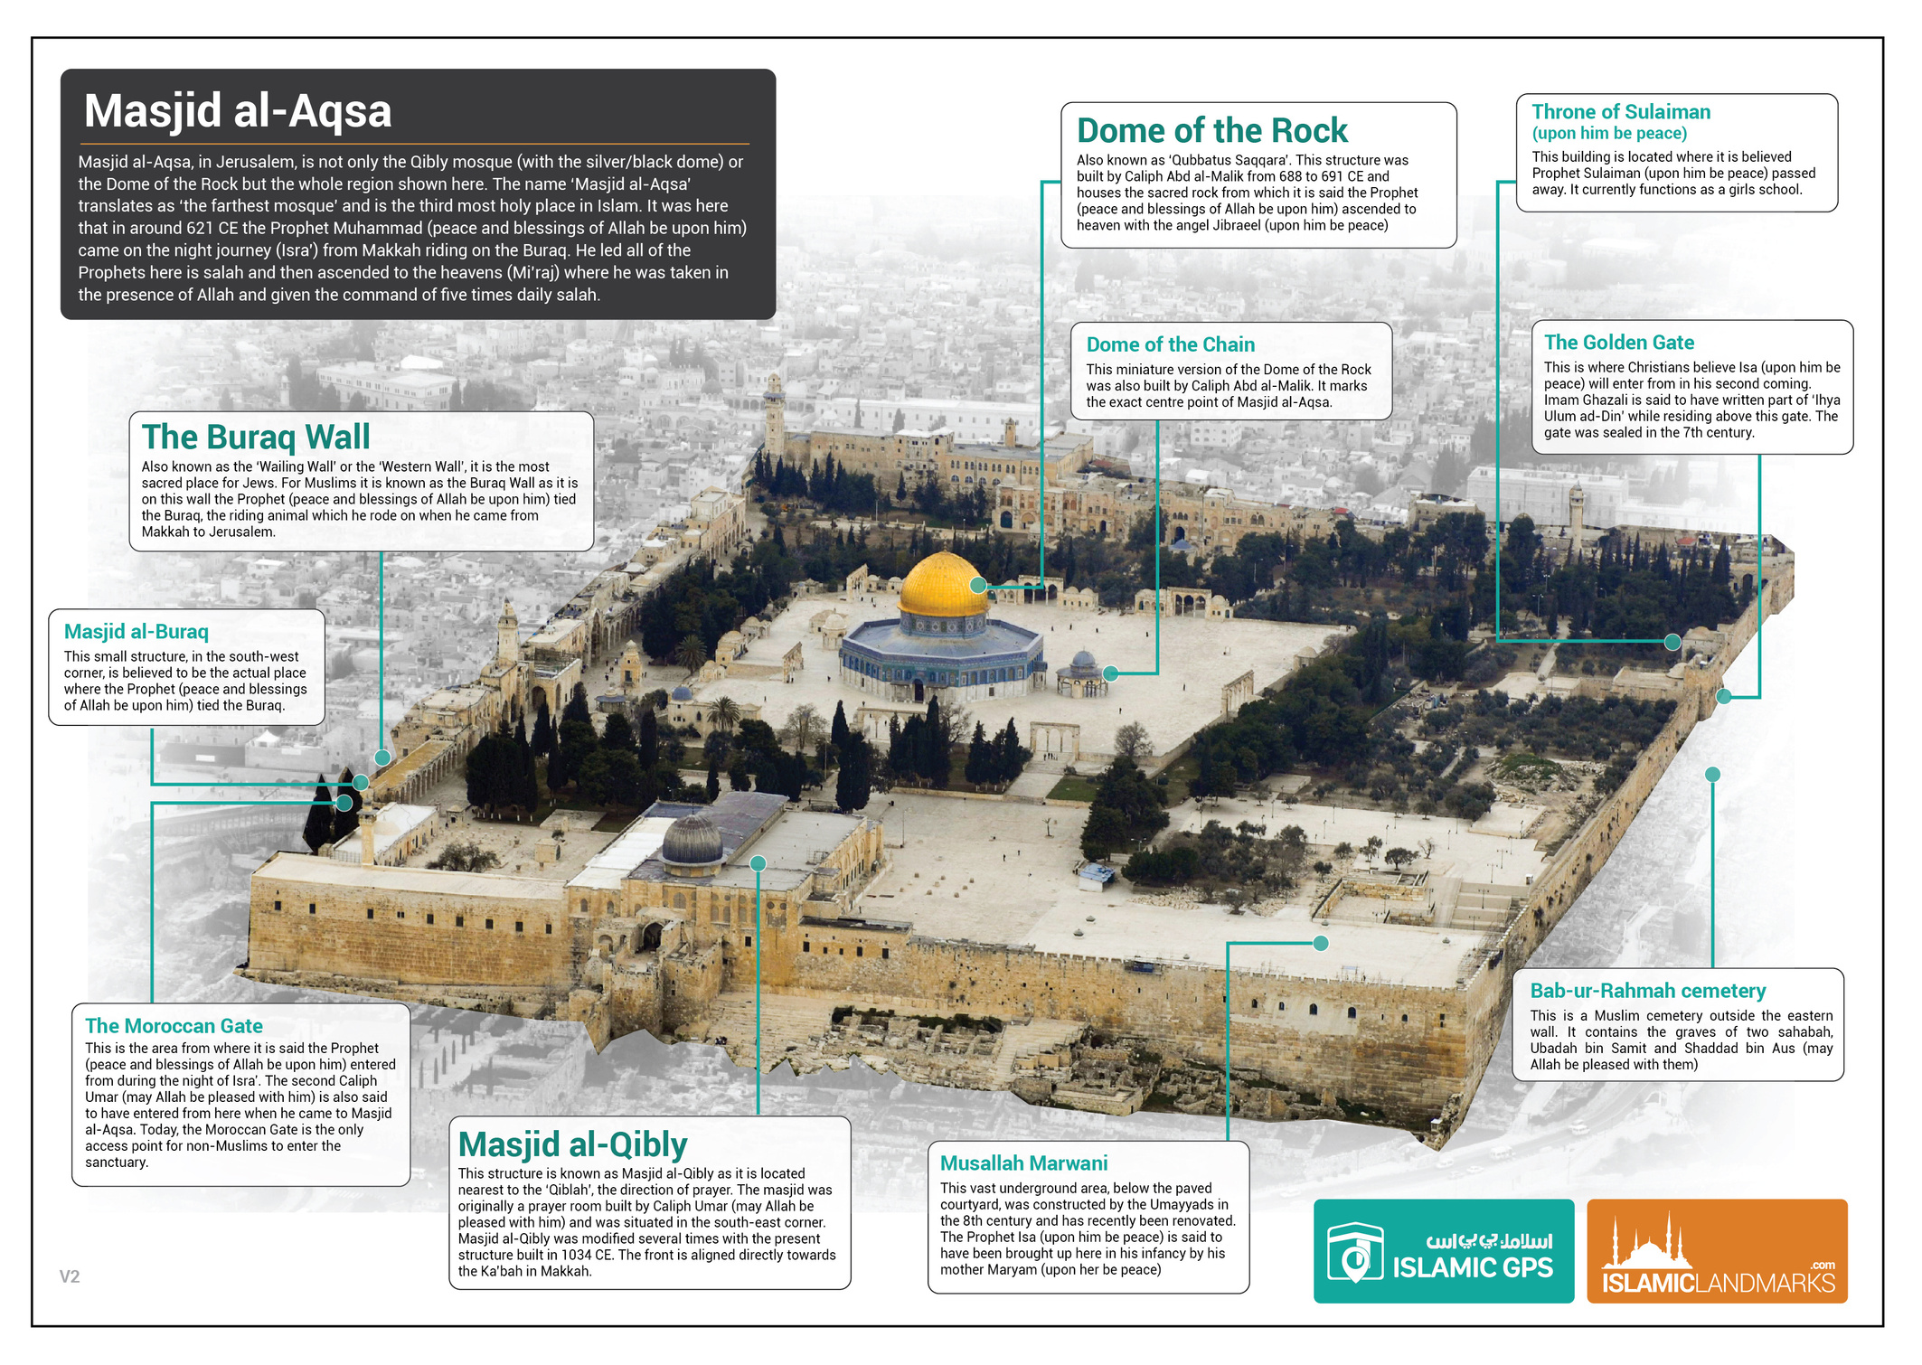

Slide 12
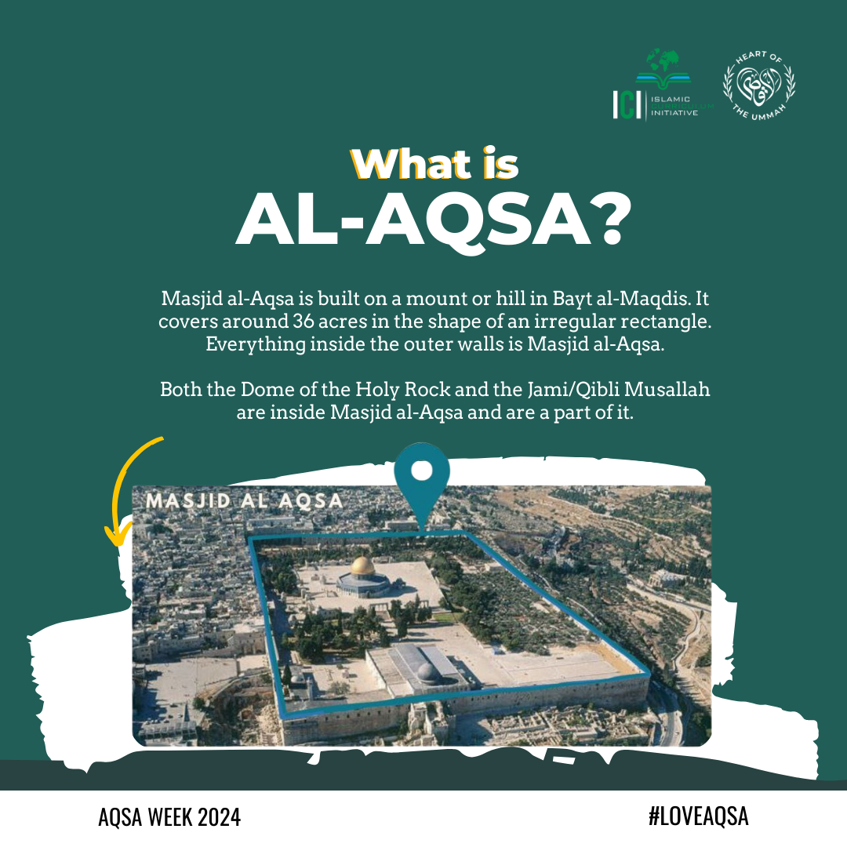
More information about Al Aqsa

Slide 13
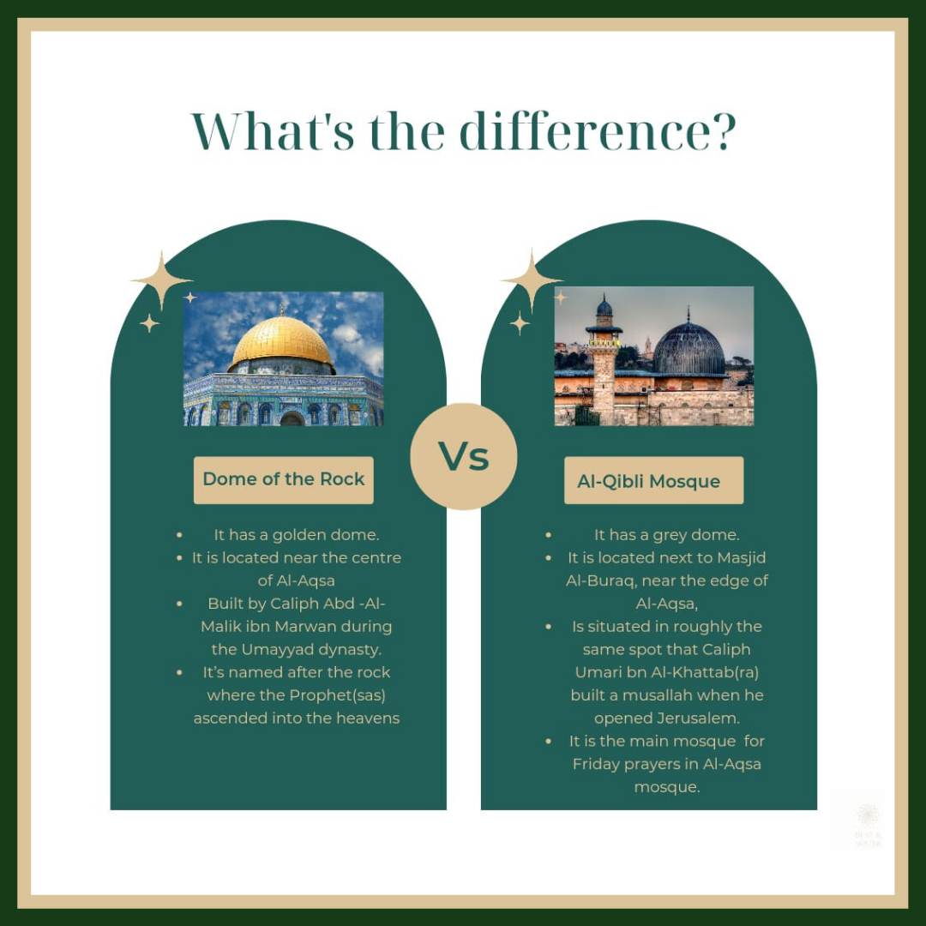
More information about Al Aqsa

Slide 14
Where is it?
Instructions And Clues
  Find the different parts of Masjid Al Aqsa by following the clues to the different places.
  All the clues lead to different places that are described on the poster given to you.
  On your sheet, write which place is correct for each clue AND how you know it is correct.
  Someone who wants to go to school at Masjid Al Aqsa.
  Two places for people love Isa a.s. to go to.
  Someone who wants to be in the middle of all the blessings here.
  They want to be as close to the Ka’ba as possible.
  You want to go somewhere the Prophet has been.

Slide 15
Where is it?
Barakah Bonus!
  Imagine you are guiding someone around the Masjid Al Aqsa complex.
  You only have time to take them to three different places.
  You will have to pick your places very carefully and justify why you have chosen them. Explain what is the purpose behind each place, and what is the intended effect on the visitor.
The Visitors
  A Muslim historian
  A new convert to Islam who was previously a devoted Christian.

Slide 16
What are your answers?

Slide 17
Review
What is the Masjid Al Aqsa?
What is the most special place to you and why?

