Slide 1

Foods in the Qur’an

Slide 2
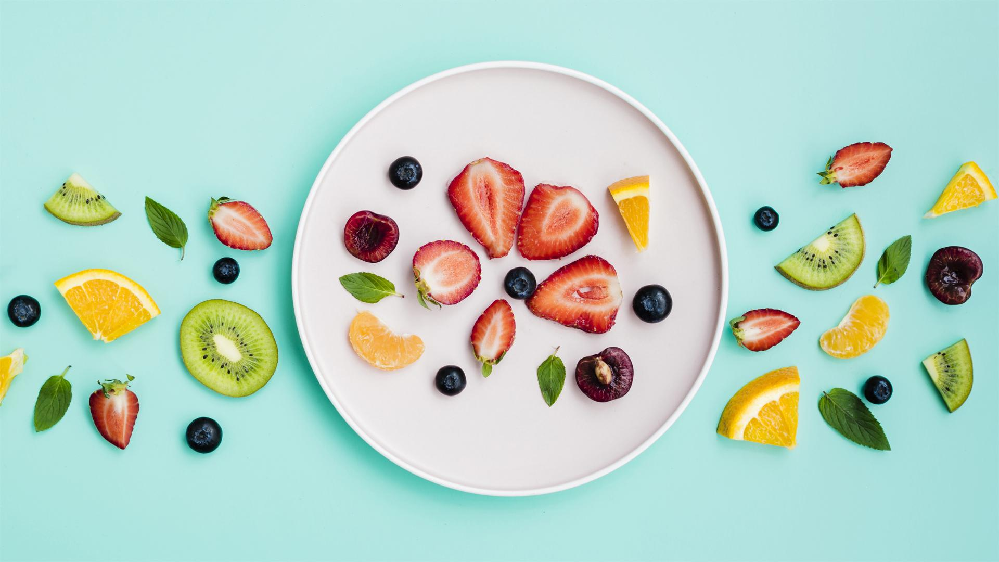
Eating healthy is our religious duty.
“So eat of the lawful and good food which Allah has provided for you, and be grateful for the favour of Allah.”
(Qur’an 16:114)

Slide 3
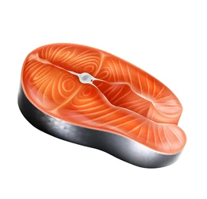
01
Fish
For your benefit, He created the sea; from it, you get fresh meat to eat, and extract jewellery that you wear. You see the ships sailing over the waves to seek His gifts, so you may be thankful.
(Qur’an 16:14)

Slide 4
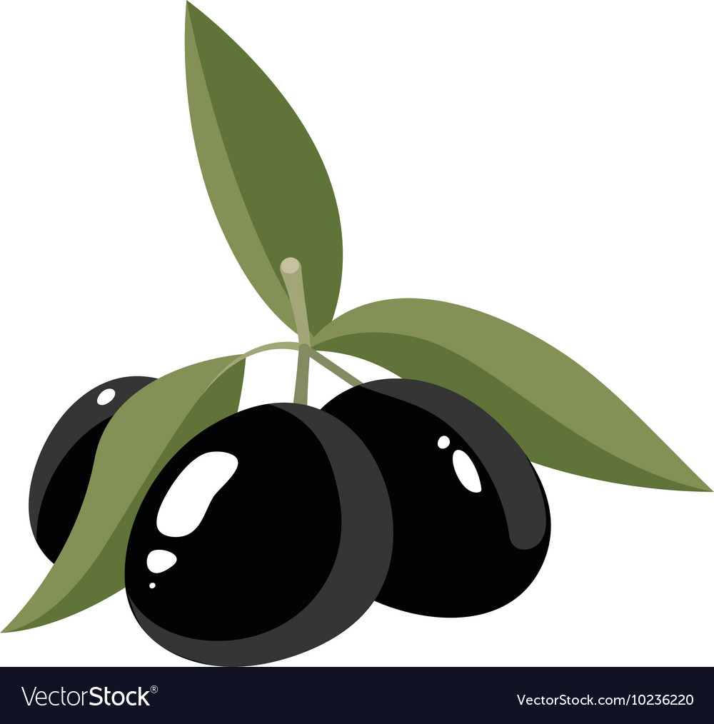
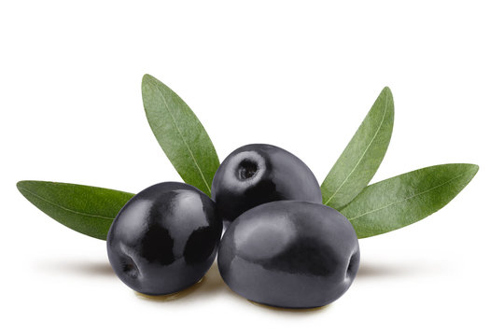
02
Olives
As well as ˹olive˺ trees which grow at Mount Sinai, providing oil and a condiment to eat.
(Qur’an 23:20)

Slide 5
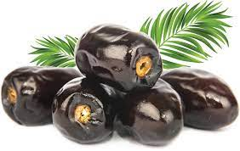
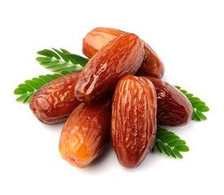
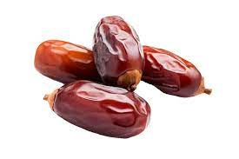
03
Dates
And shake the trunk of date-palm towards you; it will drop on you fresh ripe-dates.
(Qur’an 19:25)

Slide 6
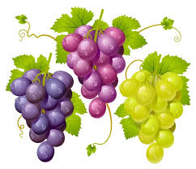
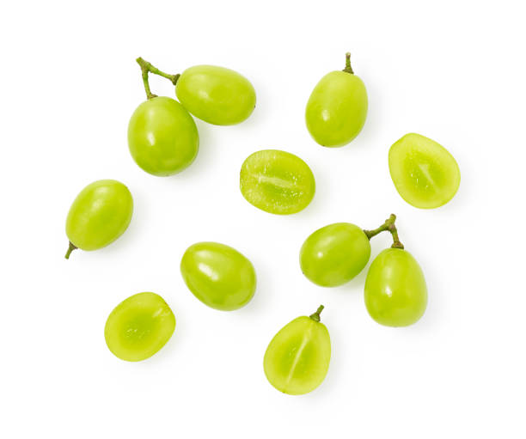
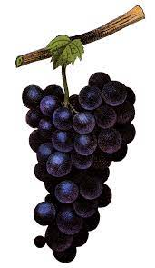
04
Grapes
We produce gardens of date palms and grapevines. There is plenty of fruit for you to eat.
(Qur’an 23:19)

Slide 7
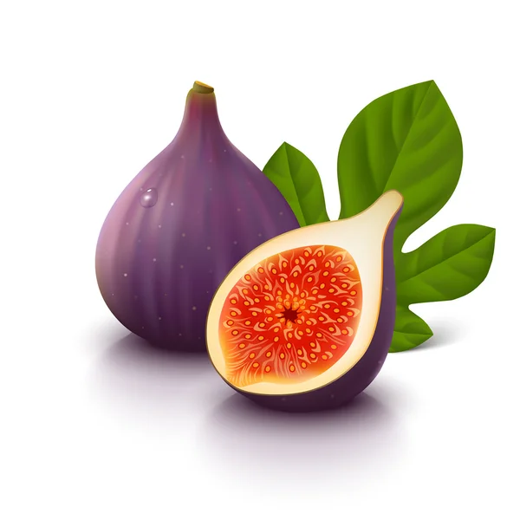
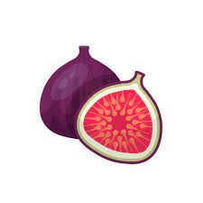
05
Figs
I swear by the fig and the olive
(Qur’an 95:1)

Slide 8
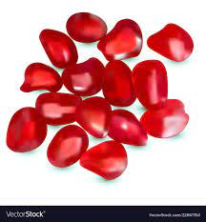
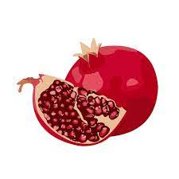
06
Pomegranates
Both gardens will have plenty of fruit dates and pomegranates
(Qur’an 55:68)

Slide 9
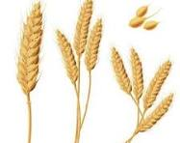
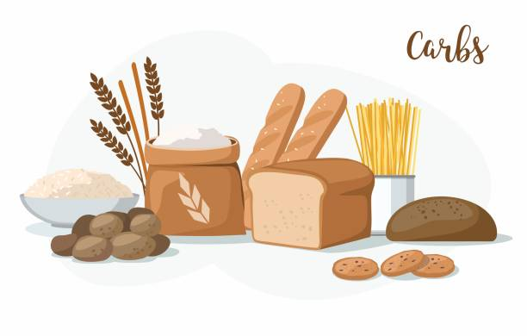
07
Grains
Let people then consider their food. How We pour down rain in abundance, and meticulously split the earth open ˹for sprouts˺, causing grain to grow in it.
(Qur’an 80 : 24-27)

Slide 10
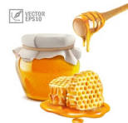

08
Honey
And your Lord has inspired the bee, saying, ‘Make yourself houses in the hills and in the trees and in the trellises which they build. Then eat of every kind of fruit, and follow the ways of your Lord that have been made easy for you.’ There comes forth from their bellies a drink of varying hues. Therein is cure for men. Surely, in that is a Sign for a people who reflect.
(Qur’an 16: 68-69)

Slide 11
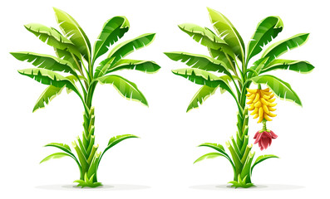
09
Bananas
And banana trees with fruits piled one above another...”
(Qur’an 56:29)

Slide 12
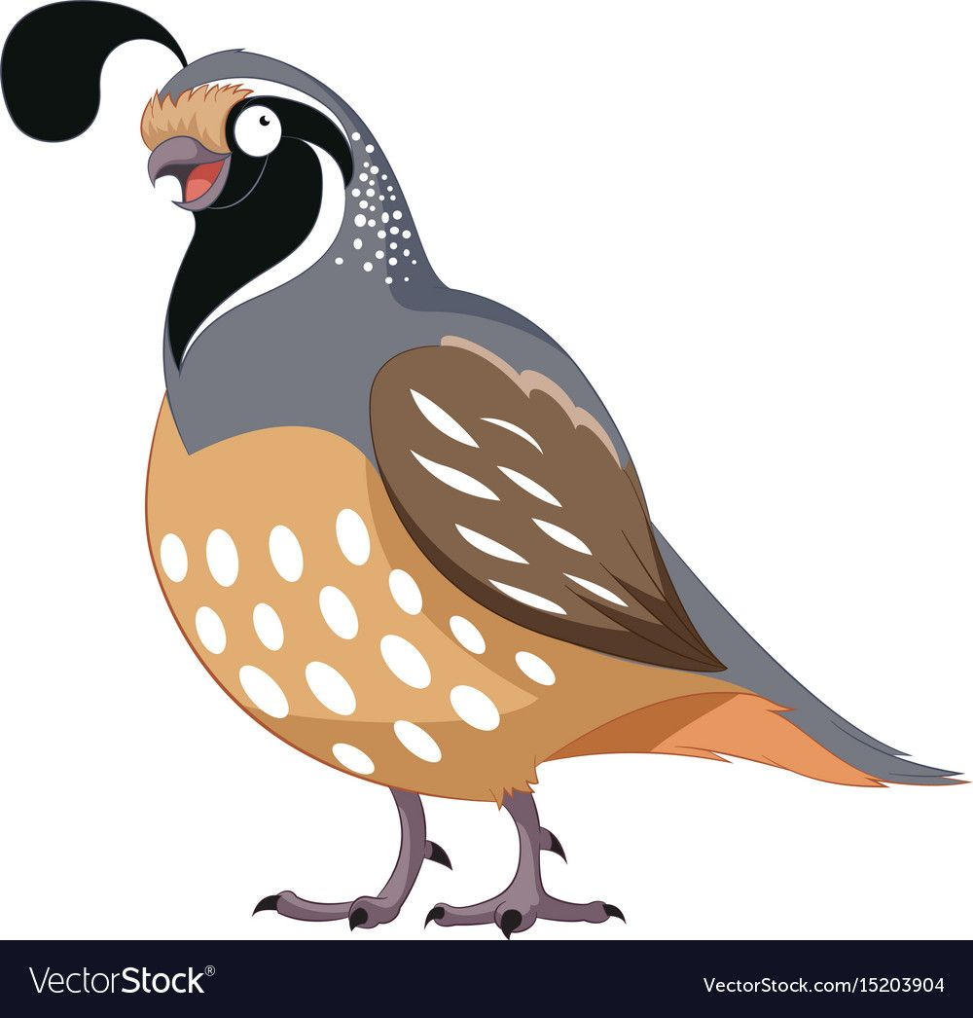
10
Quail
“...and We sent down to you Al-Manna and Quails,”
(Qur’an 20:80)

Slide 13
Conclusion
With it He produces for you crops, olives, date palms, grapes, and every kind of fruit: Verily in this is a Sign for those who give thought.
(Qur’an 16:11)

Slide 14
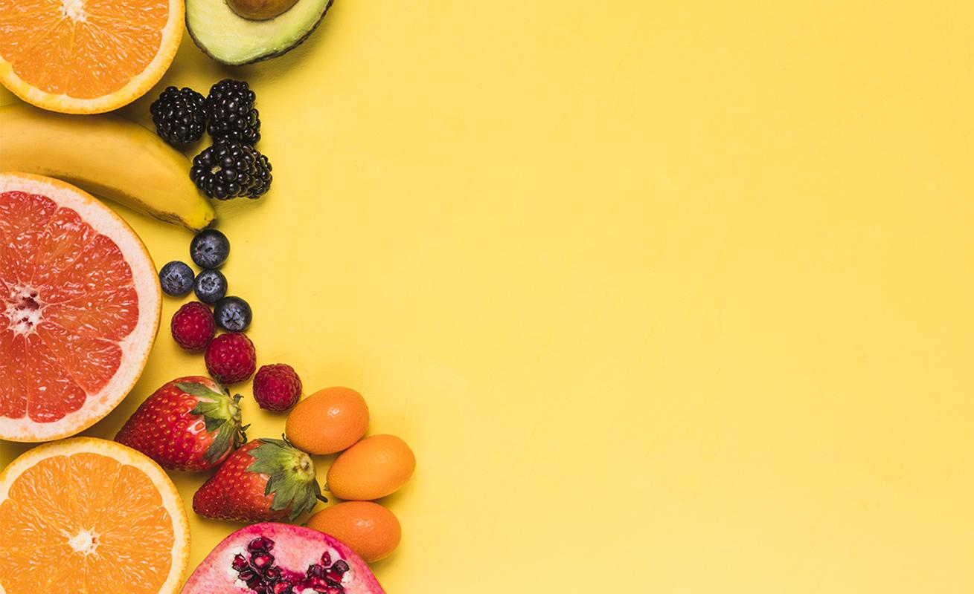
JazakAllahu Khair

