Slide 1


Slide 2

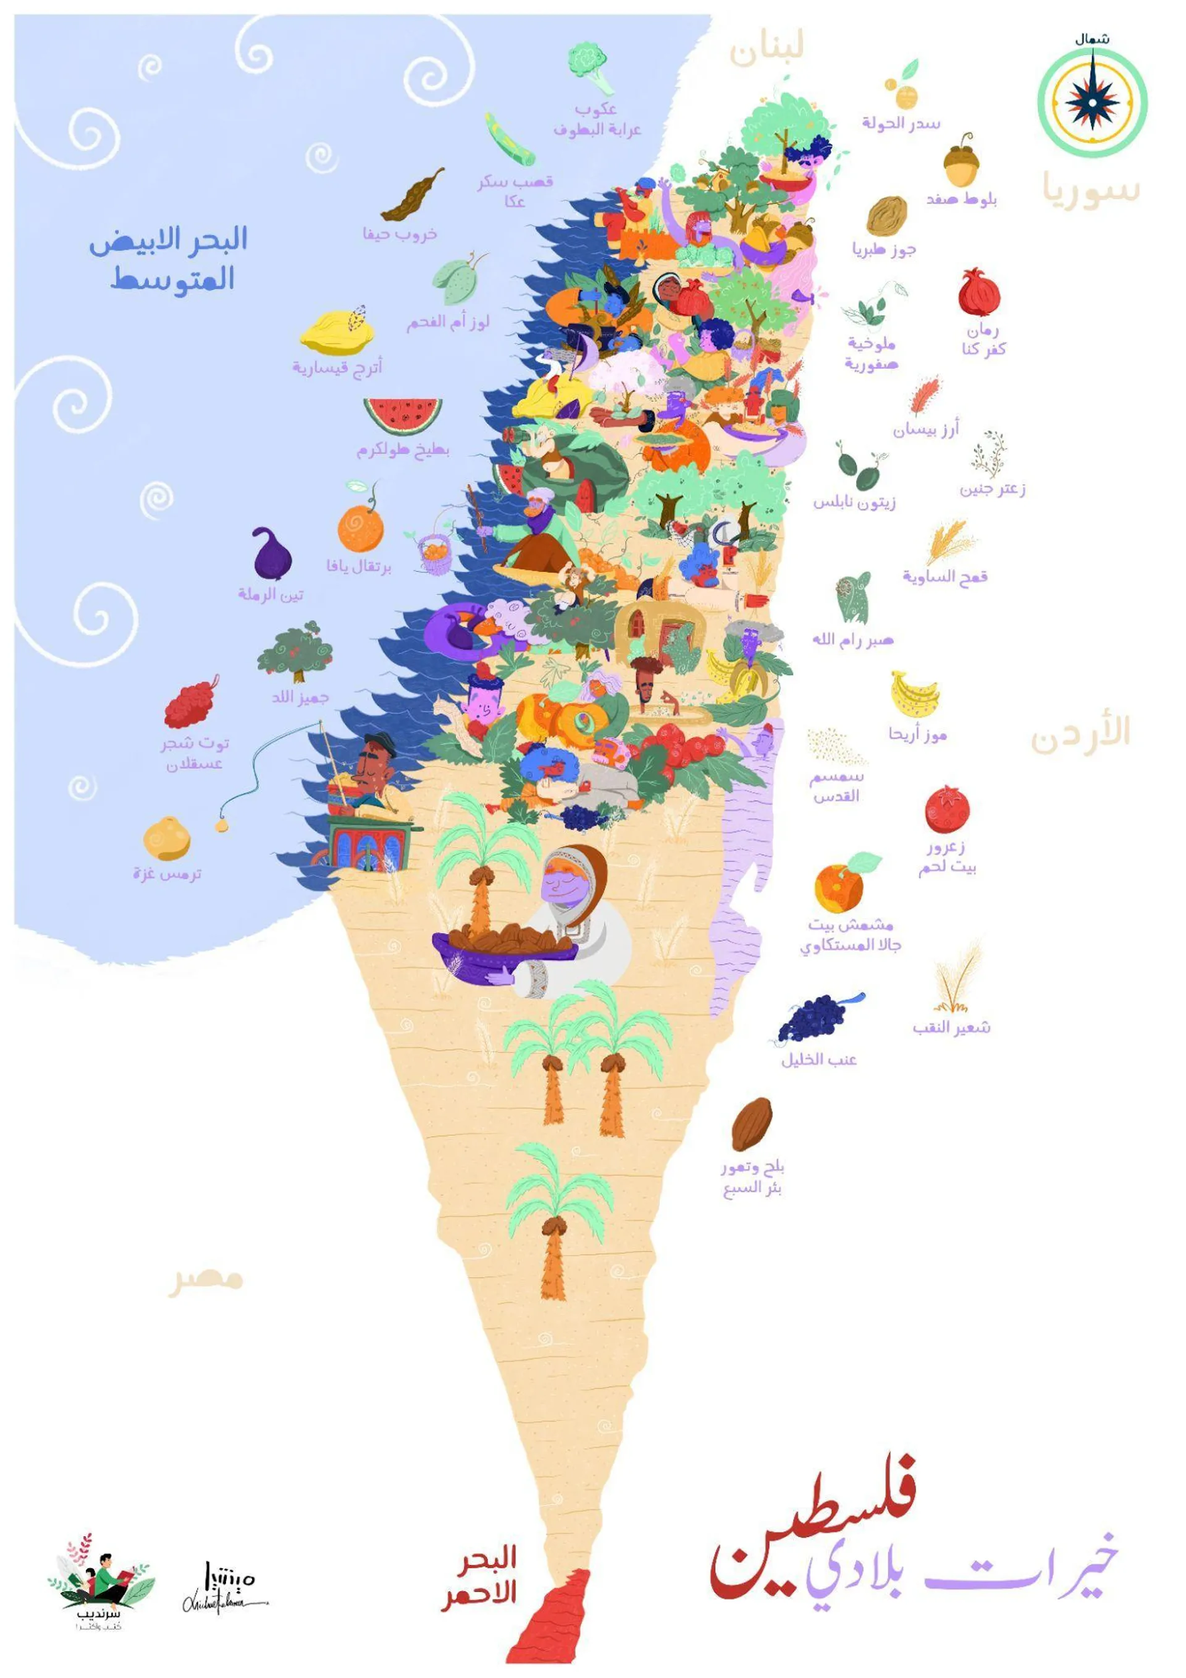
Food security
in Palestine

Slide 3

Lesson 1
Learning Objectives:
Learners will be able to:
Define that food is a basic right from Islamic sources
Understand the policies adopted by Prophet Muhammad (saw) to ensure food security in Madinah
Discuss the collective responsibility in meeting the basic needs and rights of society.
Food Security from an Islamic Perspective

Slide 4
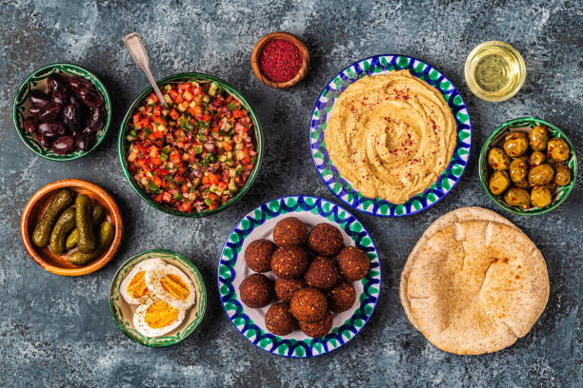
What is food security?
Food security refers to the condition where all people, at all times, have access to sufficient, safe, and nutritious food that meets their dietary needs and food preferences for an active and healthy life.

Slide 5
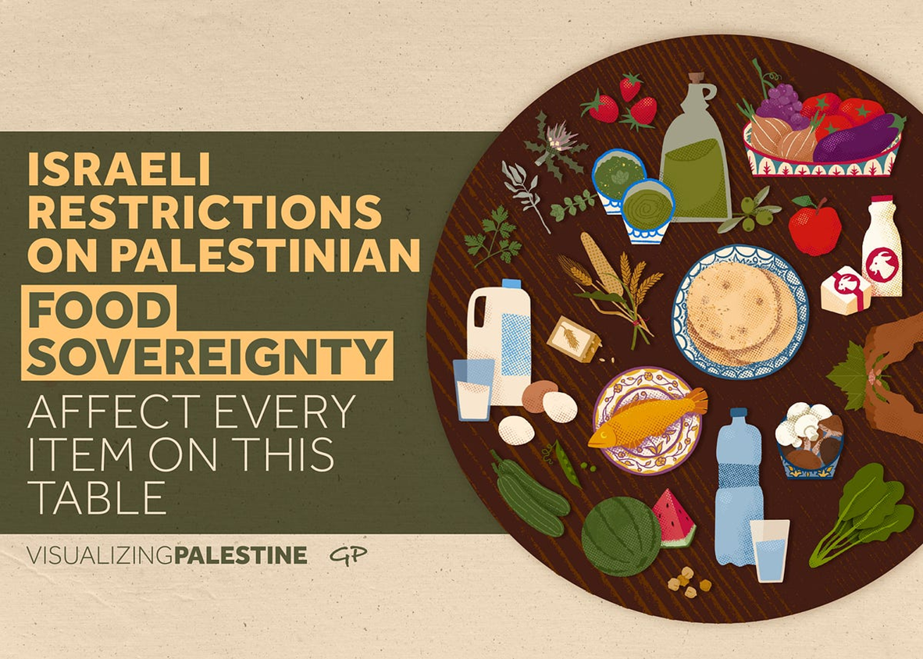
Notes:
Teacher note: What items do you see on this plate?

Slide 6

Basic Rights Defined in Hadith
'Uthman bin 'Affan (May Allah be pleased with him) reported: The Prophet ﷺ) ) said, "There is no right that the son of Adam is more entitled to other than these (four) rights: A home to live in, a garment to cover his nakedness, a piece of bread, and water." [At-Tirmidhi]

Slide 7
Reflect and Respond
1. Why do you think other things are not mentioned in the Hadith, such as any transport or other items we all need daily?
2. Do you think that this is a request or a command?
3. Do you know of any place in the world where these basic needs are met for all?
4. Why do you think that the Hadith uses the words ‘the son of Adam’?

Slide 8
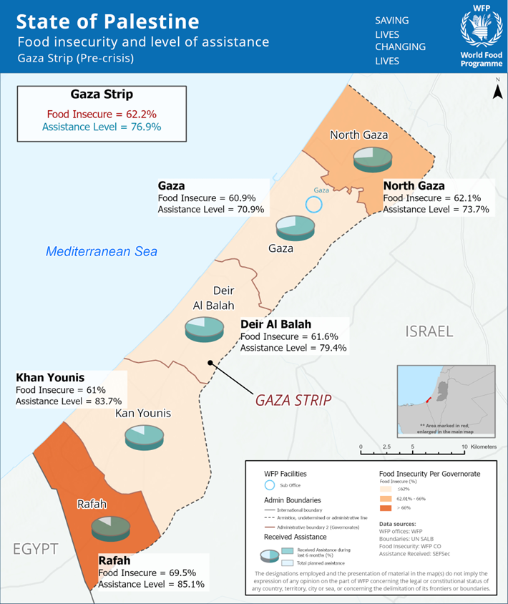
Food Insecurity in 2021
In 2021, there were high levels of food insecurity due to Israeli restrictions.

Slide 9
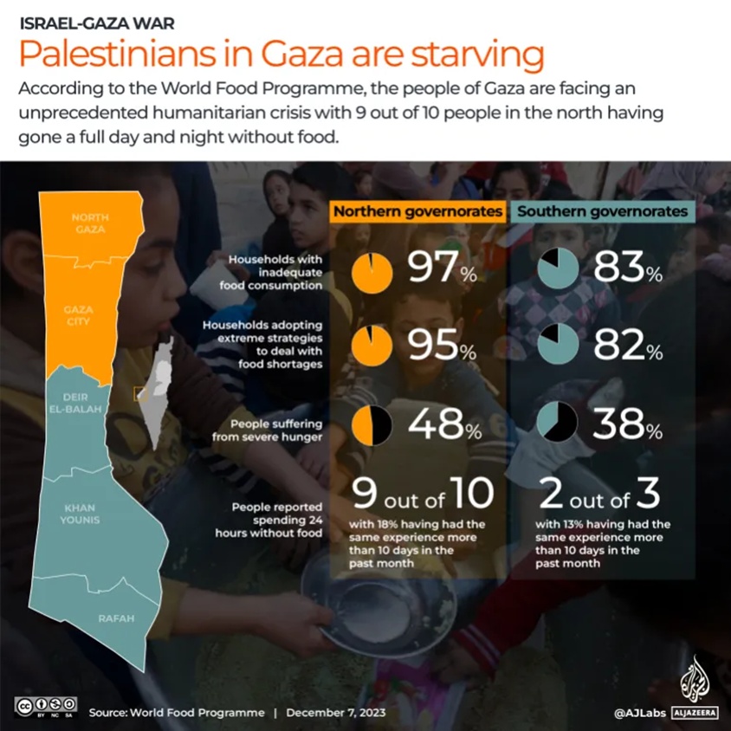
Basic need of food is not fulfilled.
People are eating animal feed. (as of March, 2024)

Slide 10
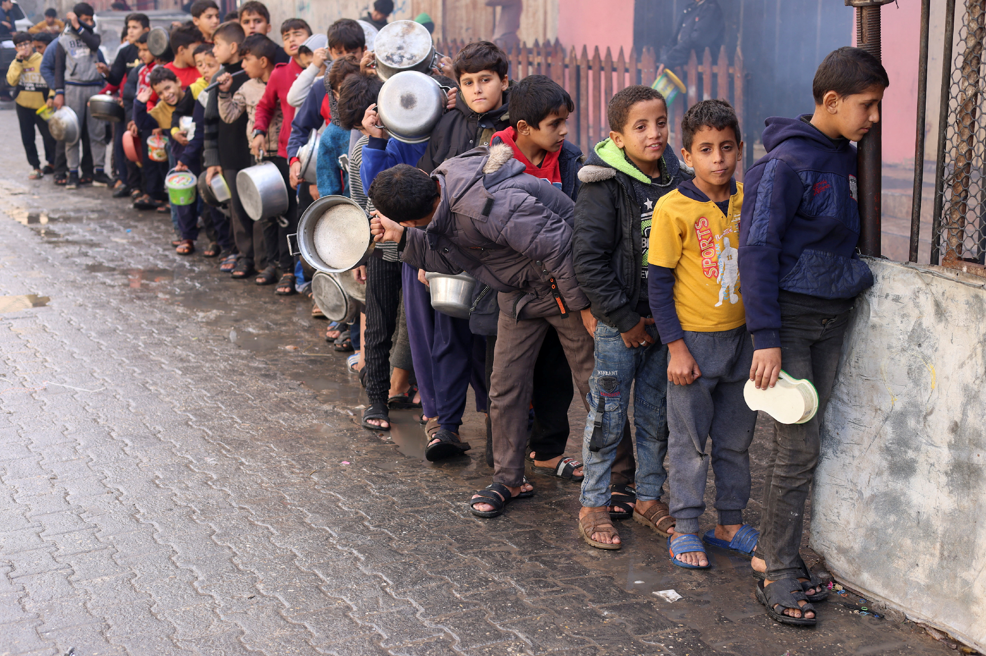

Slide 11
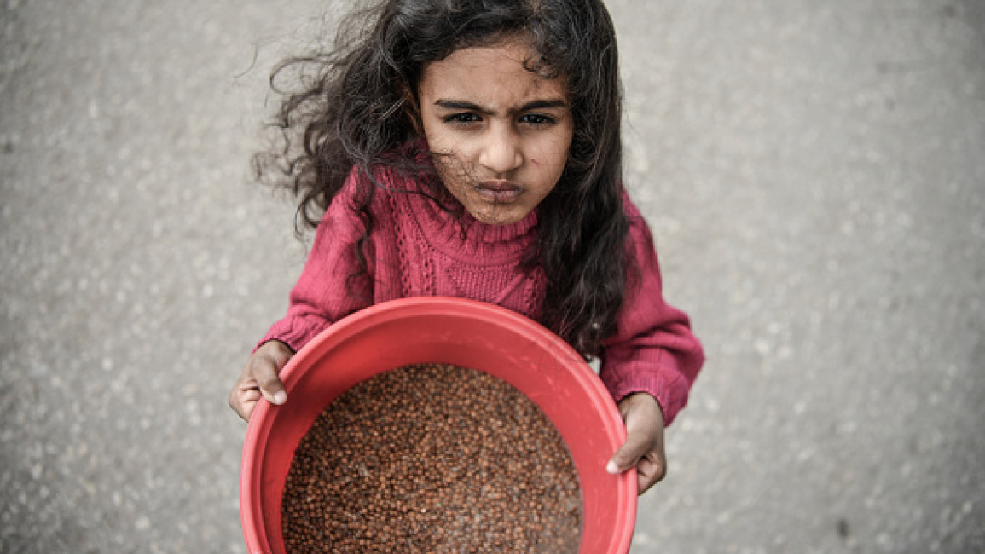

Slide 12
The Prophetic Strategy

Slide 13
Prophet (saw)’s Policy in Madinah
1. Brotherhood - When the Muhajireen arrived in Madinah, he matched them with the Ansar who had the means to support them. The local people (Ansar) shared what they had, including food, with those who had come from elsewhere. 2. Sadaqah - The Prophet encouraged people to share what they had with others. They were motivated by the following Hadith. “The best charity is to satisfy a hungry person. He also said, “No wealth (of a servant of Allah) is decreased because of charity.” (Al-Tirmidhi, Hadith No. 2247)
Notes:
How would this strategy help ensure food security for all?

Slide 14
Prophet (saw)’s Policy in Madinah
3. Zakat – This is one of the 5 pillars and is only for 8 types of people. Through Zakat, the weakest in society are supported in meeting their basic needs. “When you pay the Zakat you have fulfilled what is required of you.” (Al-Tirmidhi, Chapter 7, No. 618) 4. Agricultural policy - The Prophet encouraged and gave grants to facilitate this. By growing their own food, the people in Madinah could make sure there was always enough to eat without relying too.

Slide 15
Prophet (saw)’s Policy in Madinah
5. Collective responsibility – The whole society became conscious of their responsibility to their neighbours. Ibn Abbas reported: The Prophet, (saw), said, “He is not a believer whose stomach is full while the neighbor to his side is starving.” Source: al-Sunan al-Kubrá lil-Bayhaqī 19668

Slide 16
Lesson 2 - Activity 1
Activity 1: Exploring Prophet (saw)’s Policies
Divide the class into small groups.
Assign each group one of the policies adopted by the Prophet to ensure food security (brotherhood, Sadaqah, Zakat, agricultural policy, collective responsibility).
Ask learners to gather visuals and information for each policy.
In their groups, students discuss and prepare a short presentation on their assigned policy, focusing on its implementation and impact on food security.

Slide 17
Lesson 2 – Activity 2 and 3
Activity 2: Presentation
Each group presents their findings to the class, explaining how the assigned policy contributed to food security in Madinah.
Encourage students to ask questions and engage in discussions after each presentation.
Activity 3: Reflective Writing
Ask students to reflect on the collective responsibility emphasized by the Prophet in the context of food security.
Each group creates a visual representation (drawing or chart) depicting the importance of a government’s comprehensive policy in meeting society's basic needs.

Slide 18
Conclusion
Islam ensures that the basic rights and needs of all people are met through the policies outlined in the Qur’an and Sunnah.
They are the foundation of a comprehensive economic system and a comprehensive and functioning society in Islam.
Palestine is one of the many Islamic countries suffering food insecurity due to man-made economic policies.

Slide 19
Lesson 2
Learning Objectives:
Learners will be able to:
Examine the impact of the blockade on the Palestinian economy, discussing the weakness of aid delivery and the role of various neighbouring countries in providing resources to Israel.
Understand the impact of forced famine on communities, drawing parallels with the Irish famine and Gaza.
Forced Famine and Gaza Blockade

Slide 20
Forced Famine
Watch the videos to understand what is causing the forced famine in Gaza: Al Jazeera – a general overview https://www.youtube.com/watch?v=6nlq5RxKkSU&t=130s CBS – details of the effect on children https://www.youtube.com/watch?v=VqDLtvF1qUk&t=268s

Slide 21
Reflect and Respond
Why are certain things not allowed in or out of Gaza? What might be the reason?
The video talked about "collective punishment", what is the meaning of this term?
How do you think the Palestinian economy has fared since the war/blockade?
How do you think these events have affected people's jobs and businesses?
How do you think the lack of food is affecting people?
What kind of challenges do you think they are facing because of the hunger?

Slide 22
What happens in a famine?
1. Hunger and malnutrition: What is malnutrition? What are the long-term effects?
2. Health Impact: How does a lack of food impact someone's physical health? What about their mental health?
3. What could remove the famine? What could lead to greater food security for Gaza?

Slide 23
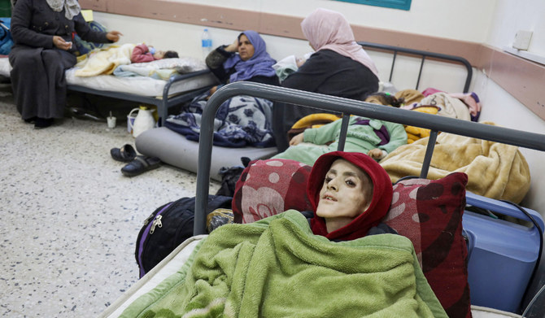
When you look at this picture, what do you feel? Does what you feel make you think of a Hadith?
Notes:
Allah's Messenger (ﷺ) said, "You see the believers as regards their being merciful among themselves and showing love among themselves and being kind, resembling one body, so that, if any part of the body is not well then the whole body shares the sleeplessness (insomnia) and fever with it." Sahih al-Bukhari 6011

Slide 24
Reflect
Think about the following questions while watching the next video.
Displacement and Suffering: Families and communities might have to leave their homes in search of food during a famine. What challenges and suffering are faced by those who are forced to move?
Emotional Toll: What is the emotional toll of famine on children? What about the parents?

Slide 25
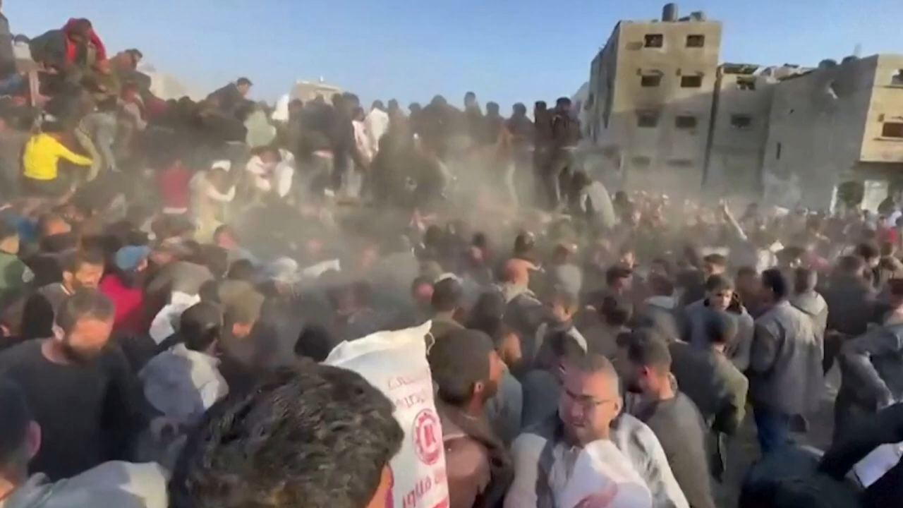

Slide 26
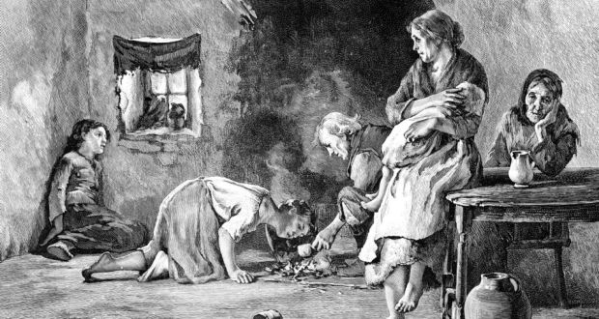
The Irish Potato famine

Slide 27
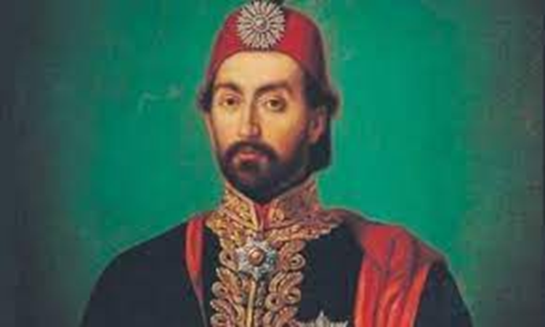
Sultan Abdul Majeed I

Slide 28
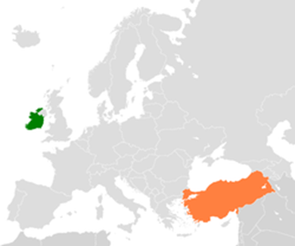
Modern Day Turkiye and Ireland

Slide 29
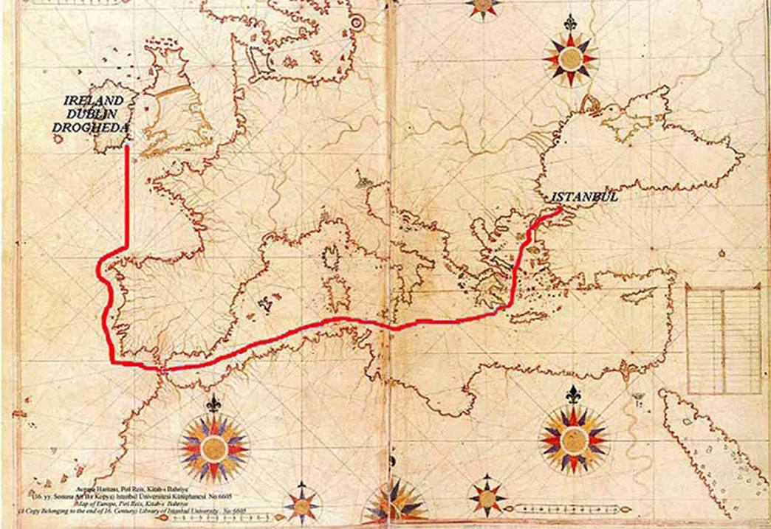

Slide 30
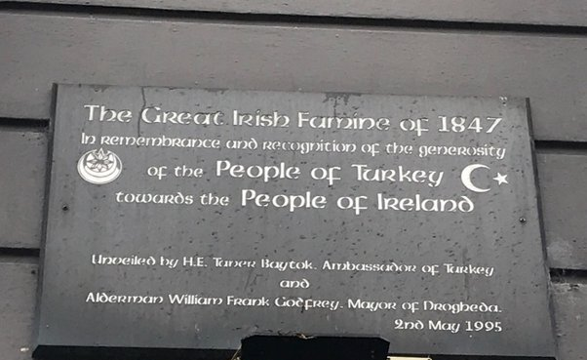

Slide 31
Lessons from Sultan Abdul Majeed I
1. Explore the ways in which Sultan Abdul Majeed I provided aid and support to the people of Ireland during their famine.
2. What were Queen Victoria's reasons for attempting to halt aid from the Uthmani Khilafah to Ireland?
3. What insights can Muslim rulers gain from Sultan Abdul Majeed I's actions during the Irish famine?
How might his approach inform contemporary leadership in the crisis in Palestine?

Slide 32
Trading with Israel

Slide 33
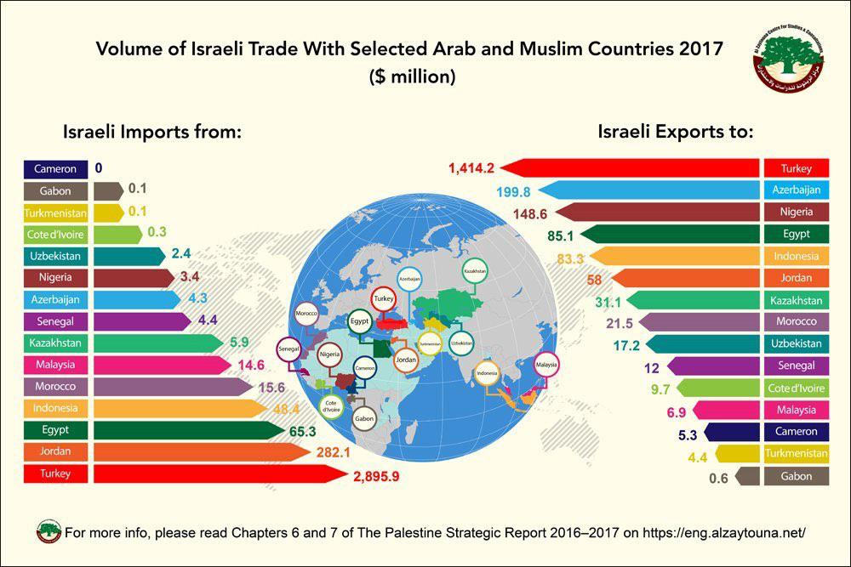

Slide 34
Trading with Israel
Are there any countries still trading with Israel and why?
How does trade with Israel impact the ability of surrounding countries to help Gaza?
Do you think the war could end if other countries stopped trading with Israel? Why or why not?
Consider whether a collective decision by the world's governments to stop trading with Israel could help stop the war.

Slide 35
Activity 1 and 2
Write a letter to government leaders to advise them of their responsibility to end the war in Palestine and provide food to end the famine. Include the hadith you learned in Lesson 1 of this topic when writing to Muslim government officials, and use similar emphasis when writing to non-Muslim government officials.
Make your own plaque inspired by the Drogheda that was made to commemorate the aid sent by Sultan Abdul Majeed I.

Slide 36
US aid drop in Gaza
Watch the video and discuss the following:
https://www.youtube.com/watch?v=AEXU1s8U01s
Why do you think the Palestinian people are confused about what the US government is doing?
How are the US government's actions similar or different from surrounding governments when it comes to dealing with the hunger problems in Gaza?

Slide 37
لَّا يَنْهَىٰكُمُ ٱللَّهُ عَنِ ٱلَّذِينَ لَمْ يُقَـٰتِلُوكُمْ فِى ٱلدِّينِ وَلَمْ يُخْرِجُوكُم مِّن دِيَـٰرِكُمْ أَن تَبَرُّوهُمْ وَتُقْسِطُوٓا۟ إِلَيْهِمْ ۚ إِنَّ ٱللَّهَ يُحِبُّ ٱلْمُقْسِطِينَ
إِنَّمَا يَنْهَىٰكُمُ ٱللَّهُ عَنِ ٱلَّذِينَ قَـٰتَلُوكُمْ فِى ٱلدِّينِ وَأَخْرَجُوكُم مِّن دِيَـٰرِكُمْ وَظَـٰهَرُوا۟ عَلَىٰٓ إِخْرَاجِكُمْ أَن تَوَلَّوْهُمْ ۚ وَمَن يَتَوَلَّهُمْ فَأُو۟لَـٰٓئِكَ هُمُ ٱلظَّـٰلِمُونَ
“Allah does not forbid you from dealing kindly and fairly with those who have neither fought nor driven you out of your homes. Surely Allah loves those who are fair. Allah only forbids you from befriending those who have fought you for ˹your˺ faith, driven you out of your homes, or supported ˹others˺ in doing so. And whoever takes them as friends, then it is they who are the ˹true˺ wrongdoers.”
Surah Mumtahina, 60: 8 -9

