Slide 1

Food and Community in Islam

Slide 2

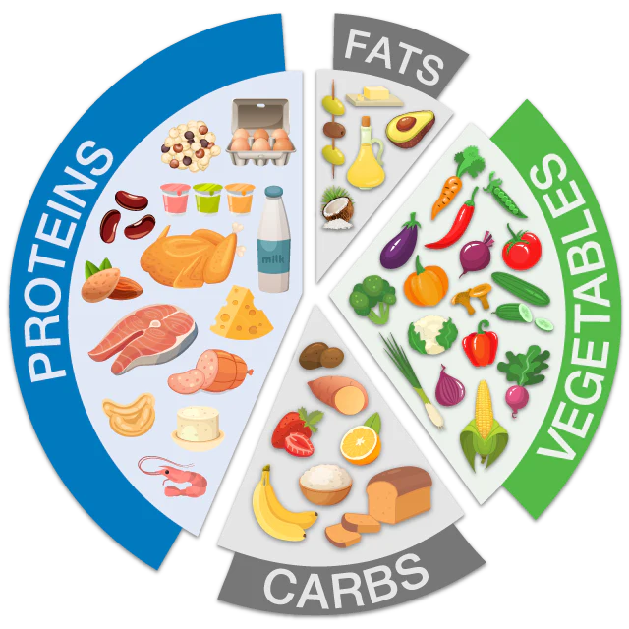
Introduction
Islam deals with our personal loves in such a way as to ensure purity and cleanliness.
To maintain a pure heart and a sound mind, to nourish an aspiring soul and a clean healthy body, special attention is needed to our diet.
Anything which is pure and good for us can be part of a diet accepted in Islam, as long as we consume moderately.

Slide 3
Introduction
Food is addressed many times in the Qur’an and for many different reasons. We learn how food begins, what it signifies, what food are permitted and which are not and their importance in the hereafter.
Qur’an and Sunnah teach us the importance of ethical production, transportation, and consumption of food.
Through this we learn the principles of balance, justice and health are evident.
Food plays an important part in building relationship within our homes, and the local and wider community.

Slide 4
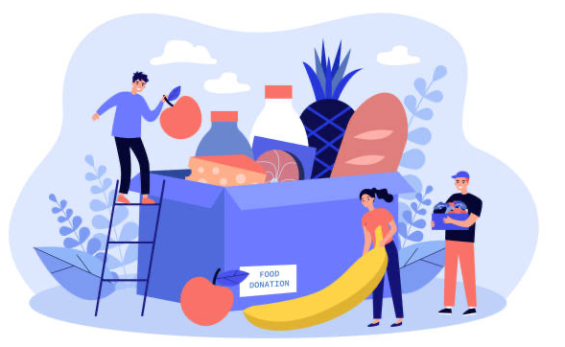
Question
How do you think food plays an important part in:
our homes?
the local community?
the wider world?

Slide 5
Food - A Wonderful Blessing
Numerous verses in the Qur’an remind us of the blessing of food. How we are given so much to enjoy but that it is only Almighty Allah who can make such blessings happen.
One example of this can be found in Surah Al-Baqarah.

Slide 6
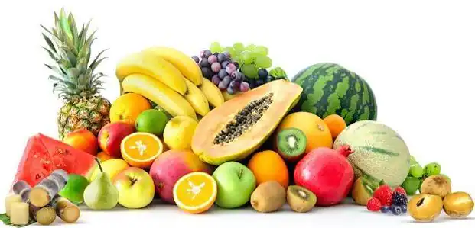
Surah Al-Baqarah 2:22
(He) who made for you the earth a bed (spread out) and the sky a ceiling and sent down from the sky, rain and brought forth thereby fruits as provisions for you. So do not attribute to Allah equals while you know ( that there is nothing similar to Him).

Slide 7
Question
Which of Allah’s 99 names can you think of when you reflect on this verse in the Qur’an?
Notes:
Allah is Wise – Al- Hakeem
Allah is Generous – Al Kareem
Allah is The Provider – Ar- Razzaq
Allah is the Nourisher – Al-Muqit

Slide 8
Prophets (AS) and Food
Allah SWT provides examples in the Qur’an which enable us to learn lessons. For example,
Ibrahim AS
When Ibrahim AS presented the angels with a roasted calf but they did not eat. (Surah Adh-Dhariyat 51: 24-27). These verses show us about our responsibility to look after our guests.
Musa AS
When his people were hungry, Musa AS made dua and Allah sent upon them al manna wa al- salwa, food of Jannah ( a sweet food and quails) ( Surah Al-Baqarah 2: 57)
Instead of showing their gratitude, the Bani Israeal complained and wanted more. (Surah Al-Baqarah 2:61). This greed for more and ingratitude led to the food being spoiled and the blessing was stopped.

Slide 9
Question
Can you think of other examples?
Are there any other stories of food in the Qur’an related to important events that you can think of?
Notes:
Examples could include Esa AS ( Surah 5: 114)
Maryam AS and dates ( Surah 19:25)

Slide 10
Food as a Test
The Qur’an teaches us that the believer will be tested. This test can come in the form of hunger, a poor harvest and loss.
We will certainty test you with a touch of fear and famine and loss of property, life, and crops. Give good news to those who patiently endure.’
Who say, when struck by a disaster, ‘Surely to Allah we belong and to Him we will (all) return.’
They are the ones who will receive Allah’s blessings and mercy. And it is they who are ‘rightly’ guided.
Surah Al Baqarah 2: 155-157

Slide 11
Question
Which group of people can you think of today that are being severely tested?
Notes:
Palestine. Ask pupils how they think they are being tested.

Slide 12
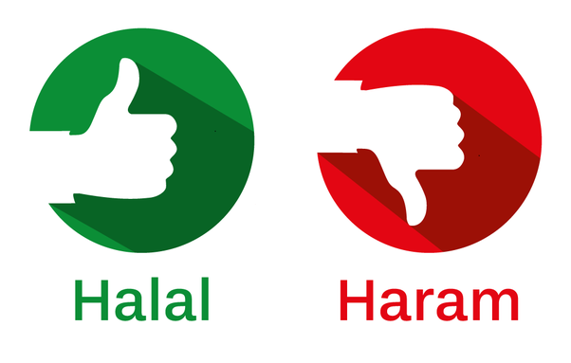
Food in the Qur’an
Surah Al Maidah or the Table Spread is a Surah which relates to food and a central theme is the regulation of lawful and unlawful food.
This Surah identifies foods (ṭa‘ām) that are prohibited, haram, and foods that are permitted, halal.

Slide 13
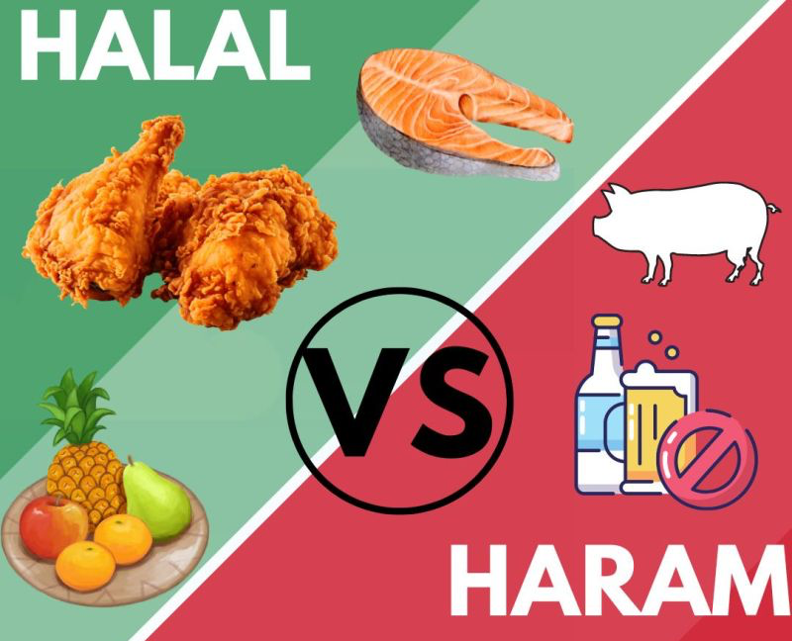
Food in the Qur’an
Haram foods include blood, dead animals, the flesh of swine, animals offered in sacrifice to other than God, or animals that have been gored and killed or remnants from what wild animals have eaten.
Islamic law requires that animals be killed in a prescribed way, such that its blood drains out.

Slide 14
Food in the Qur’an
And eat of that [meat or food] over which the name of God has been mentioned…and do not eat from that over which the name of God has not been mentioned, for indeed, it is grave disobedience.
Surah Al - Anaam 6:118–121

Slide 15
Food Consumption
Then eat of what God has provided for you [which is] lawful and good. And be grateful for the favour of God, if it is [indeed] Him that you worship.
Surah An-Nahl 16: 114
Food consumption goes beyond eating halal and also focuses on healthy foods, while eliminating overconsumption and waste. We have examples in the Qur’an and Sunnah of what foods to eat and how food should be treated and consumed.

Slide 16
The Importance of Tayyib food, not just Halal food

Slide 17
Tayyib
And We shaded you with clouds and sent down to you manna and quails, [saying], "Eat from the pure things with which We have provided you." And they wronged Us not - but they were [only] wronging themselves. (Surah Al-Baqarah 2:57)
Eat from the pure things which we have provided you”. And they wronged Us not, but they were [only] wronging themselves. (Surah Al-Araf 7:160)
And eat of what God has provided for you [which is] lawful and pure And fear God, in whom you are believers. (Surah Al Maeda 5:88)

Slide 18
Tayyib
Tayyib is a comprehensive word that has an important place Islam. The word “tayyib” means to be pure, good, clean, wholesome, gentle, excellent, fair.
The Qur’an references many types of foods, all of which have numerous health benefits: gourds (Surah As Saaffat 37:146), garlic, lentils, onions (Surah Al-Baqarah 2:61), figs, olives (Surah At-Tin 95:1-4), dates, grapes (Surah An-Nahl 16:11), pomegranate (Surah Al-Rahman 55:68), bananas (Surah Al-Waqia 56:29-31), jujube (Surah Ar-Rad 53: 13-16).

Slide 19

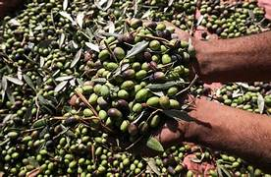
Did you know?
The people of Palestine rely on olives for their primary income.
The olive tree is seen by many Palestinians as being a symbol of nationality and connection to the land, particularly due to their slow growth and longevity.
Most of the olives are sent to presses to produce olive oil, whilst some are cured for eating and used to make medicine and soap.
Replace Image Here

Slide 20
Question
How can it be difficult to determine if a food is Tayyib?
Notes:
Much of the food we eat maybe halal but with the processing involved to maintain shelf life, addition of preservatives, the unknown history of how the plant or animal was grown or raised, and how harvesting was conducted; it can be difficult to determine which foods are actually tayyib.

Slide 21
Question
How can it impact our health?
Notes:
Eating halal and tayyib foods promotes the Islamic principles of balance, justice and health for human beings and the planet.

Slide 22
Impact
This has implications for our health. The World Cancer Research Foundation (WCRF) highlights that the consumption of diets low in fibre, high in processed red meats, and high-nitrite diets have been associated with a number of illnesses and diseases.
International bodies like the Intergovernmental Panel on Climate Change (IPCC) and the World Health Organization (WHO) promote the consumption of plant-based diets and decreasing the greenhouse gas emissions associated with agriculture and food processing and transport.

Slide 23
Etiquette of Food
‘O Prophet of God, we eat but we never eat our full.’ He said: ‘It might be that you are eating separately.’ They replied: ‘Yes.’ Thereupon, the Prophet said: ‘Get together when you eat, and mention the Name of God (when you start eating), God will bless your food.’
(Abu Dawood)

Slide 24
Question
There are examples in the Sunnah of how the Prophet (PBUH) not only ate food, but interacted with it.
Can you name some?

Slide 25

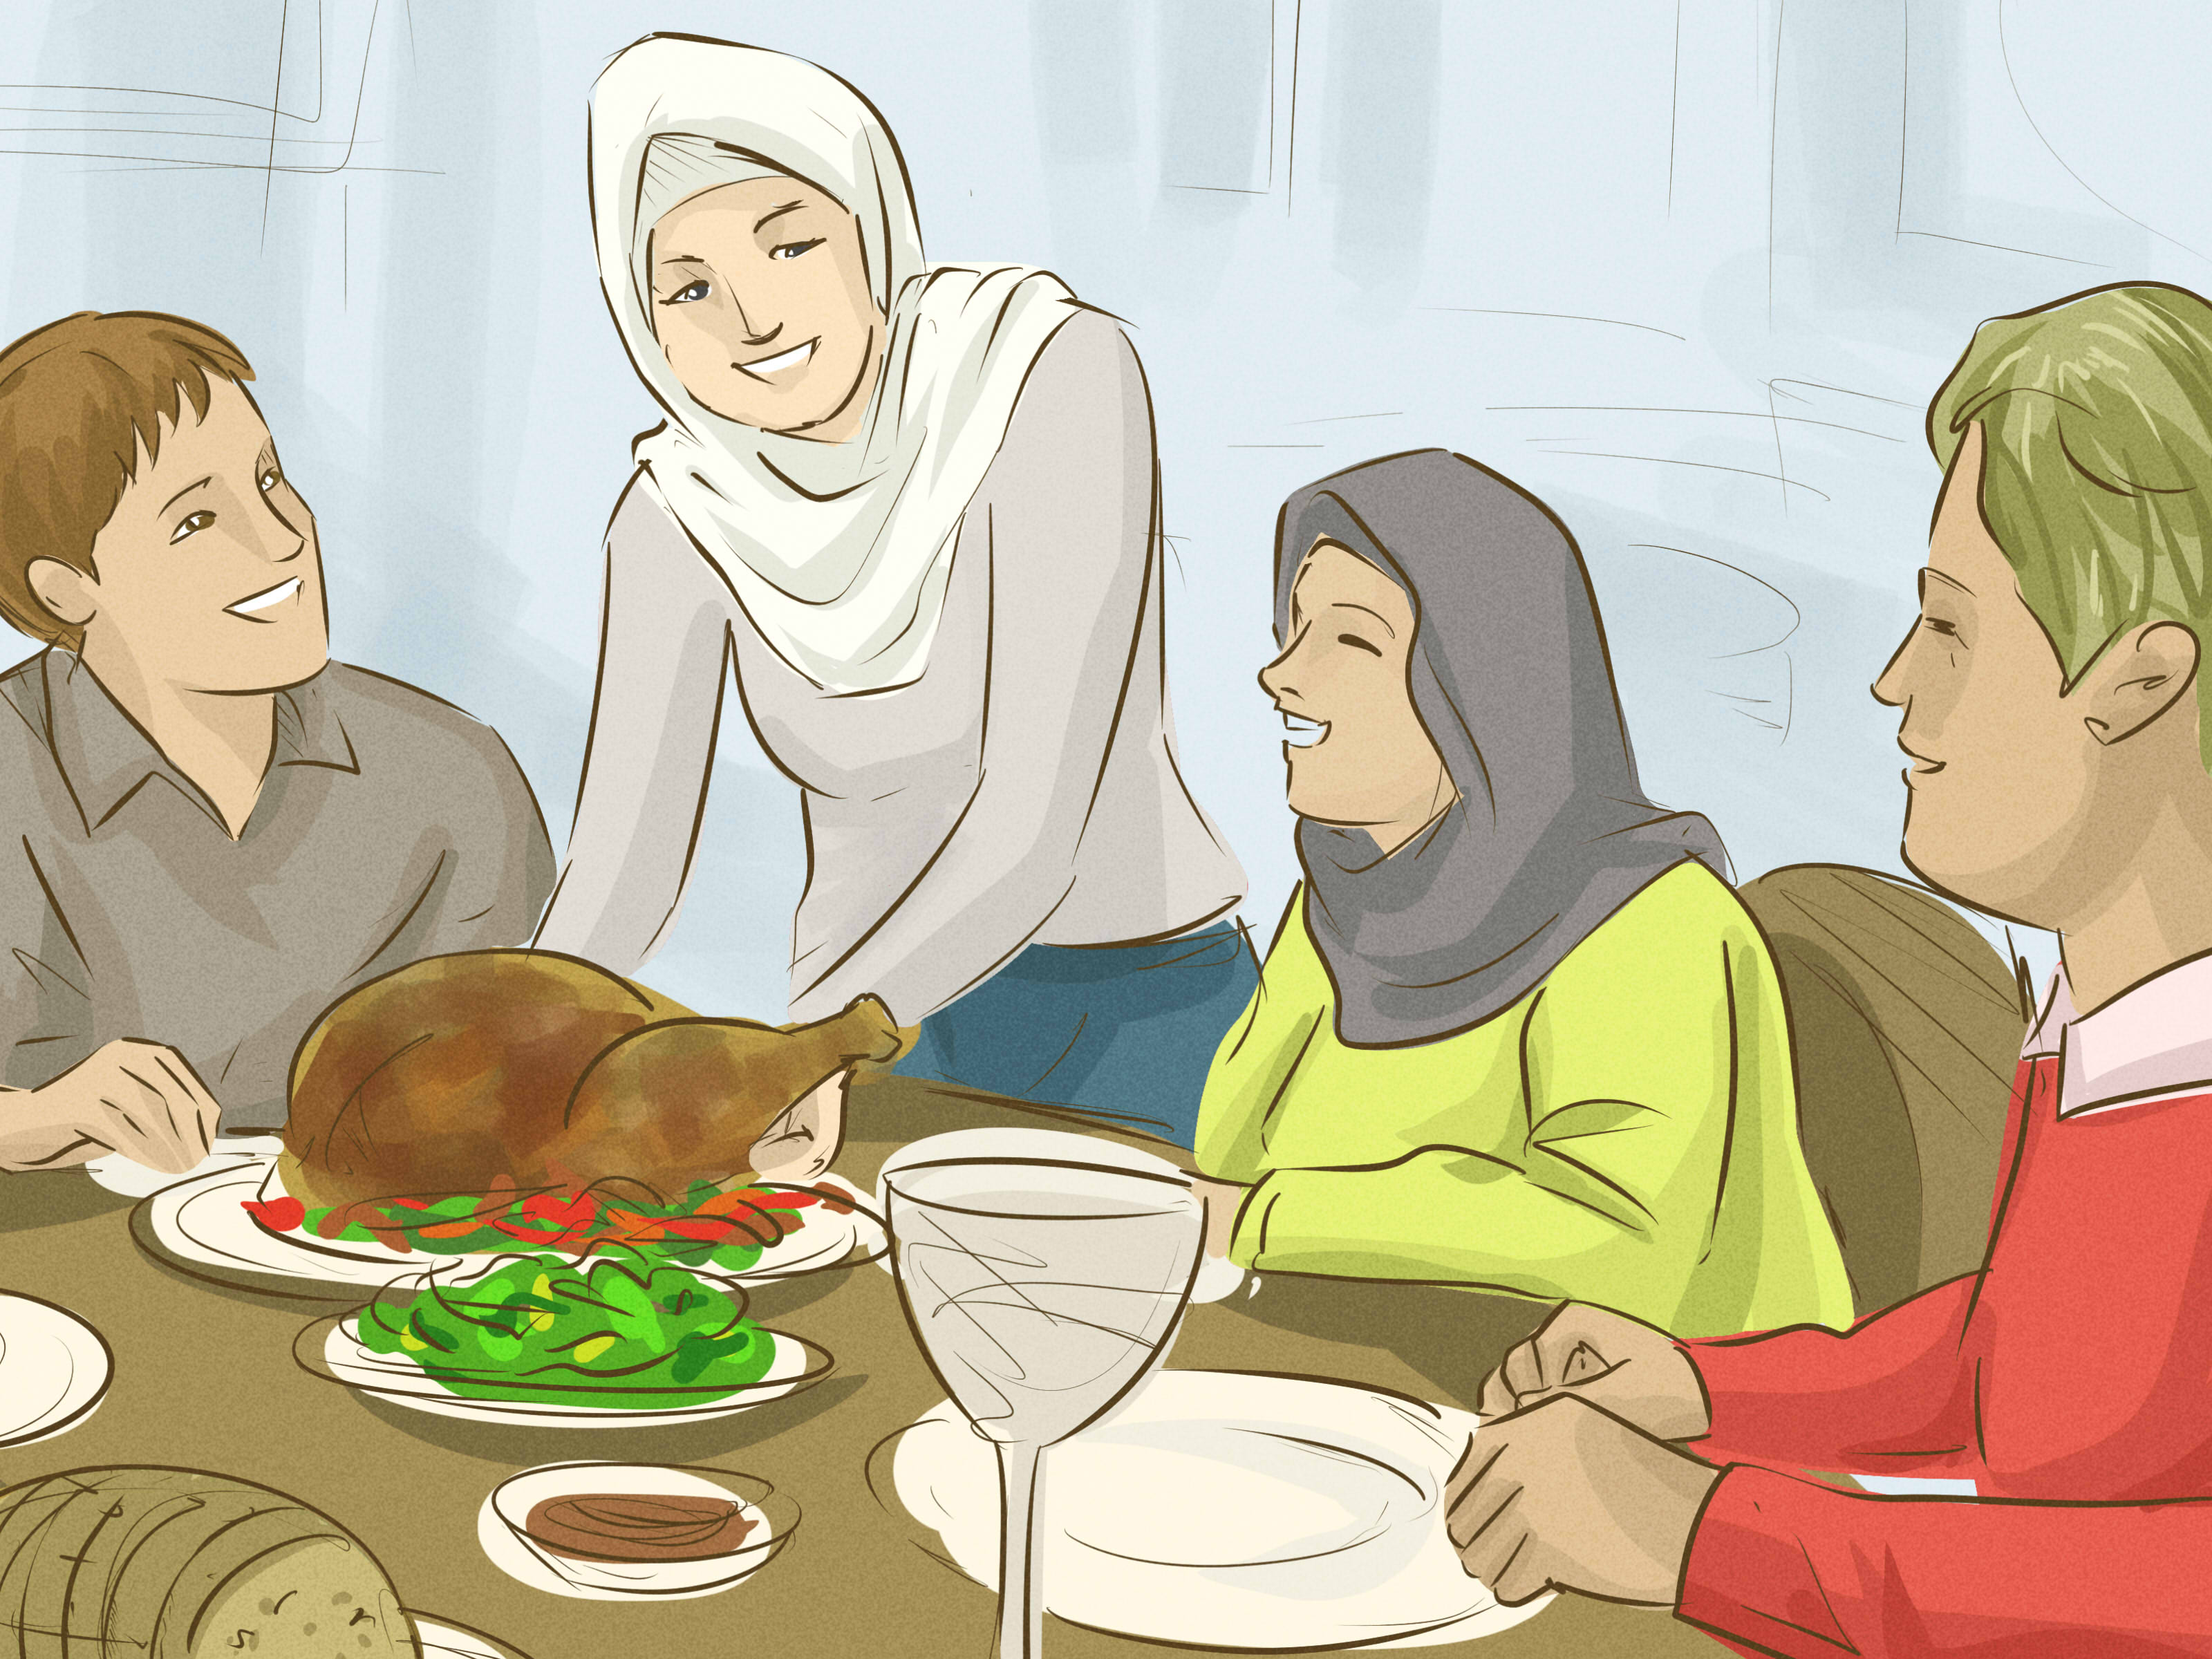
Etiquette of Food
There are examples in the Sunnah of how the Prophet (PBUH) not only ate food, but interacted with it include:
the recitation of certain duas recited prior to consuming food
eating from what was nearest on the plate to the person
showing gratitude towards the food
eating with others to promote the concept of community

Slide 26
Etiquette of Food
Rethinking how we interact with food can make us more aware of how we view our food systems.

Slide 27
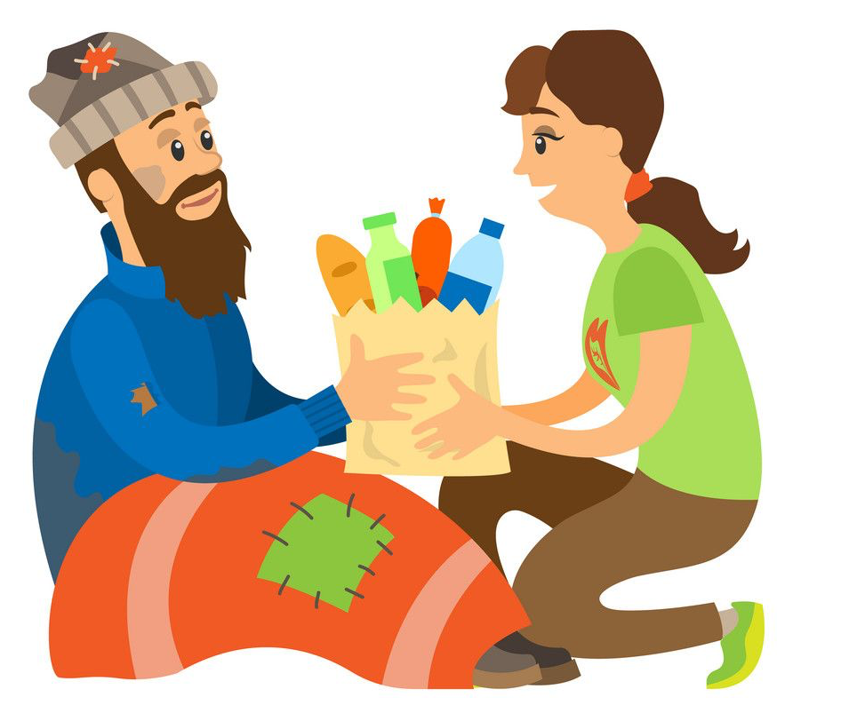
Food and Ramadhan
This blessed month brings a connection to the blessing of food.
An opportunity to re-think about the way we interact with food.
We are reminded about how much we depend on food and drink.
How much of a blessing they are.
How we have a duty to feed the poor and how if we don’t then it shows an inconsistency with our belief.

Slide 28
Food and Ramadhan
And when it is said to them, ‘Spend from that which Allah has provided for you.’
Surah Yaseen 36:47

Slide 29
Food and Waste
O children of Adam, take your adornment at every masjid, and eat and drink, but be not excessive. Indeed, He likes not those who commit excess.
Surah Al-Araf 7:31

Slide 30

Food and Waste
Food waste is an enormous problem as a staggering 40% of our food is wasted and sent to landfills.
When we look at the amount that is wasted from growing, transporting, distributing and buying food that ends up being wasted, trillions of pounds are lost each year.

Slide 31
But as we waste food, millions of people around the world suffer from malnourishment and starvation……..

Slide 32
Food and Waste
The Prophet (PBUH) said:
‘The child of Adam has not filled any receptacle worse than his stomach. It is sufficient for the child of Adam to eat small bits of food that keep him healthy. Now if he wants to eat much anyway, he should give a third to the food, a third to the drink and a third (of his stomach) to let him breathe comfortably’
(Ahmad)

Slide 33
Food and the Wider World
Earlier we discussed how our brothers and sisters in Palestine are facing a very testing time. Their biggest test is their lack of access to food and clean water.
As an Ummah, we have a responsibility to look after each other.
There are numerous verses in the Qur’an and hadith from the Prophet (PBUH) which remind us of our responsibility of being part of a community.

Slide 34
Food and the Wider World
.. Remember the favour of Allah upon you- when you were enemies and he brought your hearts together and you became, but His favour, brothers.
Surah Aal- e- Imran 3:3
Notes:
Our Prophet (PBUH) was a true inspiration in living the above verse. Being in a leadership position, he faced immense criticism to the point that he was pelted with stones, drenched in dirt and dust, and even his life was put in danger many times. Yet, our Prophet (pbuh) showed nothing but kindness and respect back to his enemies. He used kindness to change the world and create legacies that continue to live with us today. It was his kindness that made one of his worst enemies, ‘Umar ibn al-Khattab (ra), to be one of his closest friends, a khalifa and one of the ten promised paradise.
Such is the power of kindness, in which unity can be achieved and love can be spread far and wide.

Slide 35
Food and the Wider World
.. Let there be a community among you, advocating what is good, demanding what is right, and eradicating what is wrong. These are indeed the successful.
Surah Aal- e- Imran 3: 104

Slide 36
Food and the Wider World
The Prophet (PBUH) said:
‘Verily the believers are like a structure, each part strengthening the other.’ and the Prophet (PBUH) clasped his hands together.
(Al - Bukhari)
Notes:
This hadith highlights the importance of supporting one another during times of need willingly and sincerely. It also involves expressing a sense of joy and pleasure when helping one another, seeing it as an honour to be able to fulfil someone else’s need.
This strengthens bonds between people. Even if you were to help someone less fortunate, in a completely different country, though you may not know the beneficiary in person, they will naturally have some sort of love for you and make du’a for you for the peace you’ve brought into their life. Attaining unity is therefore, not restricted. And just by viewing the believers as bricks that come together to build a structure, allows us to understand and visualise that so much good can come out of just supporting one another and being aware of each other’s conditions.

Slide 37
Food and the Wider World
The Prophet (PBUH) said:
‘The parable of the believers in their affection, mercy and compassion for each other is that of a body. When any limb aches, the whole body reacts with sleeplessness and fever.’
(Al - Bukhari)
Notes:
The love that a Muslim harbours in his heart should be so sincere that it makes him give towards those in difficulty. He feels the ache of another person and he reacts in the kindest of ways. This brings forth affection, mercy and compassion naturally towards others. In a tough world which holds obstacles of conflict, natural disasters and millions of less fortunate people, it is vital we spread love to unite in goodness. It is in these times that Allah (SWT) has commanded us to help those who are in desperate need. It is in these times where we can unite to uplift others and bring good to the world. Through unity, we can make a huge difference.

Slide 38

Unity brings people together, creating love, harmony and generosity between them. As believers, we can use unity as a platform to spread kindness to others, as well as an opportunity for our spiritual growth to become closer to Allah (SWT).
Reflecting on the virtues of unity will allow us to spread sincere kindness to our family, friends, to the wider world and importantly to those in most desperate need.

Slide 39
Question
How can we help our brothers and sisters in Palestine?

Slide 40
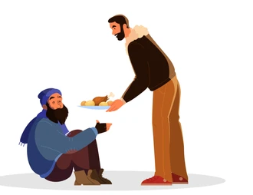
How can we help our brothers and sisters in Palestine?
Dua
Raise awareness of their difficulties
Raise money in your local community
Donate to charities that are providing aid
Let other people know how they can help
Notes:
For each of the points, ask pupils what they can do. For example, what duas can pupils make? How can they raise awareness? – write to a member of your local political party. How could they raise money – what could they do?

