Slide 1
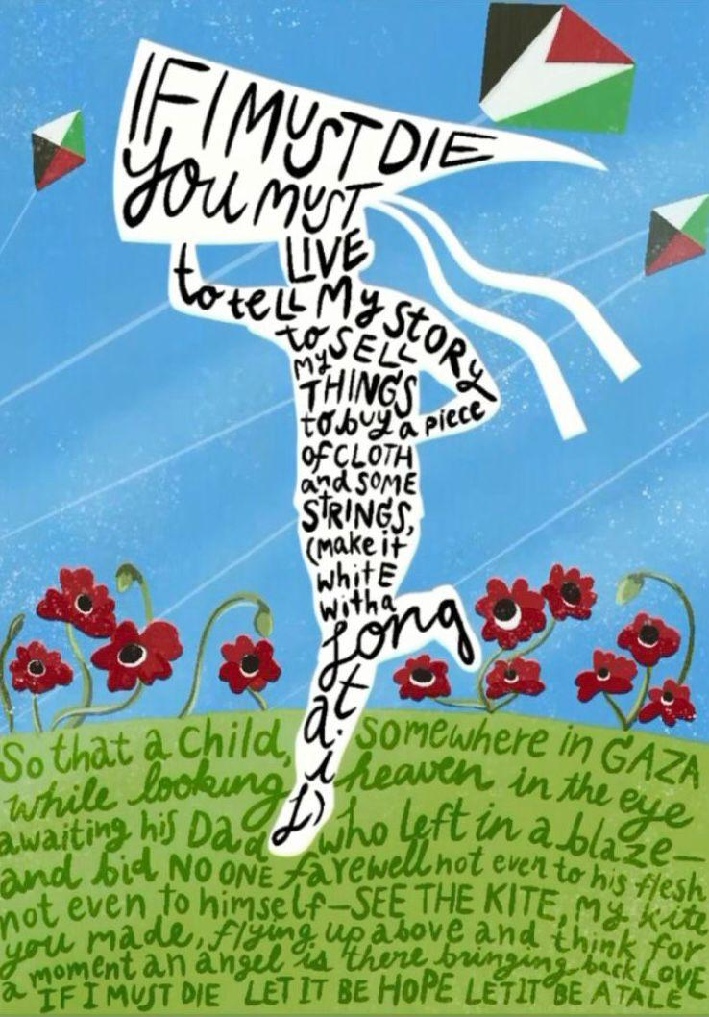

If I Must Die
You Must Live to
Tell My Story
By Dr. Rifaat Alareer

Slide 2
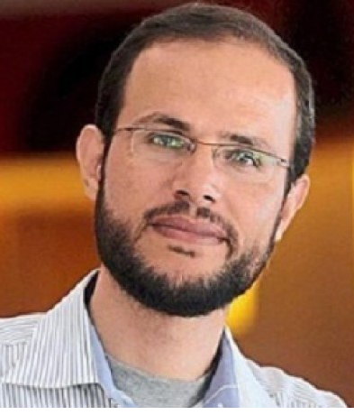
About Dr. Rifaat Alareer
He obtained a Bachelors degree from the Islamic University of Gaza in 2001 and a Masters degree from the University College London in 2007. In 2017 he obtained a PhD in English Literature from Putra University in Malaysia.
Dr. Rifaat was a poet, a professor of literature and creative writing and an activist, mashAllah. He is noted to have
co-founded an organization called We Are Not Numbers.. Alhamdulilah. This was a program that connected writers in Gaza with writers across the world.
Dr. Rifaat Alareer was a Palestinian. He was born in Gaza on the 23rd of September 1979.

Slide 3
Dr. Rifaat saw storytelling as a powerful form of Palestinian resistance. He was deeply affected by the Zionist occupation of Gaza. His every action and decision was driven by his commitment to address the oppression faced by the Palestinian people.
Dr. Rifaat strived to bring justice for Gaza and the Palestinian people. He recognized the power of stories to illuminate the suffering of Palestinians. This led him to edit Gaza Writes Back (2014) and Gaza Unsilenced (2015). He amplified voices that might otherwise have gone unheard.
Tragically, Dr. Rifaat Al Alareer was murdered on the 6th of December 2023 during a targeted assault by Israeli Zionists. Inna lilahi wa inna alaihi rajioon. To God we belong and to Him we return. InshAllah Dr. Rifaat is in Jannah flying like a kite.

Slide 4
Sources:
https://en.wikipedia.org/wiki/Refaat_Alareer#cite_note-15
https://time.com/6344843/refaat-alareer-killed-poet-gaza-notes/
Photo: https://www.newagebd.net/article/219726/palestinian-poet-refaat-alareer-killed-in-israeli-strike-in-gaza

Slide 5
If I Must Die
You Must Live to
Tell My Story
If I Must Die is a poignant poem by Dr. Rifaat Alareer. It is depicted through an image of a figure running on green grass, clutching a kite with two white tails. The words of the poem are intricately woven into the figure and the kite. The poem extends onto the grass, where red flowers bloom under a blue sky. Above, three kites soar that have the colors of the Palestinian flag. The poem symbolizes tragedy and hope.
The poem can also be interpreted as a plea to the reader. In the event of the poet's demise, it becomes the reader's responsibility to not only ensure that the plight of Palestine is not forgotten but to tell the story of Palestine.

Slide 6
If I must DIE

Slide 7
you must LIVE

Slide 8
to tell my story

Slide 9
to sell my things

Slide 10
to buy a piece of cloth

Slide 11
and some strings

Slide 12
(make it white with a long tail)

Slide 13
so that a child somewhere in

Slide 14
GAZA

Slide 15
while looking heaven in the eye

Slide 16
awaiting his

Slide 17
Dad

Slide 18
who left in a blaze

Slide 19
and bid no one farewell not even to his flesh not even to himself

Slide 20
SEE THE KITE!

Slide 21
My kite you made

Slide 22
flying up above

Slide 23
And thinks for a moment

Slide 24
an angel is there bringing back

Slide 25
LOVE

Slide 26
If I must die, let it be

Slide 27
HOPE

Slide 28
let it be a tale.

Slide 29
If I Must Die
you must live
to tell my story
to sell my things
to buy a piece of cloth
and some strings,
(make it white with a long tail)
so that a child, somewhere in Gaza
while looking heaven in the eye
awaiting his dad who left in a blaze—
and bid no one farewell
not even to his flesh
not even to himself—
sees the kite, my kite you made, flying up above
and thinks for a moment an angel is there
bringing back love
If I must die
let it bring hope
let it be a tale
By Dr. Rifaat Alareer

Slide 30
Question Time

Slide 31
1. Dr. Alareer was born in
Hebron
Bethlehem
Al Quds
Gaza

Slide 32
1. Dr. Alareer was born in
Hebron
Bethlehem
Al Quds
Gaza

Slide 33
2. Dr. Alareer was born on
23 September 1979
23 October 1979
28 September 1979
28 September 1979

Slide 34
2. Dr. Alareer was born on
23 September 1979
23 October 1979
28 September 1979
28 September 1979

Slide 35
3. Dr. Alareer was a
doctor, poet, engineer
writer, poet, engineer
professor, poet, writer
activist, professor, poet, writer

Slide 36
3. Dr. Alareer was a
doctor, poet, engineer
writer, poet, engineer
professor, poet, writer
activist, professor, poet, writer

Slide 37
4. Dr. Alareer formed an organization called
We Are Not Letters
We Are Not Sentences
We Are Not Numbers
We Are Not Digits

Slide 38
4. Dr. Alareer formed an organization called
We Are Not Letters
We Are Not Sentences
We Are Not Numbers
We Are Not Digits

Slide 39
5. In the poem what does Rifaat want us to make?
A story
A kite
A flag
A piece of clothing

Slide 40
6. What color is the kite?
White
Red, green, black
Red, white, green, black
Green

Slide 41
7. Finish the sentence:
If I must die ..
You must write
You must run
You must cry
You must live

Slide 42
8. Rifaat wants everyone to tell about his
poem
story
song
life

