Slide 1

Food For Thought This Ramadan

Slide 2

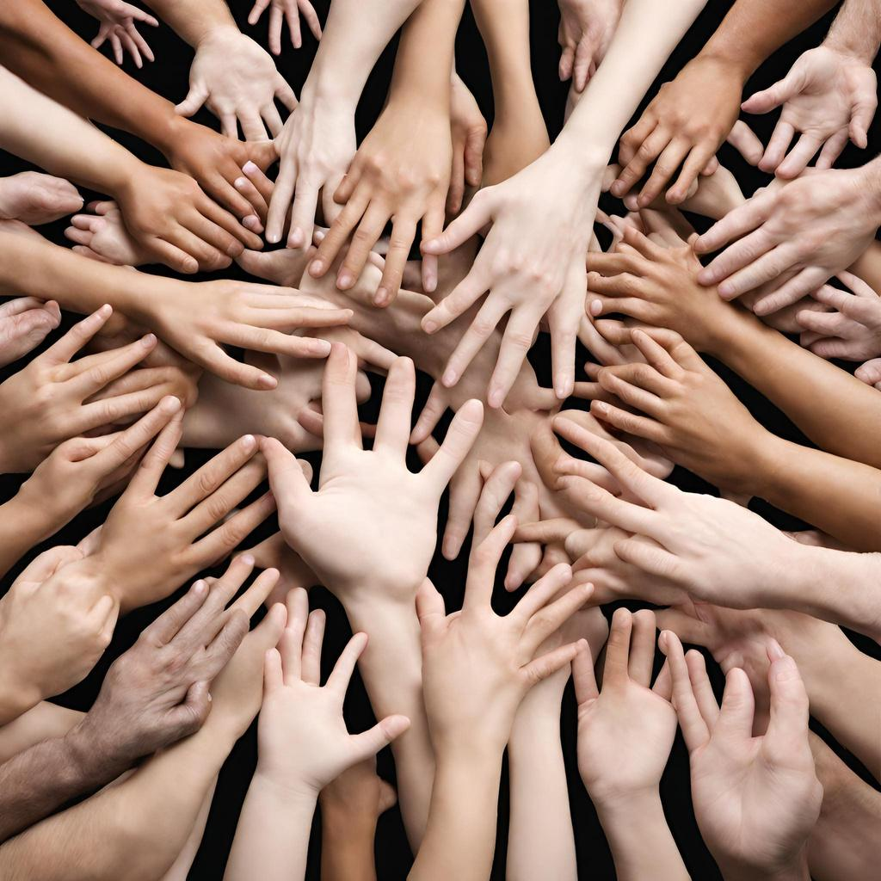
What Do Hands Have To Do With Ramadan?

Slide 3
Who is this describing now?
“The example of the believers in their affection, mercy, and compassion for each other is that of a body. When any limb aches, the whole body reacts with sleeplessness and fever.”

Slide 4
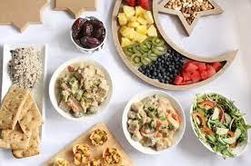

What Do Hands Have To Do These Things?

Slide 5

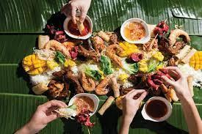
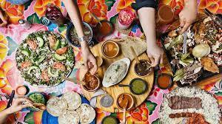
Hands for Eating

Slide 6
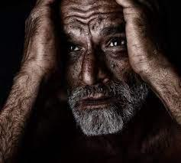
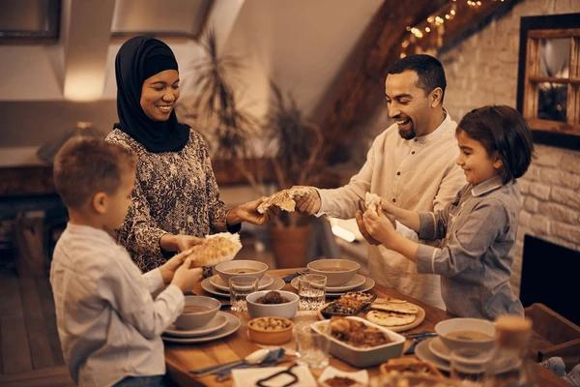
How do feel...
At the end of a fast?
After Iftar?

Slide 7


Share Your Thoughts and Feelings!
A really difficult fast
A wonderful iftar
Your favorite Ramadan food

Slide 8
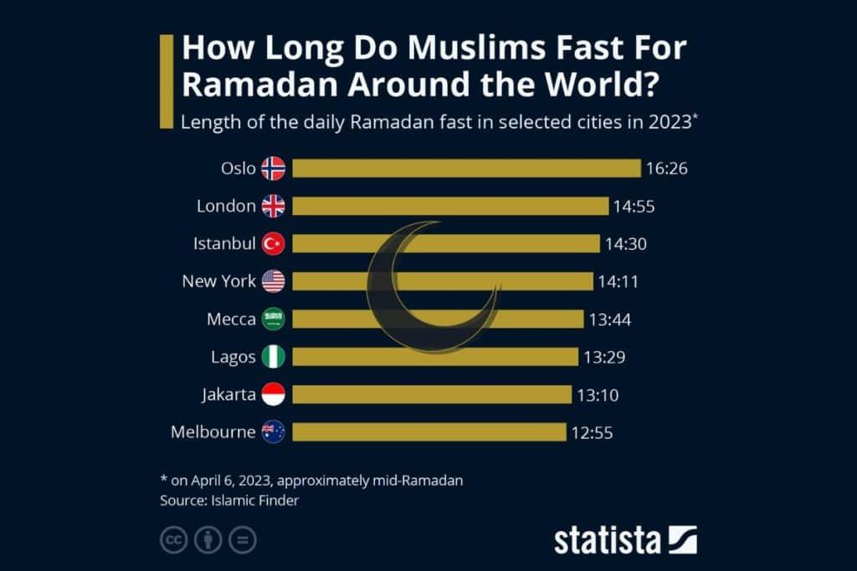
How Long Do Muslims Fast Around The World?

Slide 9
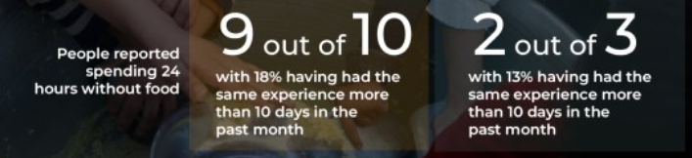
Palestinan Fast Times
In Gaza The Fast Does Not Finish

Slide 10
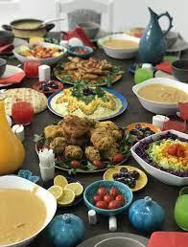
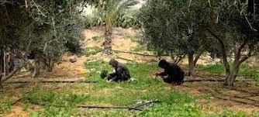
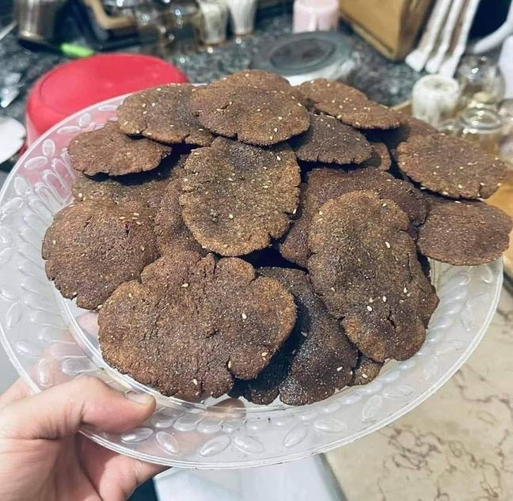
Compare Iftars
Their Iftar
Animal Feed And Wild Plants
Your Iftar
Anything You Want

Slide 11
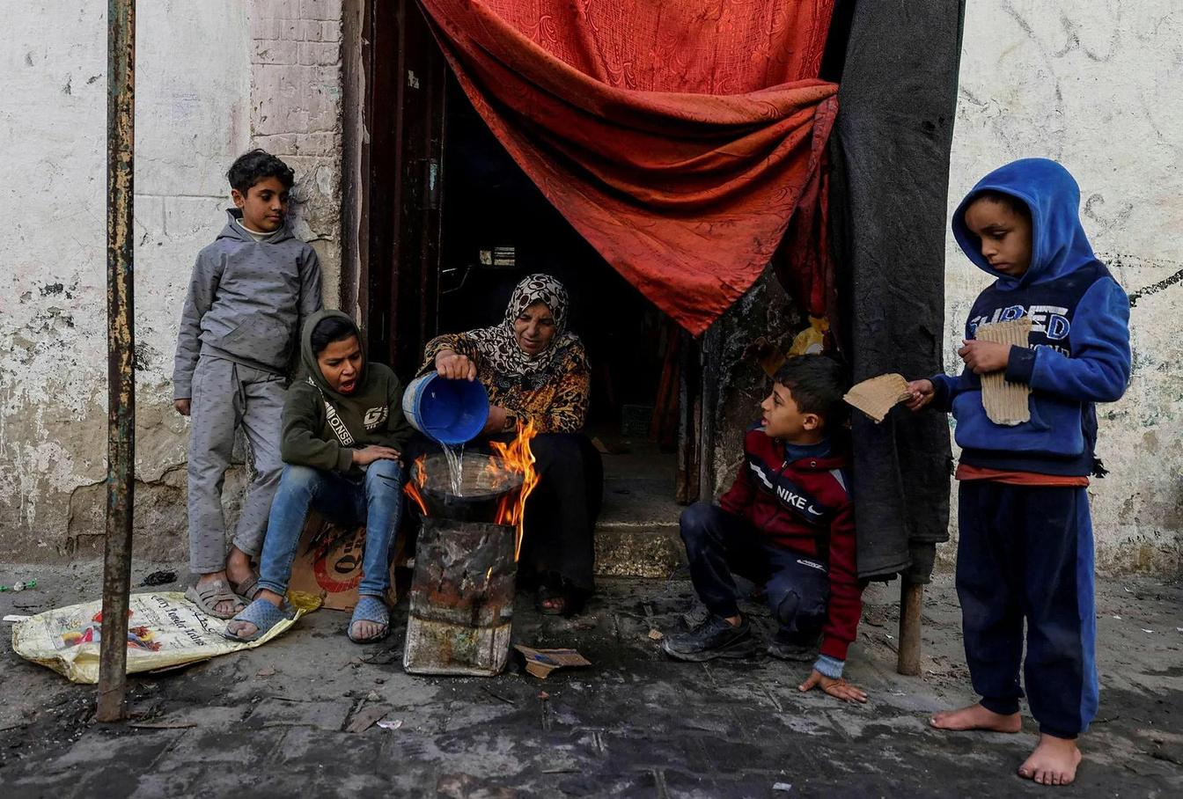
How do you feel?

Slide 12
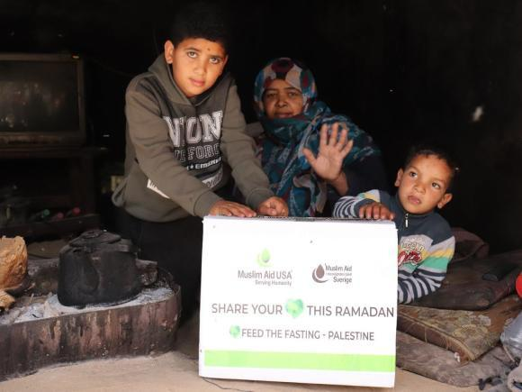
Hadith On Feeding Others
"The food for one person suffices for two; the food for two suffices for four, and the food for four suffices for eight persons".
Replace Image Here
“If a Muslim feeds a hungry Muslim, Allah will feed him from the fruits of Paradise on the Day of Judgment”
“The best of you are those who feed others”

Slide 13
Ideas To Help
Brainstorm ways in which we can be a helping hand to our brothers and sisters this year in Ramadan.
How can we connect and help through food?
Most ideas wins!

Slide 14
What Are Your Ideas?

Slide 15

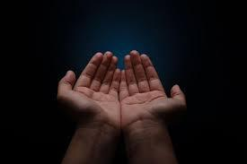
Hands For Worship

Slide 16
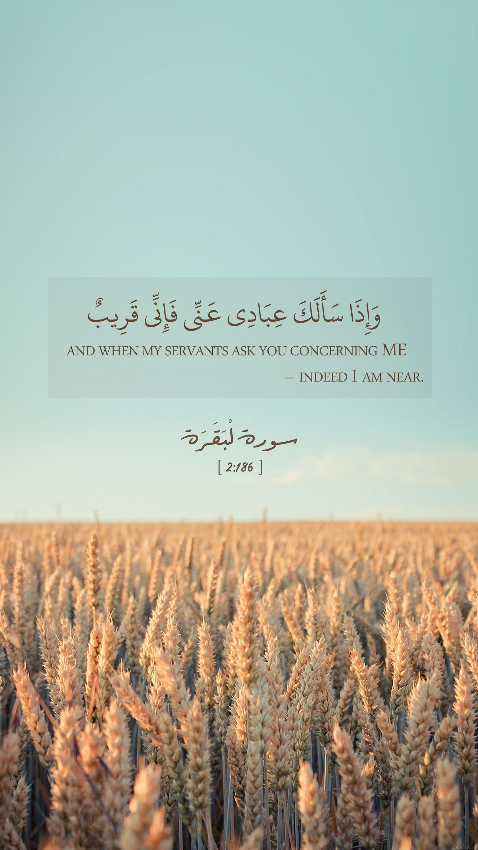
Ayah On Dua
“When my servants ask you concerning me, (tell them) I am indeed close (to them). I listen to the prayer of every suppliant when he calls on me (make Dua).”
[Quran 2:186]

Slide 17
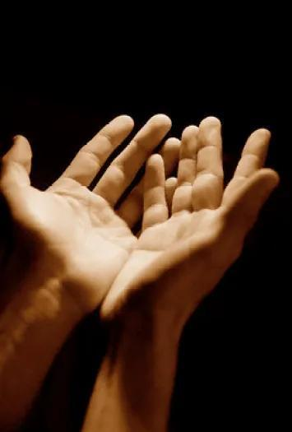
Hadith On Dua
“The dua of a Muslim for his brother (in Islam) in his absence is readily accepted. An angel is appointed to his side. Whenever he makes a beneficial dua for his brother the appointed angel says, ‘Aameen. And may you also be blessed with the same.'”

Slide 18
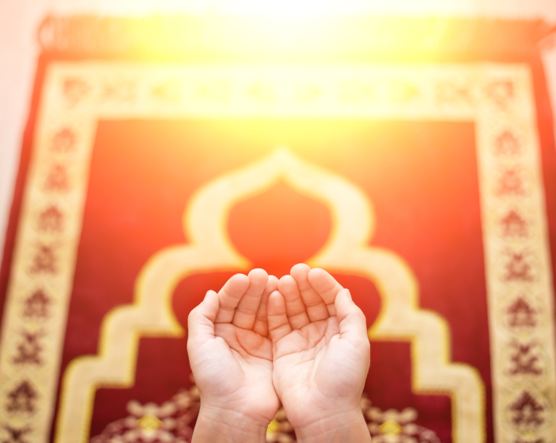
Dua Changes Events
“Nothing can change the Divine decree except dua”.
“No precaution can protect against the decree of Allah. Dua is beneficial with regard to what has been decreed and what has not been decreed. The dua meets the calamity that has been decreed and wrestles with it, until the Day of Resurrection.”

Slide 19
How To Make Dua
You tell me
  How should we start?
  What should we ask for?
  How should we end?

Slide 20
How To Make Dua
  Raise your hands
  Start with the basmala.
  Praise Allah
  Ask Allah to bless the Prophet s.a.w.
  Sincerely ask Allah for what you want (to relieve the people of Palestine).
  Ask for blessing on the Prophet s.a.w. again.
  Praise Allah again.

Slide 21
Write A Dua For Palestine
  Write a dua for the Palestinians from your heart.
  Think about how they are being treated and what they are going through.
  Know that Allah can change it.
  Ask Him for specific things to change.
  Commit to making this dua throughout Ramadan

Slide 22
Sharing Is Caring
What did you learn today?
What will you change in Ramadan after this lesson?
Is there anything you would like to add to our lesson today?

