Slide 1


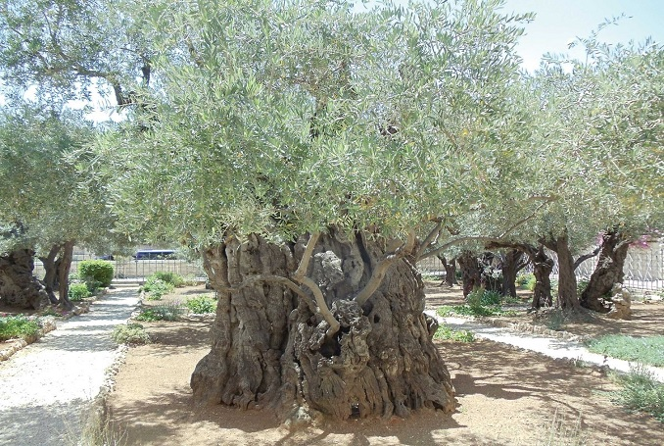
The Olive Trees of Palestine

Slide 2

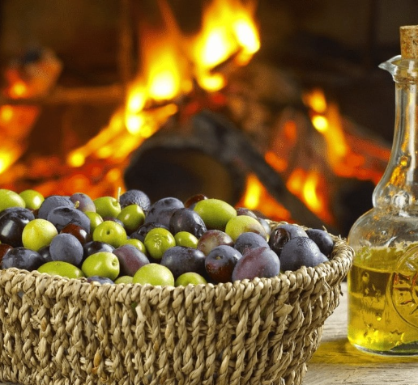
In this lesson we will discuss:
The olive tree and its uses,
the harvesting of the olives and the factories pressing it into oil, and
the challenges faced by the farmers by the destruction of the trees and the theft of the olives and their farms by the occupation forces and settlers.

Slide 3
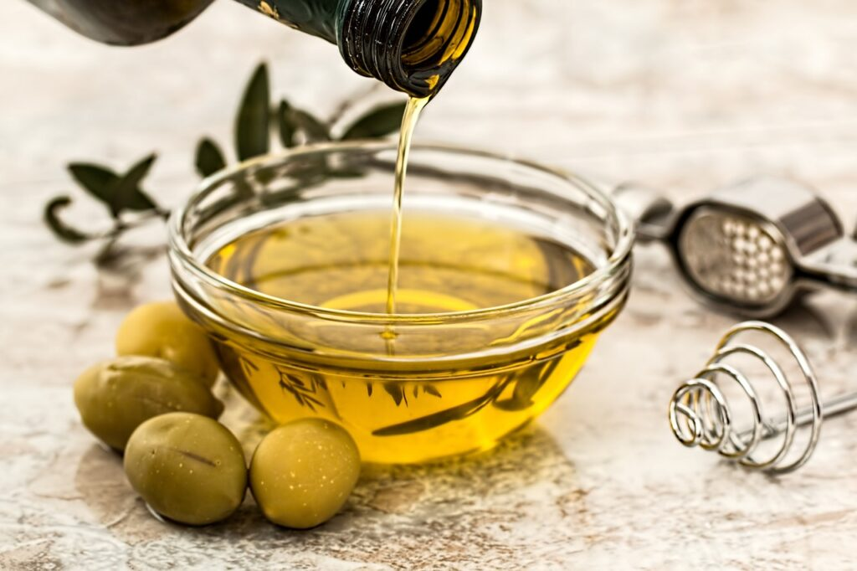
• Raise your hands if you have tried olive oil.
• What kind of foods do you usually add olive oil to or what can you do with olive oil?
To really appreciate the
importance of the olive tree to Palestinians we need to know a little about Palestine’s history.
Notes:
What kind of foods do you usually add olive oil to or what can you do with olive oil? (possible answers: for cooking, or adding to pizza, salad, pasta,..).
What kind of foods do you usually add olive oil to or what can you do with olive oil? (possible answers: for cooking, or adding to pizza, salad, pasta,..).
What kind of foods do you usually add olive oil to or what can you do with olive oil? (possible answers: for cooking, or adding to pizza, salad, pasta,..).

Slide 4

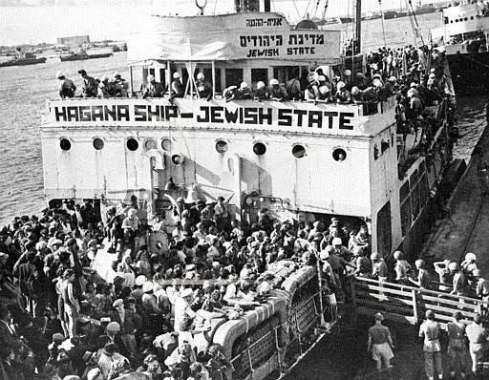
1. Before 1917 Palestine was under the control of the Ottoman Empire.
2. After WWI in 1917, Britain gained control of Palestine.
3. The Zionists requested the British to allow them to move to Palestine and the British agreed.
4. The Palestinians resisted. The Jewish army started a war against the Palestinians, as did the British, who also objected to Jews moving in large numbers.
A Brief History of Palestine

Slide 5
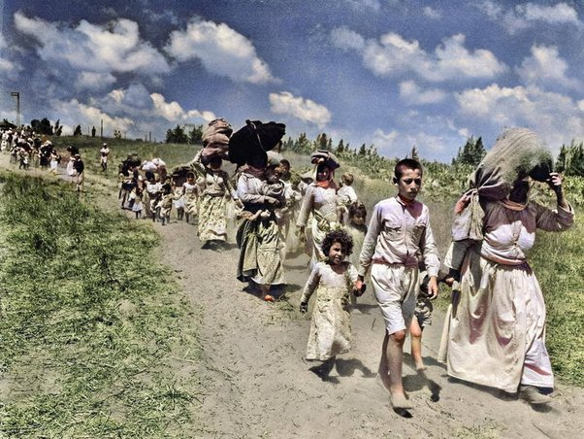
5. In 1948, after WWII, without permission from the Palestinians, Palestine was “given” to the Jewish people.
6. 56% of Palestine was given to the Jews and 44% to the local Palestinians.
7. Jewish militias killed 1000s of Palestinians and destroying over 500 Palestinian villages.
8. 800,000 Palestinians were forcibly evacuated. This is called the Nakba, meaning “catastrophe.”

Slide 6
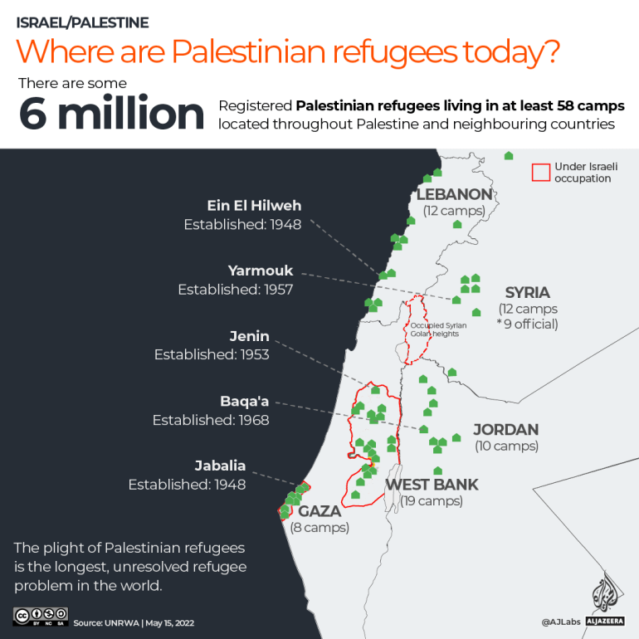

Slide 7
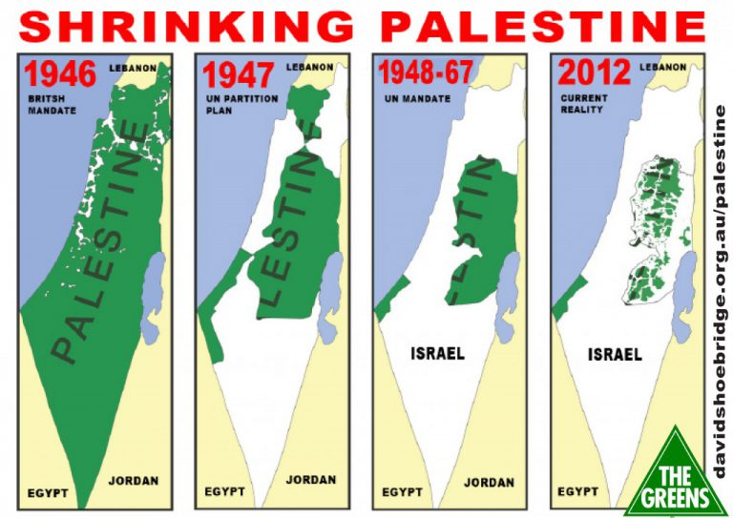

Slide 8

Olives - a truly amazing and blessed fruit!
They are mentioned in the Qur’an seven times.
The Prophet (saw) encouraged the use of olives and its oil.
Olives have great nutritional as well as cosmetic benefits.

Slide 9
How does Allah (swa) talk about olives in the Qur’an?
The olive trees of Al-Aqsa have a particularly high status. These olive trees are so blessed that Allah (swa) actually swears by them in the Qur’an!
وَالتِّيۡنِ وَالزَّيۡتُوۡنِۙ‏ (95:1) By the fig and the olive;
وَطُوۡرِ سِيۡنِيۡنَۙ‏ (95:2) and by the Mount Sinai,
وَهٰذَا الۡبَلَدِ الۡاَمِيۡنِۙ‏ )95:3) and by this city (of Makkah), a haven of peace:

Slide 10
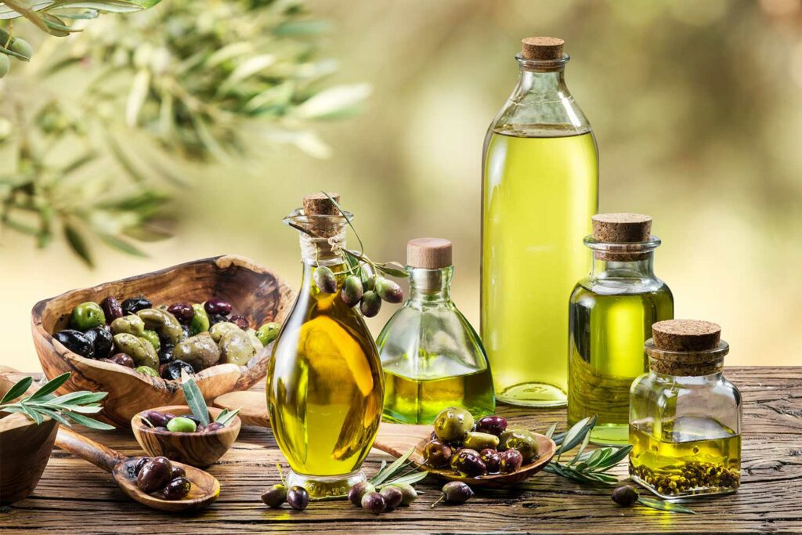
How did the Prophet (saw) use olive oil?
The Prophet (saw) said, ‘Eat the oil (of olives) and use it on your hair and skin, for it comes from a blessed tree’. (Tirmidhi)
The Prophet (saw) is reported to have said:
“Take oil of olive and massage with it – it is a blessed tree.” (Darimi, 69:103).

Slide 11

Palestine’s olive harvest: A timeless tradition

Slide 12

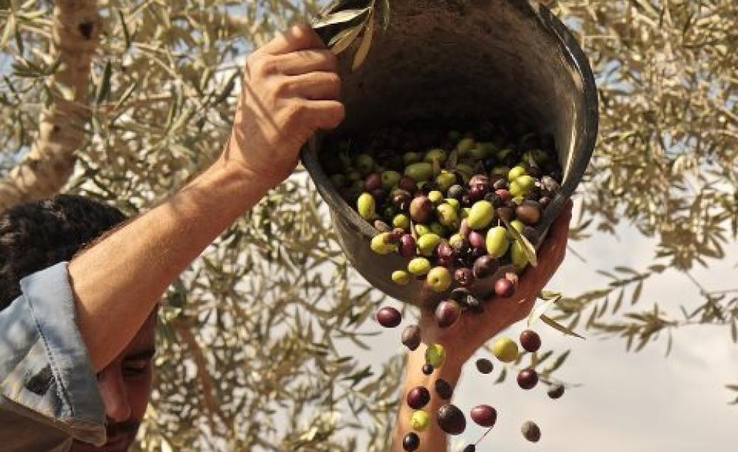
What were some things you learnt from the video?
The importance of olives to Palestinian culture, heritage, and tradition.
Olives as a symbol of resistance and connection.
Obstacles faced because of Israeli occupation and settler violence.
The resulting devastation to the Palestinian economy.
Notes:
What were some things you learned from these videos?
If not mentioned by students, highlight the importance of olives to Palestinian culture, heritage, and tradition; olives as a symbol of resistance and connection; and obstacles faced because of Israeli occupation and settler violence.

Slide 13
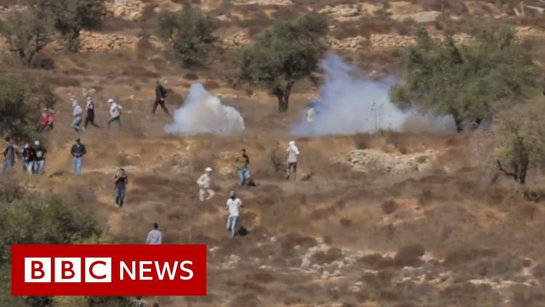
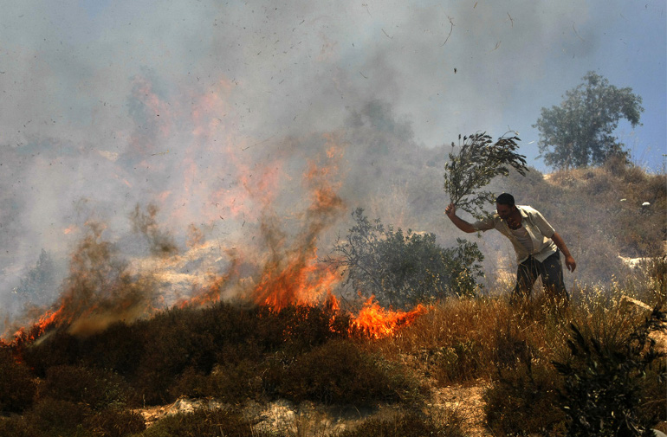
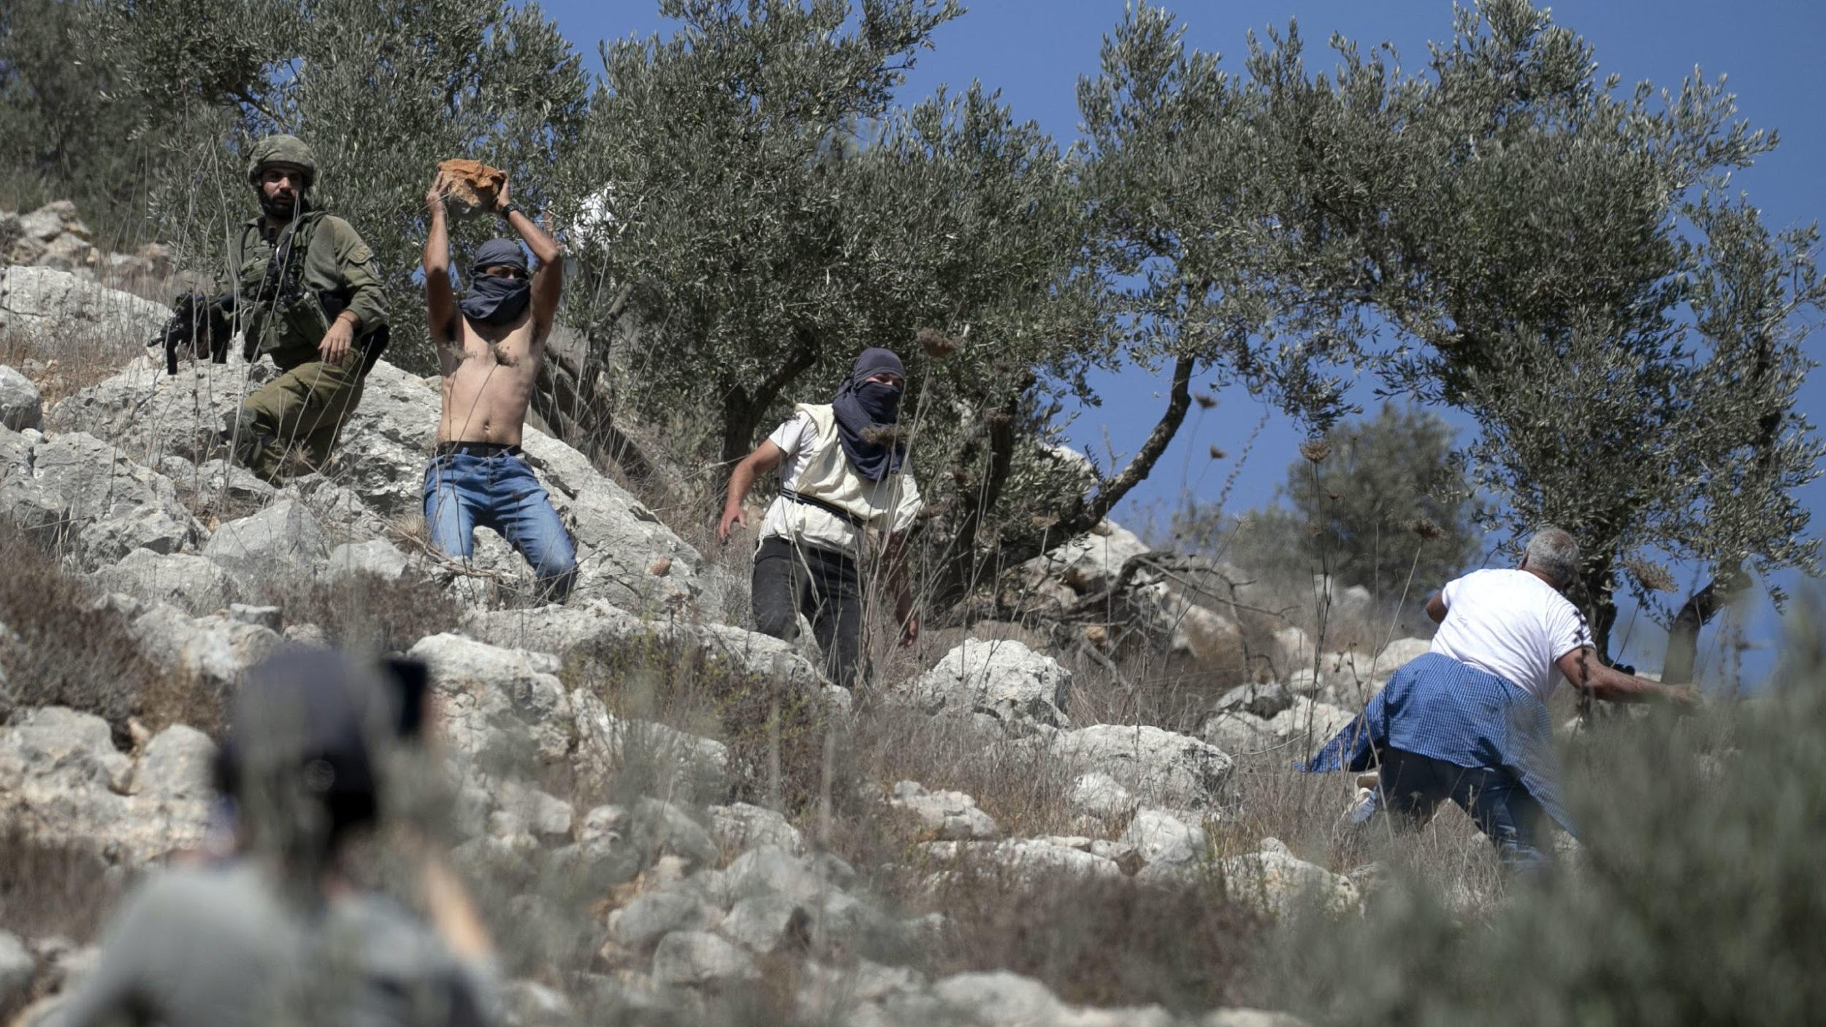
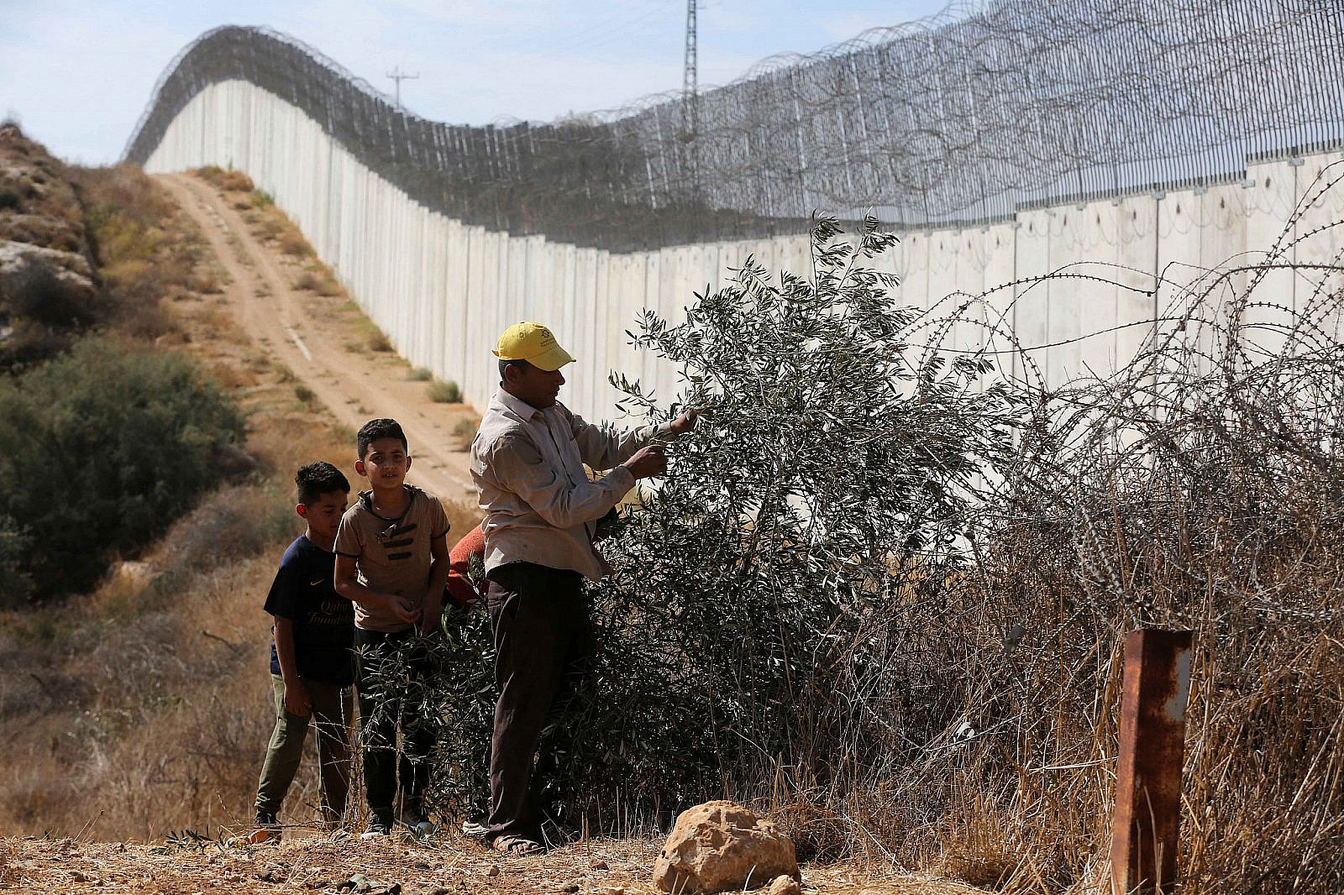

Slide 14
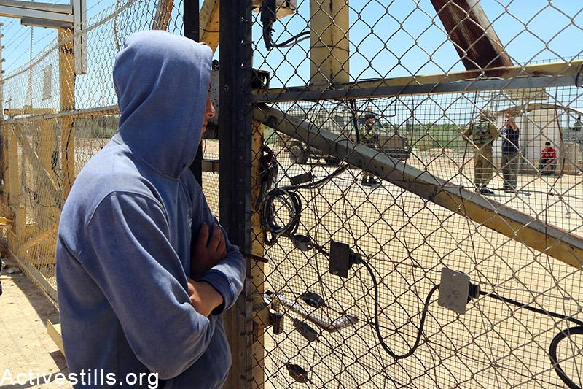
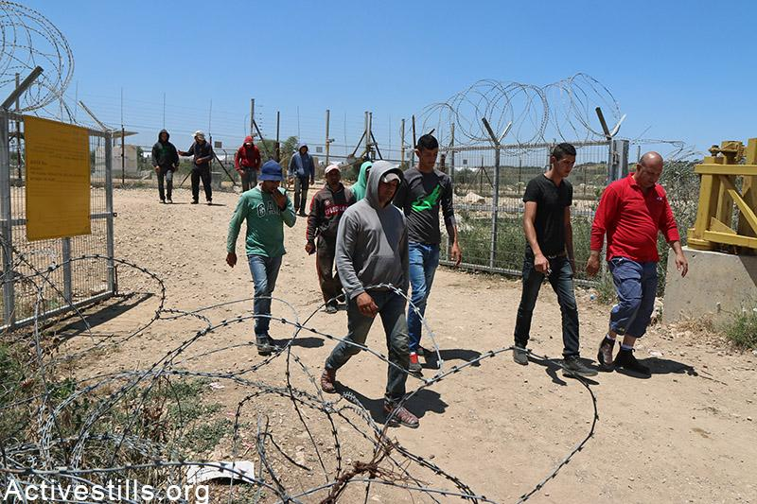
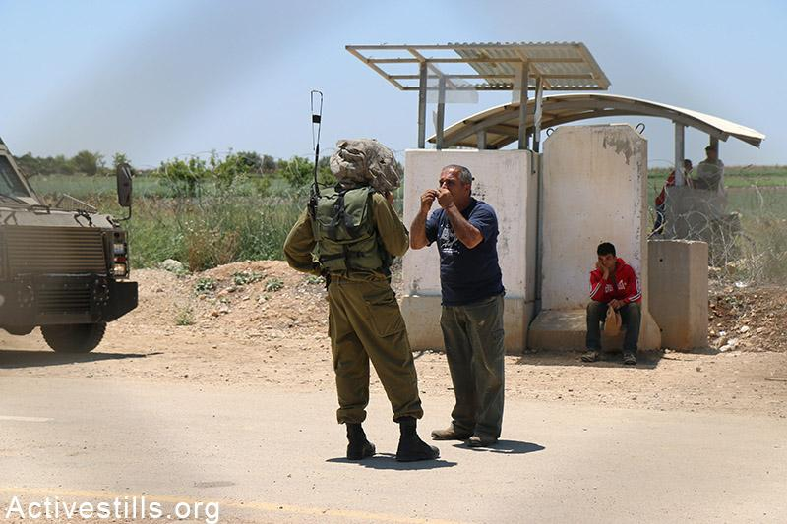
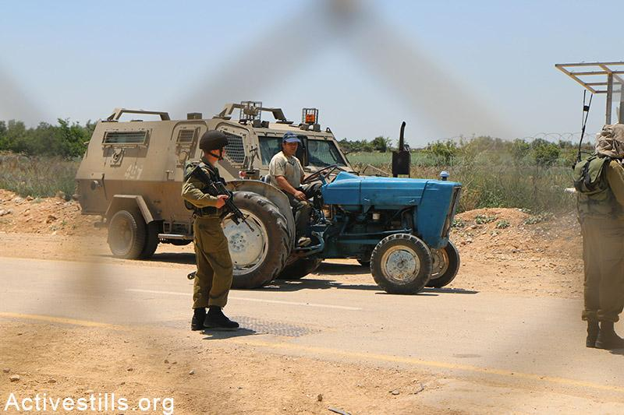

Slide 15
WHAT IS SUMUD?
Sumud (صمود ṣumūd) means “steadfastness” and refers generally to the resistance of Palestinians to the takeover and settlement of Palestinian land by the Israeli occupation.
The olive tree is a symbol of Sumud, of the Palestinians holding onto the land like a deeply rooted olive tree and preserving their identity.

Slide 16
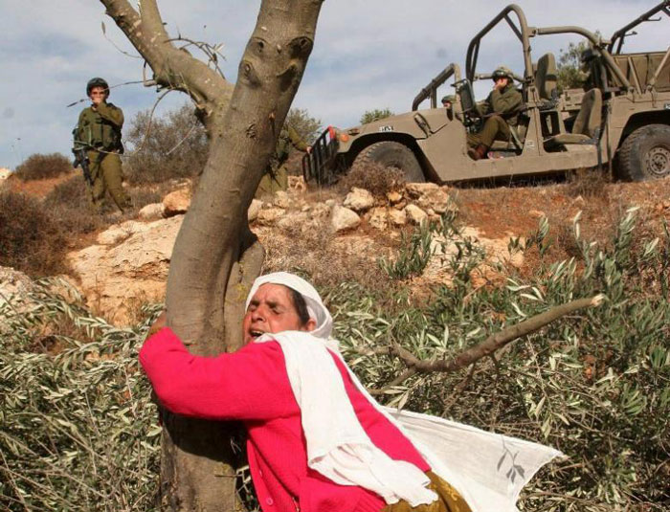
Who is this woman and what is she doing?

Slide 17
This is an iconic picture that has become a primary symbol and sign of Sumud.
It shows an elderly Palestinian woman in the village of Salem (in the occupied West Bank) who cries as she hugs an olive tree after settlers cut down the olive trees near Nablus in 2005.

Slide 18
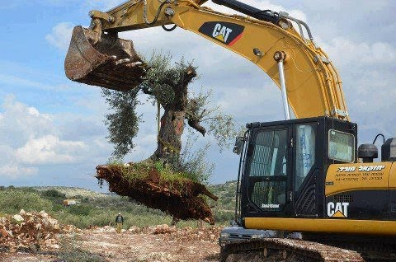
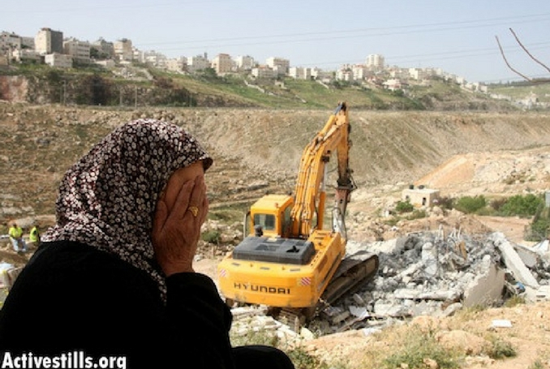
DESCRIPTION OF SUMUD
When the occupation uproots our olive trees, we plant many others;
when they demolish our homes, we reconstruct new ones;
when they close our schools, we create makeshift schools;
when they obscure our history, we engage in witnessing, remembering, and documenting.

Slide 19
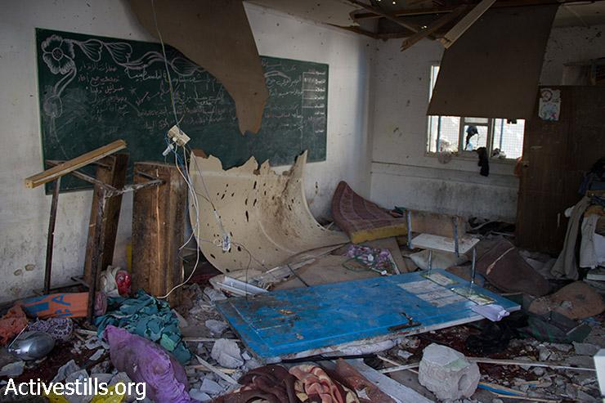
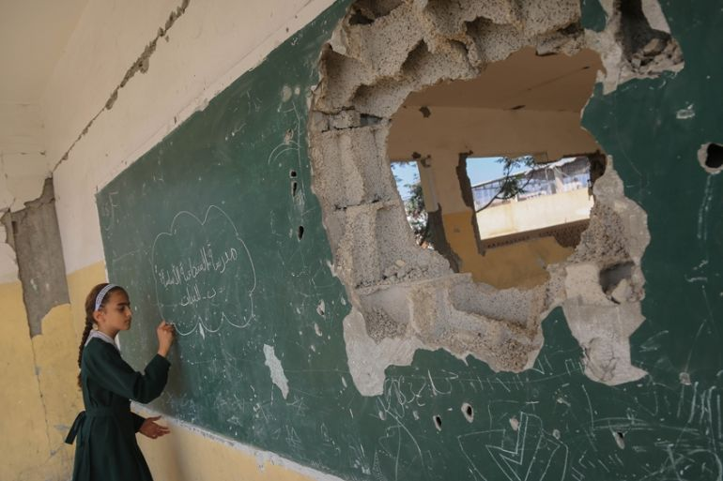
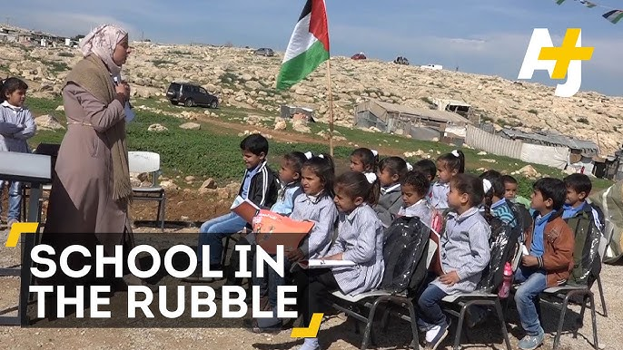
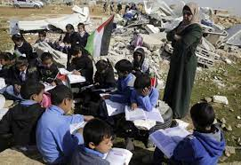

Slide 20
ARE THERE ANY QUESTIONS

