Slide 1


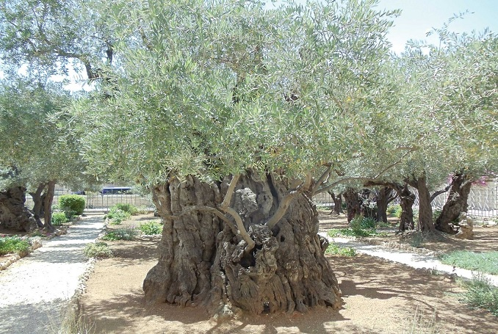
The Olive Trees of Palestine

Slide 2

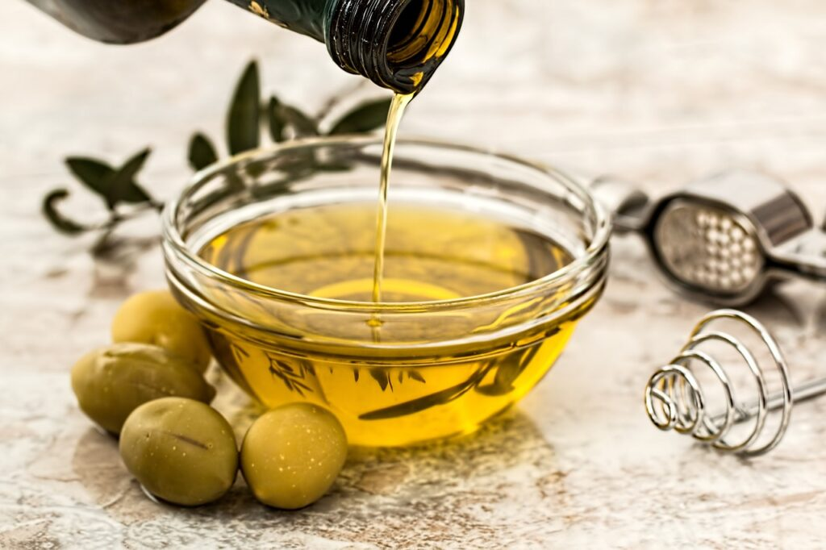
Olive trees are a symbol of Palestinian identity and heritage.
Palestinian olive oil is rich in flavour and regarded as some of the world's best olive oil.

Slide 3
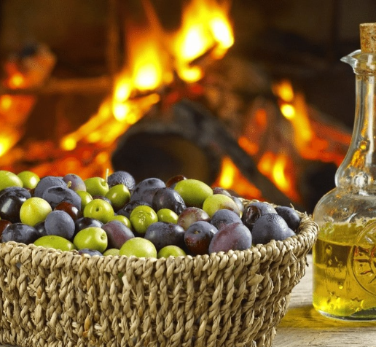
In this lesson we will look at:
the different parts of an olive tree and its uses,
the harvesting of the olives and the factories pressing it into oil, and
the challenges faced by the farmers by the destruction of the trees and the theft of the olives and their farms by the occupiers and settlers.

Slide 4
Palestinian song on olives
https://drive.google.com/file/d/1y1B1Kgnx3LIn4PyANt5ci4CIEJMC9nBe/view?usp=sharing

Slide 5

Reflect and Respond
1. What does the opening of the video depict?
2. Who is the young girl and what is she doing?
3. What are the buildings depicted in the beginning?
4. What is the grandmother showing her granddaughter in the video?
5. What is the significance of the key that the grandmother hands over to her granddaughter?
Notes:
Answer: the Nakba
Answer: She is the grandmother in the video, escaping from the occupying soldiers as a young girl.
Answer: A beautiful Palestinian village before it was destroyed.
Answer: The grandmother is reminiscing about her childhood days, playing freely in the beautiful village.
Answer: The grandmother has kept the key to the family house that was taken from them in 1948, and she has held on to the key in the hope of returning to the house. But alas, in her twilight years, the hope of returning is fading, and it is her wish and desire that her granddaughter will one day return to their village in occupied Palestine.

Slide 6
• Raise your hands if you have tried olive oil.
• What kind of foods do you usually add olive oil to or what can you do with olive oil?
• Today’s lesson is about a very special symbol of the Palestinian culture and identity, the olive tree.
• Remember that Palestine has been under occupation since 1948. Palestinian elders and their children and grandchildren have been prohibited from returning to their homeland because of the occupation. Despite that, Palestinians across the world are still resisting the occupation so that they can claim their right to return to their land, Palestine.
Notes:
What kind of foods do you usually add olive oil to or what can you do with olive oil? (possible answers: for cooking, or adding to pizza, salad, pasta,..).
What kind of foods do you usually add olive oil to or what can you do with olive oil? (possible answers: for cooking, or adding to pizza, salad, pasta,..).
What kind of foods do you usually add olive oil to or what can you do with olive oil? (possible answers: for cooking, or adding to pizza, salad, pasta,..).

Slide 7
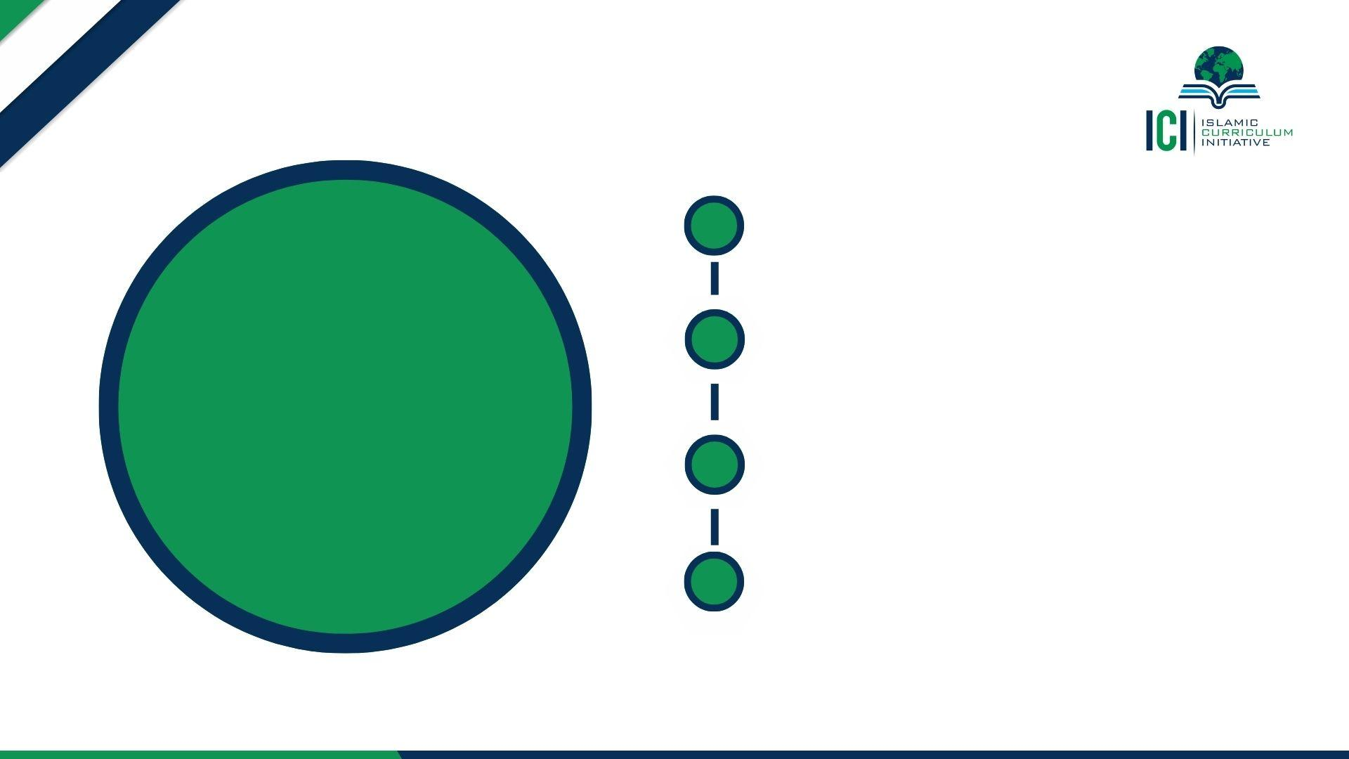
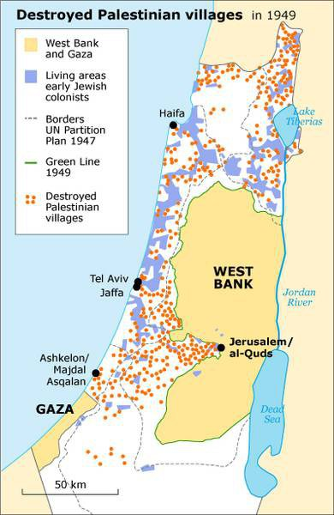
1. Before 1917 Palestine was under the control of the Ottoman Empire.
2. After WWI in 1917, Britain gained control of Palestine.
3. The Jews were expelled from many countries over the centuries and roamed the world without a homeland.
4. The Zionist Movement was formed in 1897 with the main purpose of finding a homeland.
A Brief History of Palestine

Slide 8
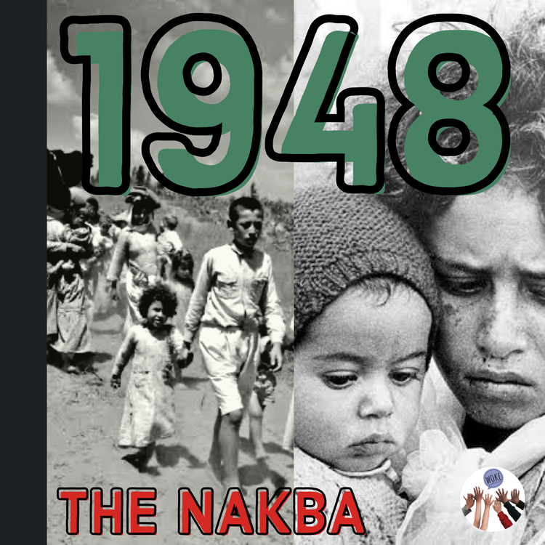
5. Their preferred choice was Palestine because they believe that is where they originally resided.
6. The Zionists requested the British to allow them to move to Palestine and through the Balfour Declaration, the British agreed.
7. When more Jews began moving to Palestine, the Palestinians objected.
8. The Jewish militia (army) began killing Palestinians, as well as the British who also objected to Jews moving in large numbers.

Slide 9
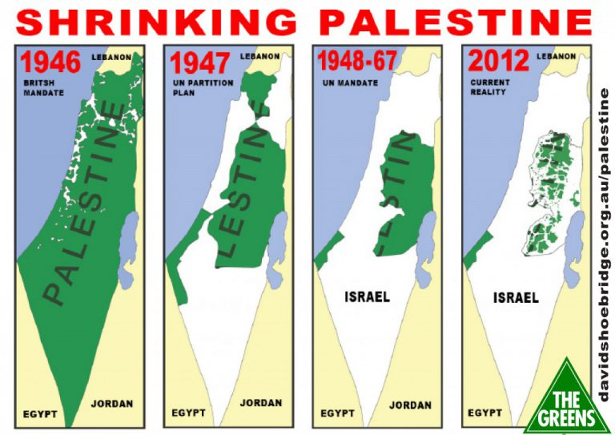
9. In 1948, after WWII, without permission from the Palestinians, Palestine was “given” to the Jewish people.
10. 56% of Palestine was given to the Jews and 44% to the local Palestinians.
11. Jewish militias killed 1000s of Palestinians and destroying over 500 Palestinian villages.
12. 800,000 Palestinians were forcibly evacuated. This is called the Nakba, meaning “catastrophe.”

Slide 10
Olives - a truly amazing and blessed fruit!
They are mentioned in the Qur’an seven times.
The Prophet (saw) encouraged the use of olives and its oil.
Olives have great nutritional as well as cosmetic benefits.

Slide 11
How does Allah (swa) talk about olives in the Qur’an?
Firstly, Allah (swa) draws our attention to how much variety we have in our diet and He tells us to eat of His provision. (Qur’an, 6:141 & 23:20 )
Secondly, Allah (swa) tells us that we should reflect on them as well! (Qur’an, 16:11 & 6:99)
Thirdly, Allah (swa) uses olives as a way to describe His Light in the Qur’an. (Surah Nur: 35). Subhan Allah, Allah (swa) literally uses the example of olive oil as a way of illustrating His own Light – what an honour!
Finally, the olive trees of Al-Aqsa have a particularly high status. These olive trees are so blessed that Allah (swa) actually swears by them in the Qur’an! (Surah At-Tin, 95:1-4)
“By the fig and the olive, and by Mount Sinai, and by this secure city [Makkah], We have certainly created man in the most excellent of forms…”

Slide 12
How did the Prophet (saw) use olive oil?
The Prophet (saw) said, ‘Eat the oil (of olives) and use it on your hair and skin, for it comes from a blessed tree’. (Tirmidhi)
Health benefits of olives have been propounded in Prophetic medicine. The Prophet (saw) is reported to have said:
“Take oil of olive and massage with it – it is a blessed tree.” (Darimi, 69:103).

Slide 13
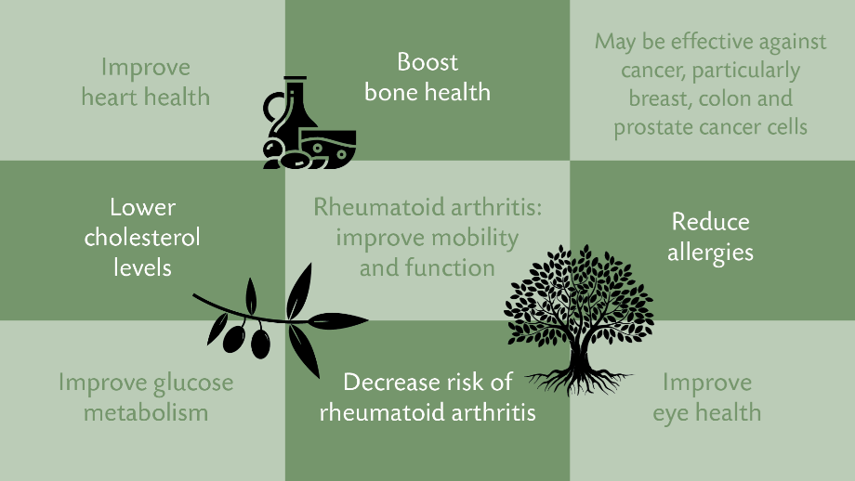
Health benefits of olives and olive oil
(Source - https://muslimhands.org.uk › latest › 2020/03 › benefits-...)

Slide 14
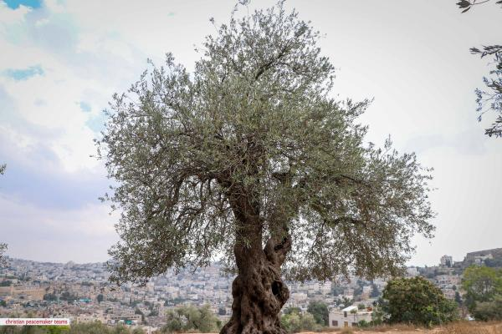
The olive trees of Palestine
Palestine has some of the world’s oldest olive trees.
Some olive trees are hundreds, even thousands of years old.
In Palestine there are about 10 million olive trees.
Many families have olive trees that are passed down from generation to generation.

Slide 15
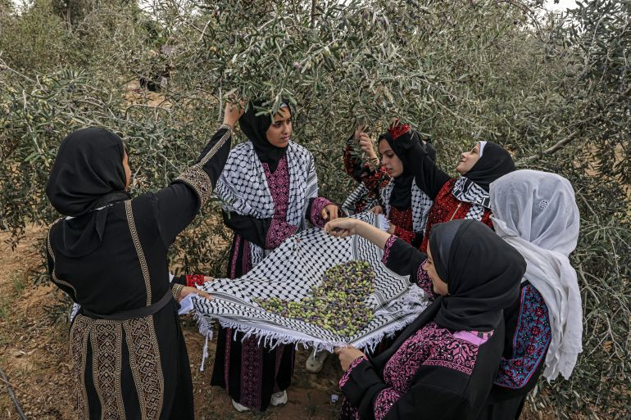
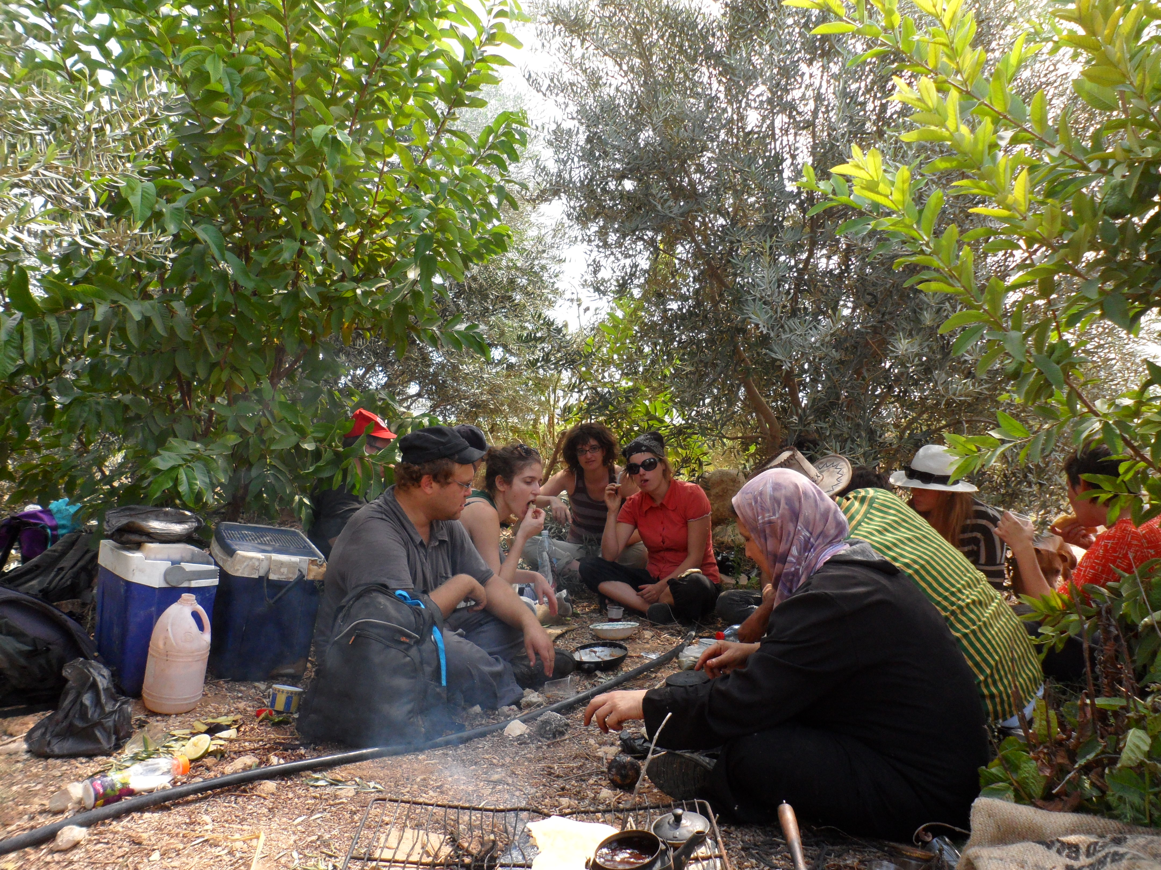
Palestinians take great care of their olive trees and work hard to harvest the olives.
In October each year families come together and take part in the olive harvest.
The harvest is about gathering as a family and enjoying the results of hard work.
Families often take a break from harvesting and have a picnic under their trees sharing food and drinking tea.

Slide 16
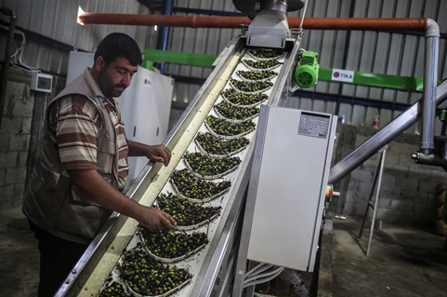
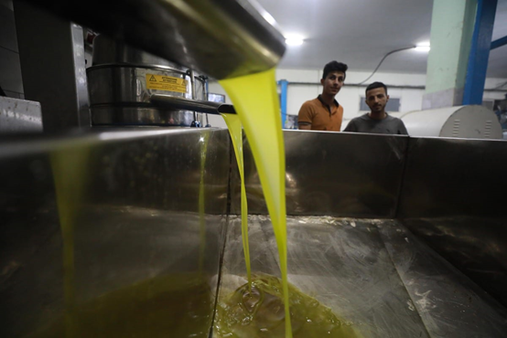
After picking the olives families take their harvest to a local mill.
Here machines will sift, wash, and press the olives until they turn into oil.
For Palestinians the olive tree symbolises a connection to their land.
It also holds a special place in their hearts.

Slide 17
Palestine’s olive harvest: A timeless tradition
https://drive.google.com/file/d/179qiJoONovay4YSXjXf5l7vvVcxuyrj-/view?usp=sharing

Slide 18

Olive oil is liquid gold
Lifeline of the economy
In Palestine, olive oil is extremely financially valuable.
Almost half of all cultivated land across the occupied West Bank and Gaza is planted with an estimated 12 million olive trees.
The olive oil industry supports the livelihoods of more than 100,000 Palestinian families including more than 15 percent of working women.

Slide 19
Palestinian olive farmers hope to harvest in peace
https://drive.google.com/file/d/1neU71Yf98mZOj3lSjH1rjb-PhXYbanzV/view?usp=sharing

Slide 20

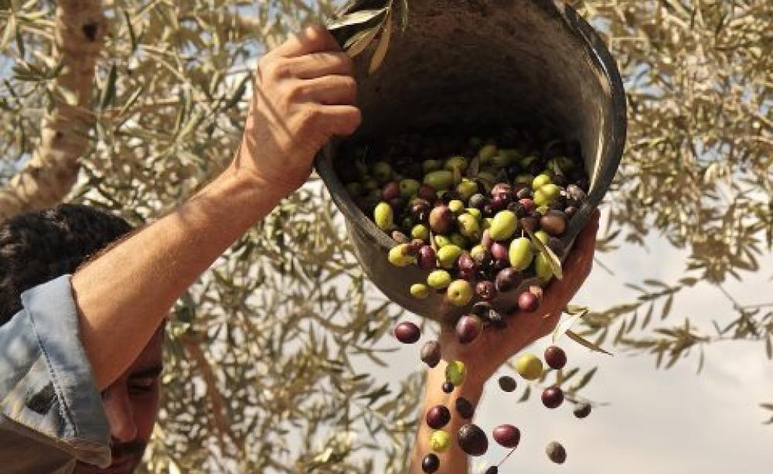
What were some things you learnt from these videos?
The importance of olives to Palestinian culture, heritage, and tradition.
Olives as a symbol of resistance and connection.
Obstacles faced because of Israeli occupation and settler violence.
The resulting devastation to the Palestinian economy.
Notes:
What were some things you learned from these videos?
If not mentioned by students, highlight the importance of olives to Palestinian culture, heritage, and tradition; olives as a symbol of resistance and connection; and obstacles faced because of Israeli occupation and settler violence.

Slide 21
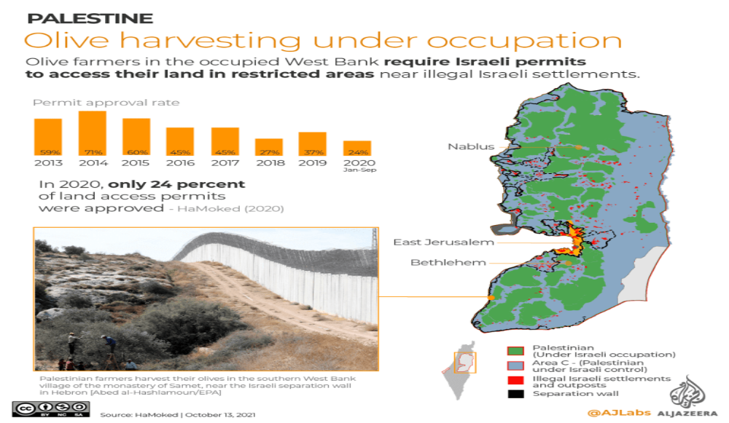

Slide 22
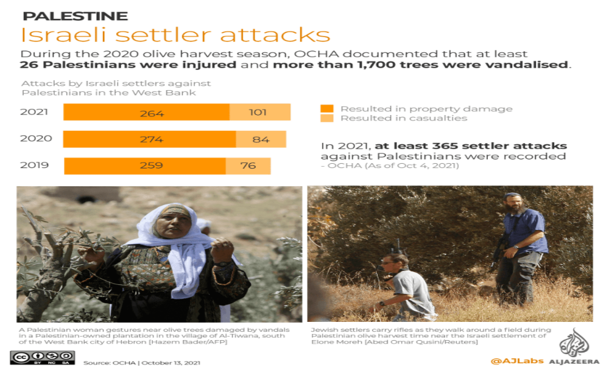

Slide 23
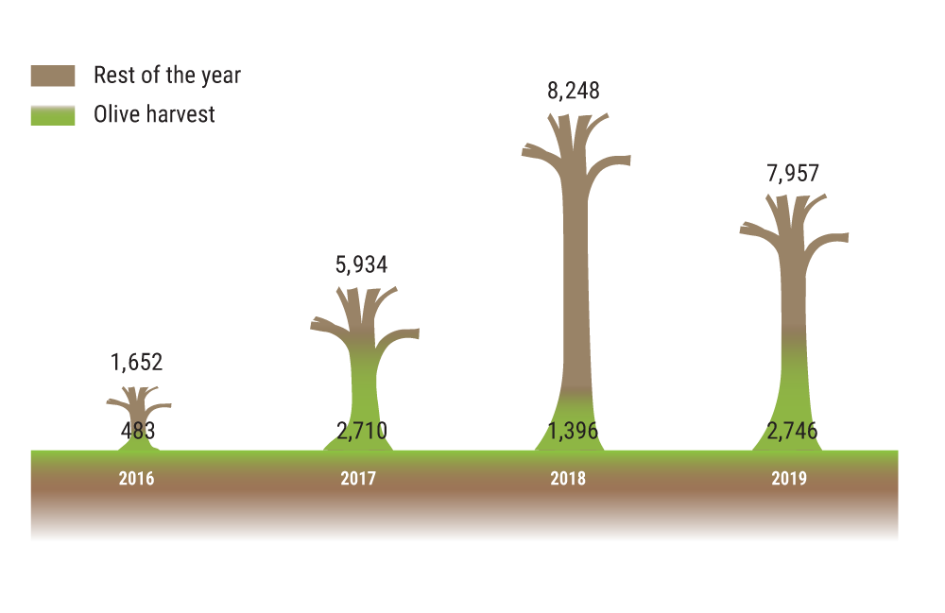
Trees vandalized by Israeli settlers

Slide 24
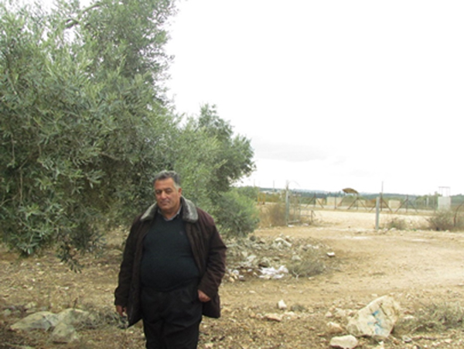
The Story of Palestinian Farmer Tayseer Amarneh
Tayseer Amarneh owns land in the Akkaba village of northern West Bank where he has 700 olive trees and he also grows tobacco.

Slide 25
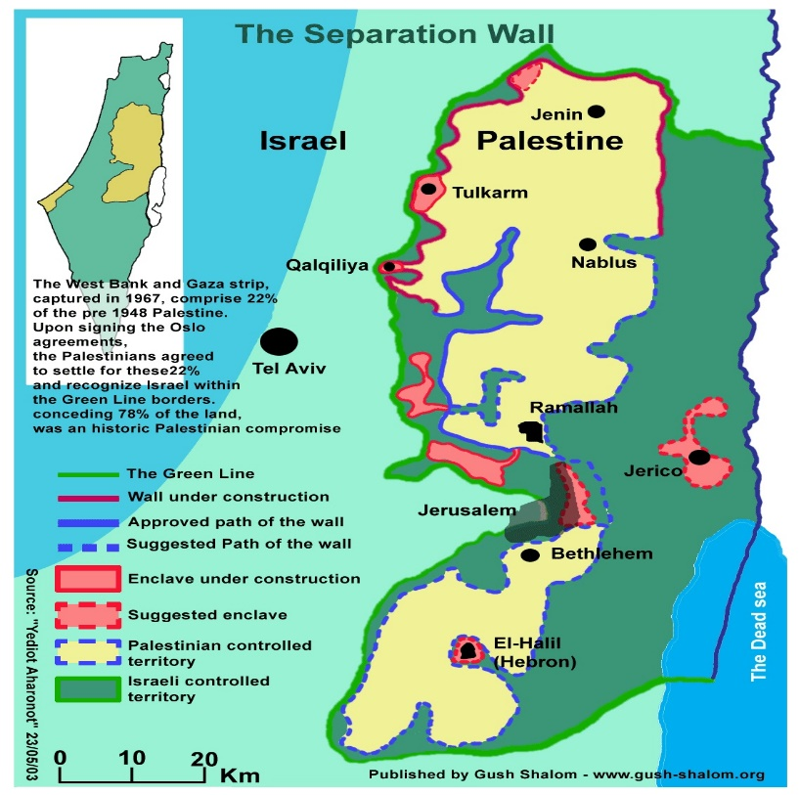
The majority of Tayseer’s land is located is in the closed area between the Barrier and the Green Line.
To access this land, farmers like Tayseer must obtain a special permit from the Israeli authorities, a requirement which also applies to family members and agricultural workers.
Given the labour-intensive nature of the olive harvest, Tayseer always applies for additional permits for family members.

Slide 26
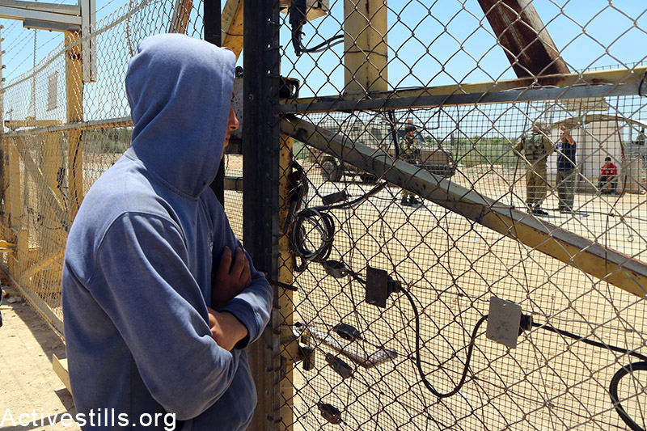
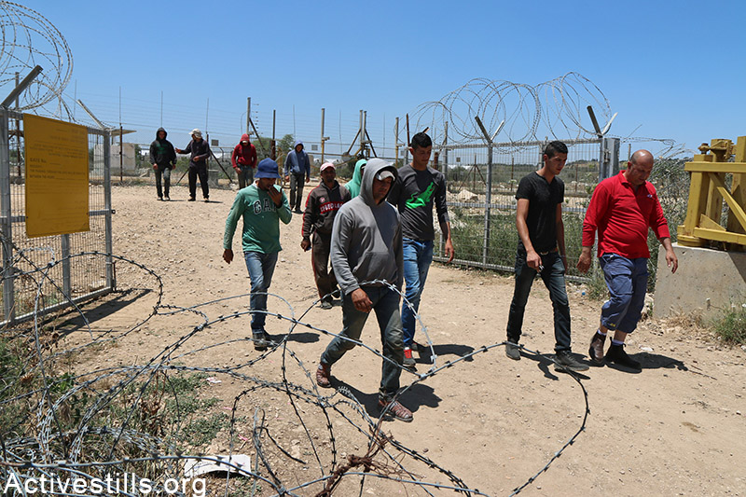
If permits are granted, land in the closed area can only be accessed through designated Barrier gates or checkpoints, that are controlled by Israeli soldiers, and only open according to a certain schedule.
Most of these are only open during the olive harvest period and only for a limited amount of time on those days, prohibiting year-round access.
During the 2019 olive harvest, 74 gates and five checkpoints were designated for agricultural access, of which only 11 open daily, ten open for some day(s) of the week and during the olive season; and the majority, 53, only open during the olive season.

Slide 27
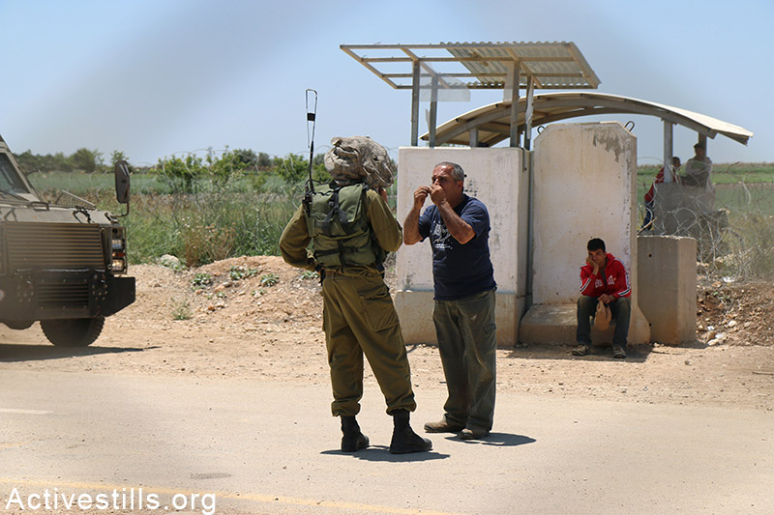
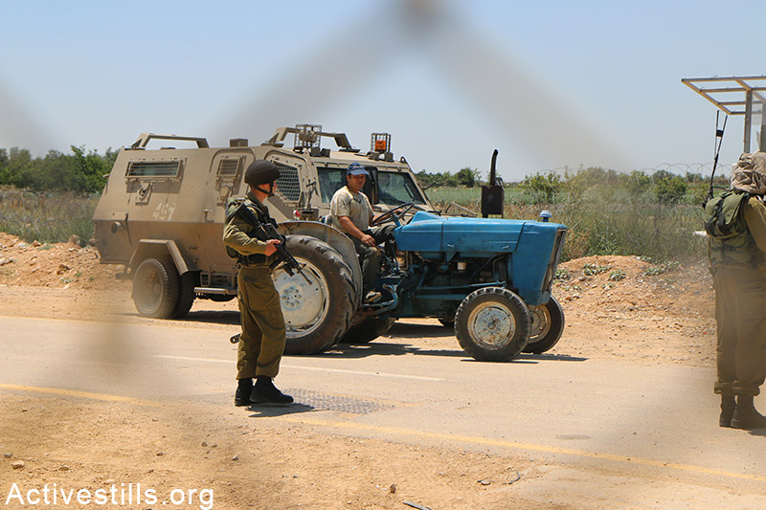
Fewer Barrier permits approved in Akkaba; gate opening delayed.
Significant decline in the allocation of Barrier permits. In 2018, the approval rate for permits for landowners fell from 76 per cent of applications in 2014 to 28 per cent.
In the northern West Bank (Jenin, Tulkarm, Qalqiliya and Salfit governorates) the approval rate for permit applications overall for 2019 was 56 per cent, with about 10,000 applicants approved and 8,000 rejected.
Farmer arguing with soldier
Farming under constant threat and fear

Slide 28
According to Tayseer, in 2019 he only obtained 90 permits, and most of these were only valid for 3 months.
“My nine family members usually get permits, but this year (2020) we only received three. I have a two-year permit, but it expires in January. My wife has a one year-permit, which also expired recently. Only one of my sons got a permit, but that was as an agricultural worker and only for a period of three months, which has also expired. Otherwise, I received no permits this year for agricultural workers.”
“My revenue from tobacco has decreased from NIS 120,000 (R 600 000) in 2015 to only NIS 11,000 (R 55 000) in 2019.”
“I used to plant 35 dunums of tobacco when I managed to get permits for all my family members, in addition to five workers. However, as the permits granted have been going down each year since 2015, I’ve been planting fewer dunums, and only three dunums in 2019, because I couldn’t get a permit for any worker this year.”

Slide 29
REFLECT AND RESPOND
What are some of the challenges faced by farmers like Tayseer?
_________________________________________________________
2. How are these challenges affecting the Palestinian economy?
_________________________________________________________
3. What solution can you provide for overcoming these challenges?
_________________________________________________________

Slide 30
WHAT IS SUMUD?
Sumud (صمود ṣumūd) is an oft-used word in Palestinian Arabic meaning “steadfastness” and refers generally to the resistance of Palestinians to the takeover and settlement of Palestinian land by the Israeli occupiers.
It emerged among the Palestinian people in the wake the 1967 Six-Day War as a consequence of their oppression and the resistance it inspired.
Sumud forms the basis of a lifestyle of endurance, holding onto the land like a deeply rooted olive tree, preserving one’s identity, pursuing autonomy and agency, preserving the Palestinian narrative and its culture in the face of elimination.

Slide 31
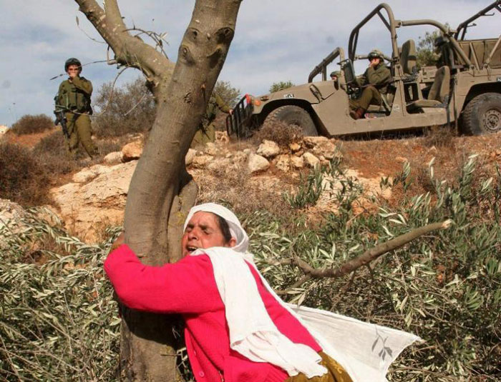
Who is this woman and what is she doing?

Slide 32
This is an iconic picture that has become a primary symbol and sign of Sumud.
It shows an elderly Palestinian woman in the village of Salem (in the occupied West Bank) who cries as she hugs an olive tree after settlers cut down the olive trees near Nablus in 2005.
[Photo by Abed Alrahim Qusini, from an exhibit at @UN]

Slide 33
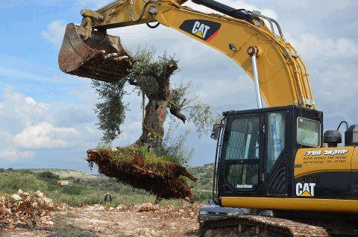
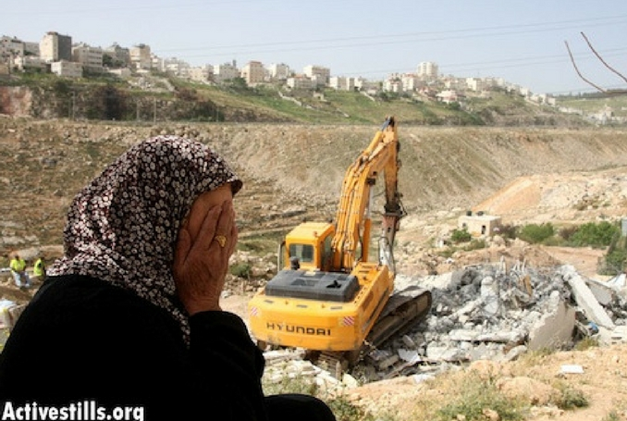
DESCRIPTION OF SUMUD
When the occupation uproots our olive trees, we plant many others;
when they demolish our homes, we reconstruct new ones;
when they close our schools, we create makeshift schools;
when they obscure our history, we engage in witnessing, remembering, and documenting.

Slide 34
1. Existence is resistance – e.g. through the blockade of Gaza
2. Remaining on their land
3. Occupiers destroy and Palestinians rebuild
4. Enduring imprisonment and torture
EXAMPLES OF
SUMUD

Slide 35
Dr Mads Gilbert, the Norwegian doctor who worked in Gaza, talks about the Palestinians’ beautiful quality of Sumud.
https://drive.google.com/file/d/1wS2LbgusN5NU3zVMKyB4troDxVLdrY7d/view?usp=sharing

Slide 36
ARE THERE ANY QUESTIONS

