Slide 1
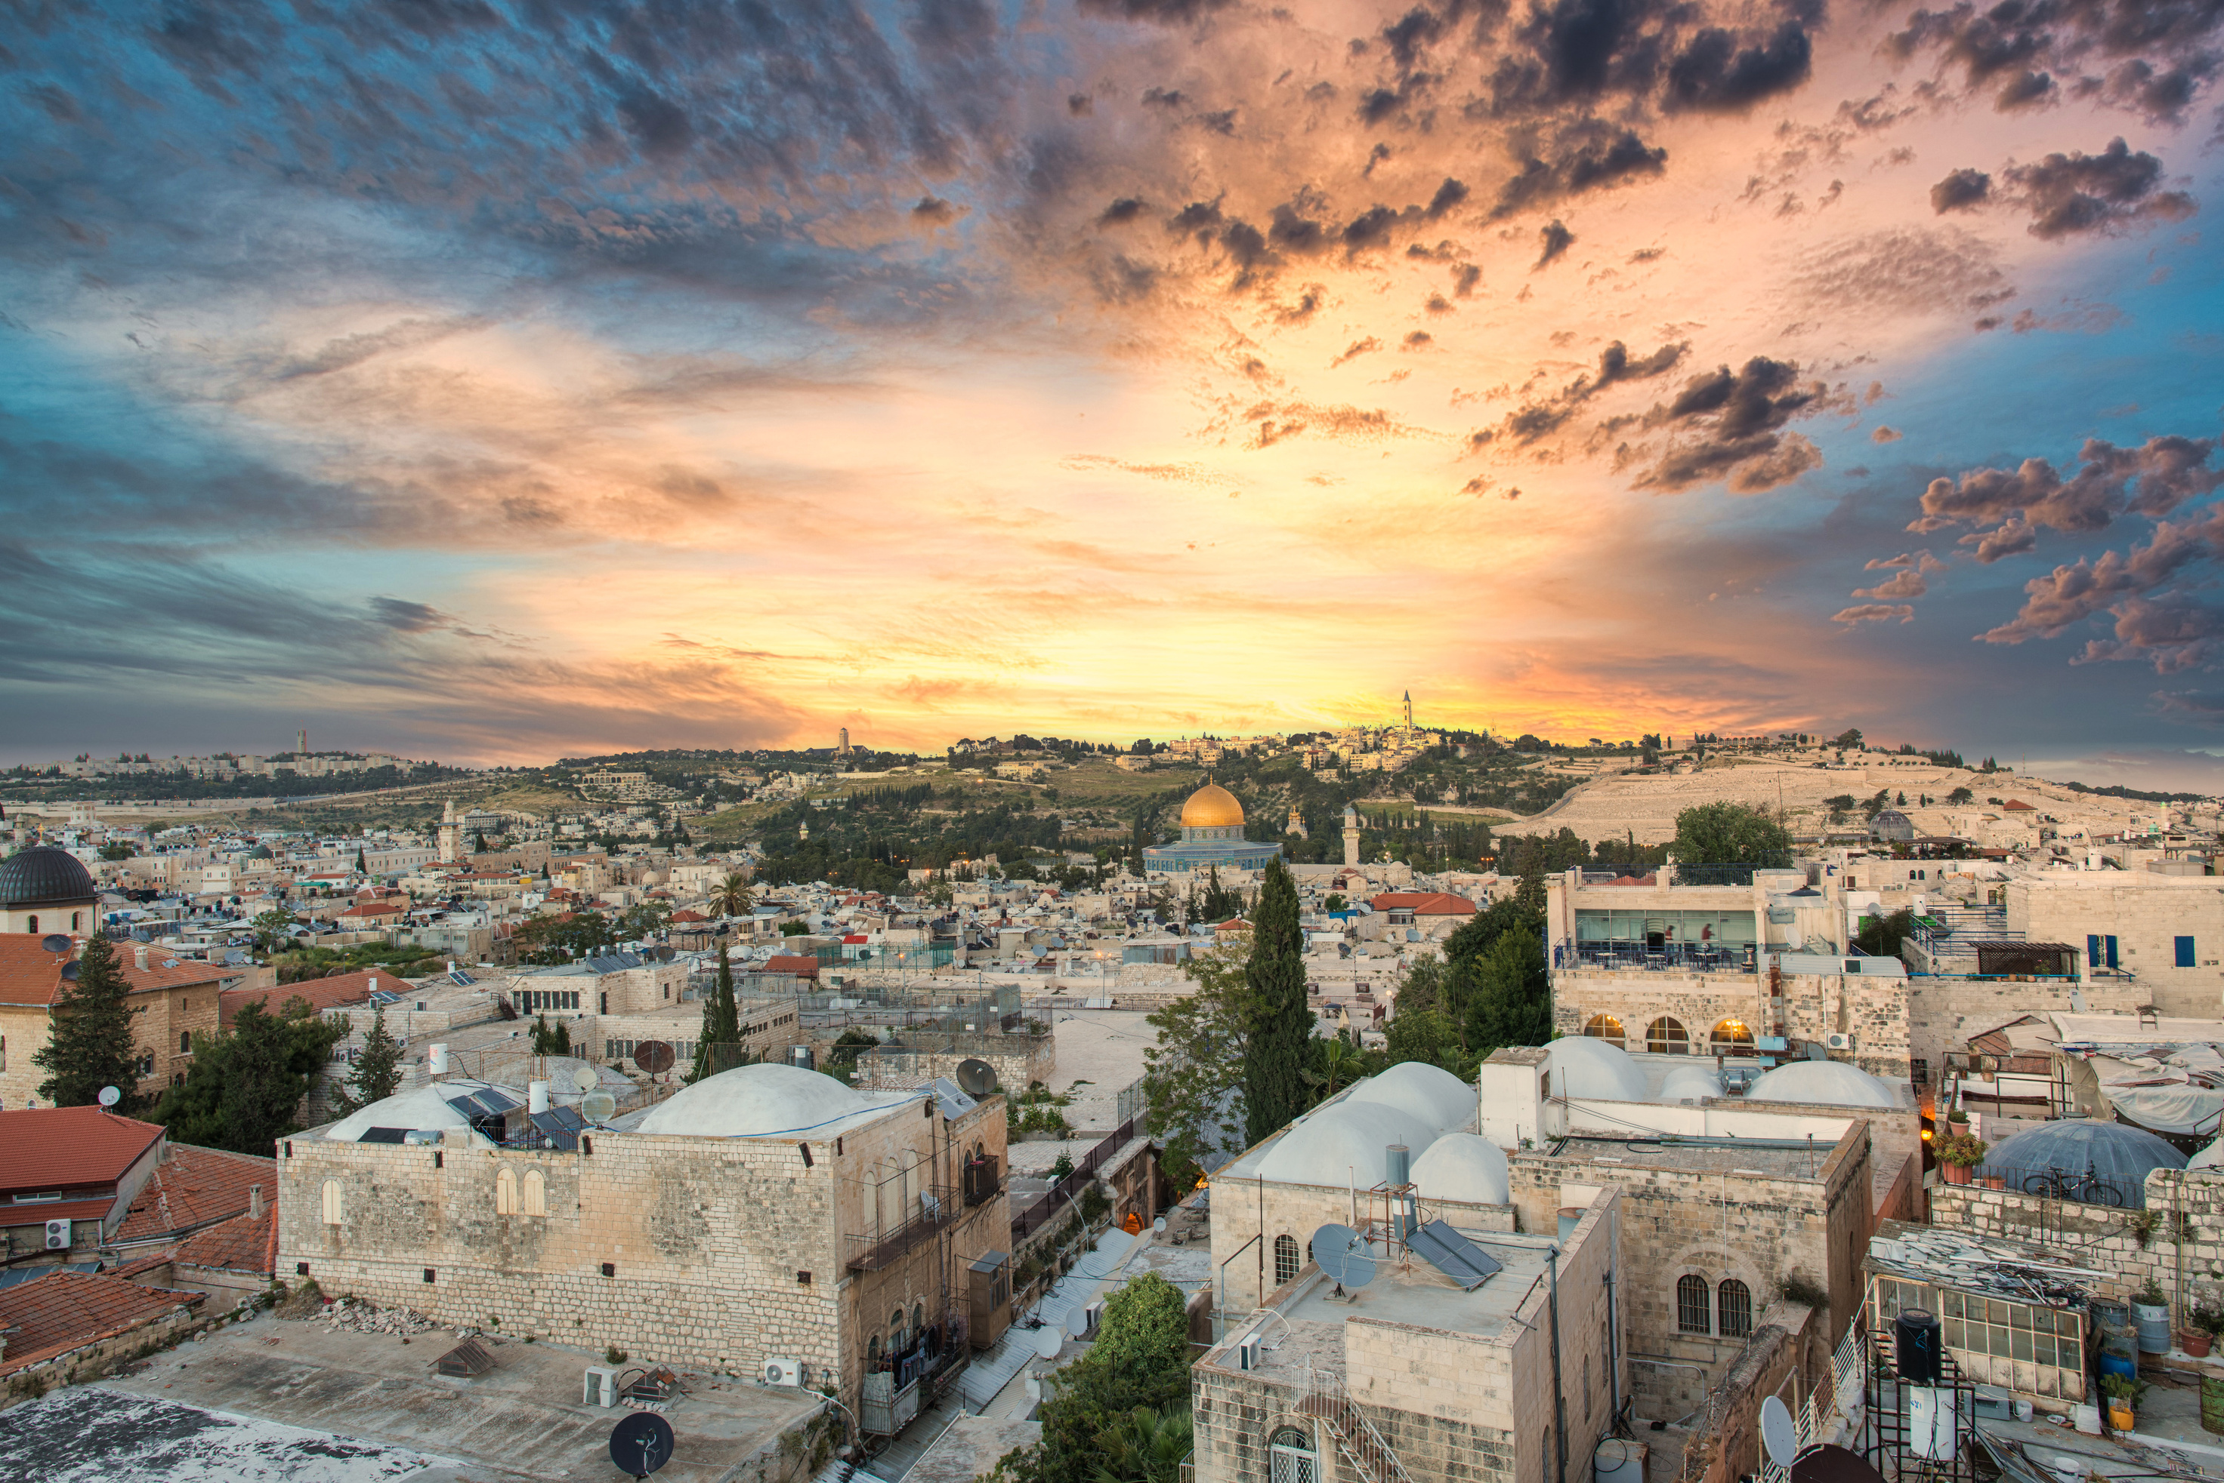
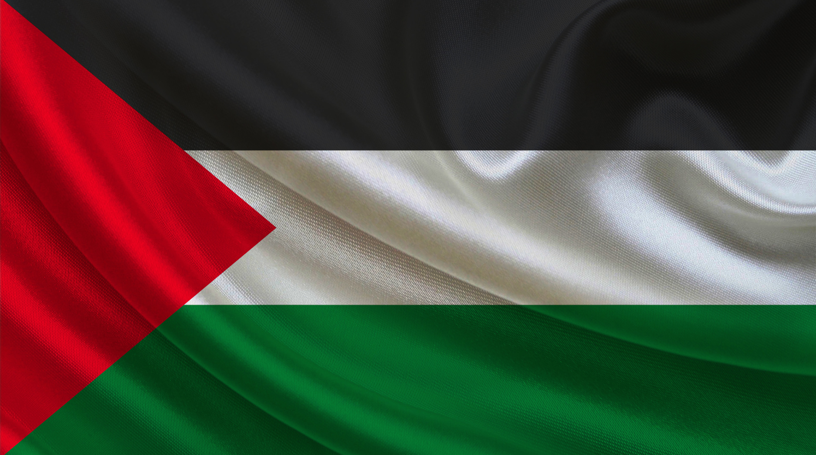

THE NAKBA
The Catastrophe
1948

Slide 2
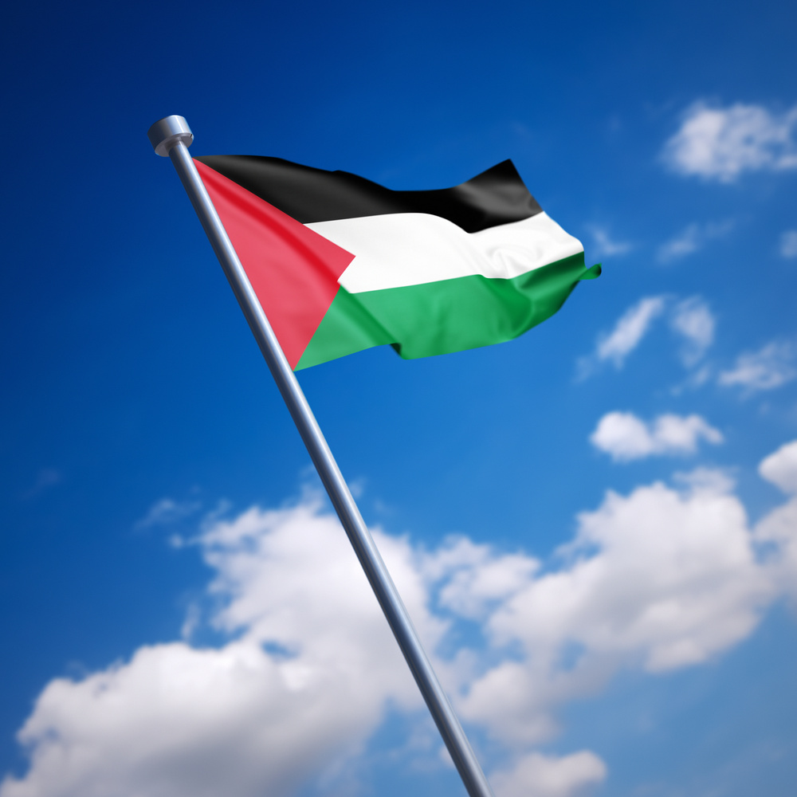

Note and
DISCLAIMER
This presentation is not an exhaustive or comprehensive document. Its purpose is to provide an overview, highlighting that the Nakba did not begin in 1948 and has not ended; it is an ideology that originated long ago and persists to this day.
Teachers should check the material thoroughly to ensure that it is appropriate for their pupils.
Teachers are also encouraged to do independent research and provide context for the material being presented.
Notes:
Note to teachers: The PowerPoint is divided into three sections. Its purpose is to inform and assist teachers in educating students about the Nakba and the ongoing genocide in Gaza. Teachers can use this presentation as a resource to deepen their own understanding and to create educational materials for their students.

Slide 3
Learning
OBJECTIVES
  Define "Nakba" and assess its historical impact on Palestinian society.
  Assess the political, social, and economic factors leading to the Nakba.
  Examine the immediate and long-term effects of the Nakba on Palestinians.
  Recognize that Israel's creation in 1948 did not occur in isolation but was the result of many decades of historical events and developments.
  Explore the origins of Zionism, key figures, and events leading to Israel's creation in 1948.
  Evaluate Sultan Abdulhamid II’s response to the early Zionist movement.
  Examine Theodor Herzl’s role in establishing Zionism.
  Investigate the British role in colonizing Palestine and its impact.
  Discuss the influence of international actors in Israel's territorial expansion.
  Trace the emergence and development of key Palestinian political groups.
  Define "settler" in the context of Israeli settlements and its implications.
  Identify the key events and factors leading to the current Gaza conflict (2023-2024).
Notes:
Note to teachers: The PowerPoint is divided into three sections. Its purpose is to inform and assist teachers in educating students about the Nakba and the ongoing genocide in Gaza. Teachers can use this presentation as a resource to deepen their own understanding and to create educational materials for their students.

Slide 4
What is
the Nakba?
  1.5 million Palestinians live in refugee camps in Palestine.
  Socio-economic conditions are very poor.
  The camps are overcrowded with very limited access to health care, education and employment opportunities.
  Palestinians are restricted in their movements.
  Palestinians have an international right to return to their homes.
  Many Palestinians left their homes expecting to be temporarily displaced. Today, many still hold the keys to their homes as a symbol of their hope to return.
  Nakba, "the catastrophe", is the killing and expulsion of Palestinians from their homes and the confiscation of the land and businesses of the indigenous population.
  Around 80% of Palestinians (Estimated at between 750,000 and one million), were forced out their homes in the years leading up to 1948, fleeing the attack by Jewish militia to set up a Jewish state under the name of Israel.
  The term Nakba also refers to the period of war itself and events affecting Palestinians from December 1947 to January 1949.
  This created the world’s longest lasting refugee crisis with camps in the West Bank, Gaza Strip, Lebanon, Jordan and Syria for displaced Palestinians.
Notes:
For more information watch this documentary: https://www.youtube.com/watch?v=H7FML0wzJ6A&t=### Teacher's Note:
Definition of the Nakba:
- Displacement
- Trauma
- Deaths
- Flight from homes
- Families torn apart
- Deep-rooted love for homeland
- Right to return
Contrast with the Recent Real-Time Genocide:
Life in refugee camps is characterized by prolonged displacement and the absence of a permanent home. For many Palestinians, multiple generations have grown up in these camps, with no experience of life outside their confines.

Slide 5
SECTION 1
Palestine Before 1948

Slide 6
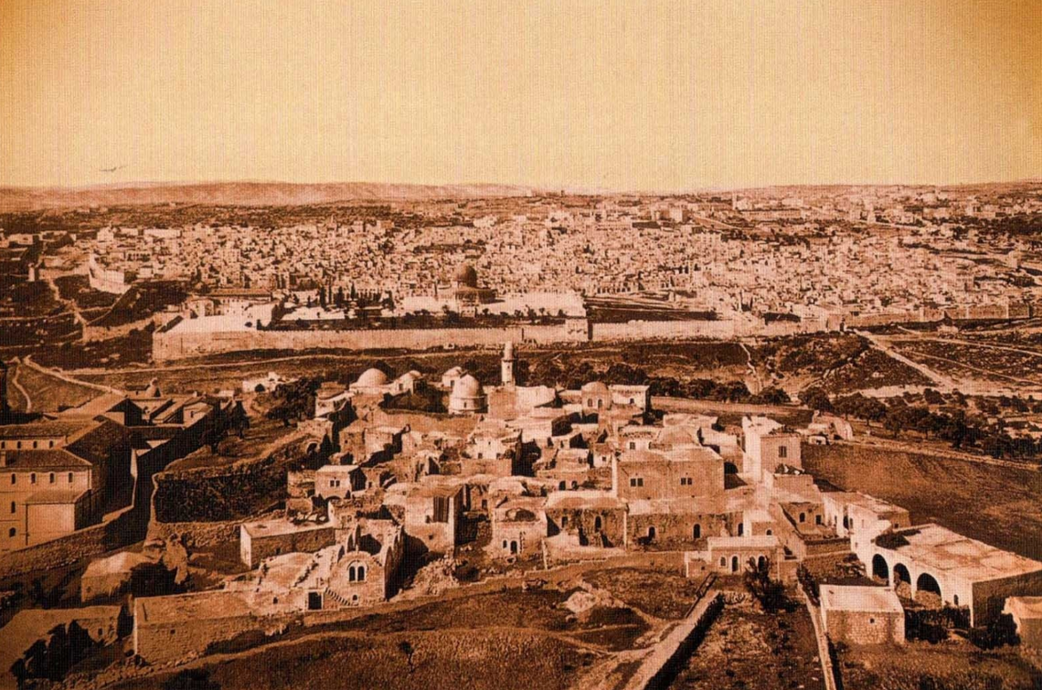
PALESTINE
Before 1948
Notes:
Before the British occupation, all three faiths lived in harmony under Muslim rule.

Slide 7
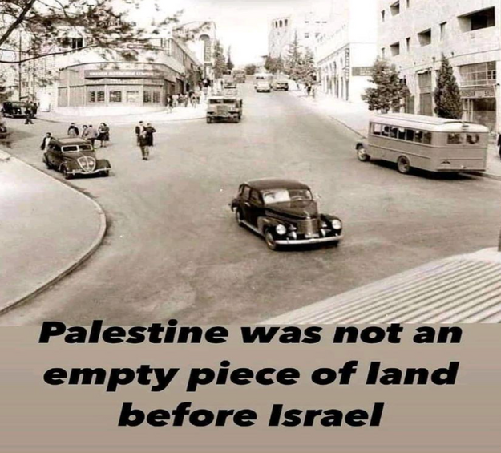
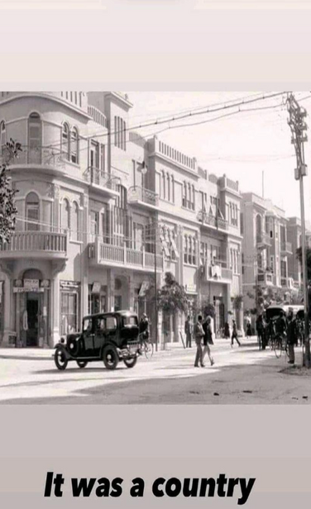
PALESTINE
Notes:
Before the Nakba, Palestine was a peaceful, beautiful, clean country, full of culture and impressive infrastructure.

Slide 8
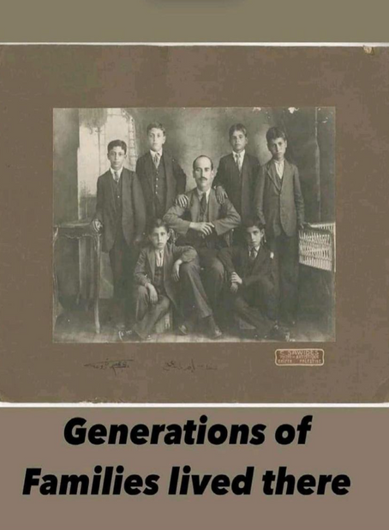
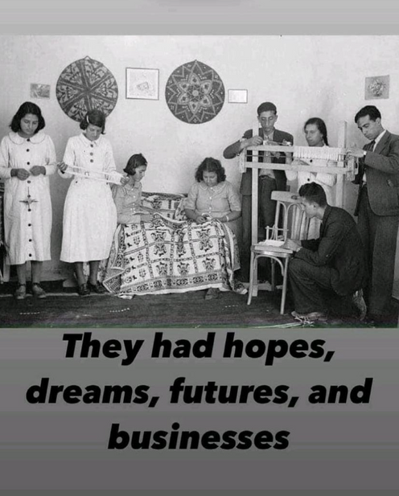

Slide 9
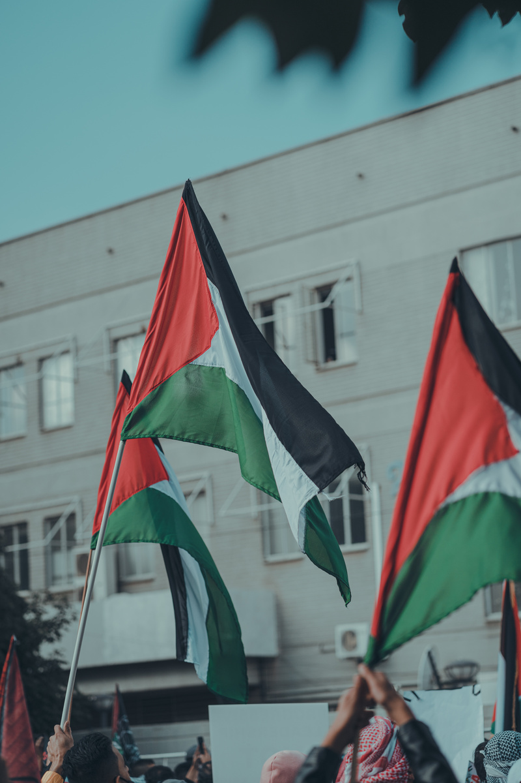
Palestine
before 1948
  Palestine was an integral part of the Ottoman Empire for more than 400 years and was one of the most revered places in the realm. All the indigenous Arab communities living in Palestine, be they Muslims, Christians or Jews, were protected and respected.
  For centuries the land of Palestine was inhabited by a mixed population – approximately 86% Muslim Arabs, 10% Christian Arabs and 4% Jewish Arabs – living in peace.
  The Israeli narrative has been that Palestine was empty and undeveloped until Israel was created in 1948.
  These historical images from 1930-1940 show us that Palestine was beautiful, well established with its own culture, tradition and architecture.
  Plans for the dispossession of Palestine from its indigenous Arab population were in place long before the creation of Israel in 1948.

Slide 10
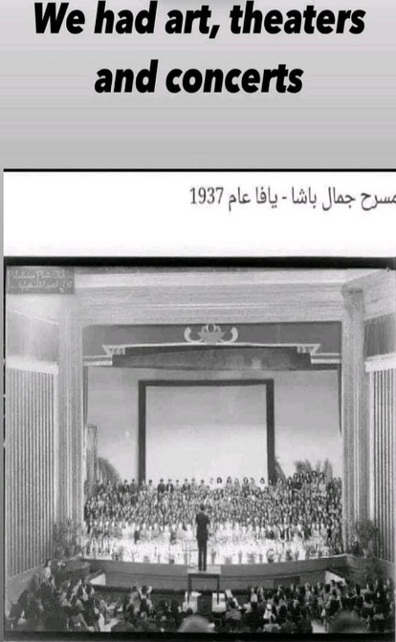
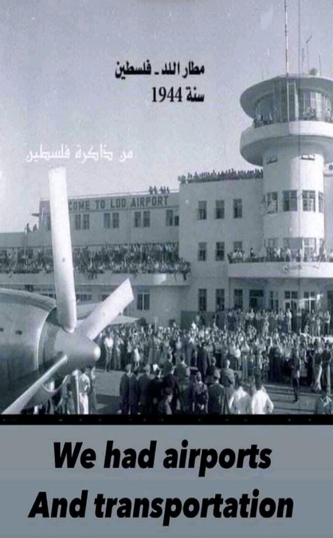
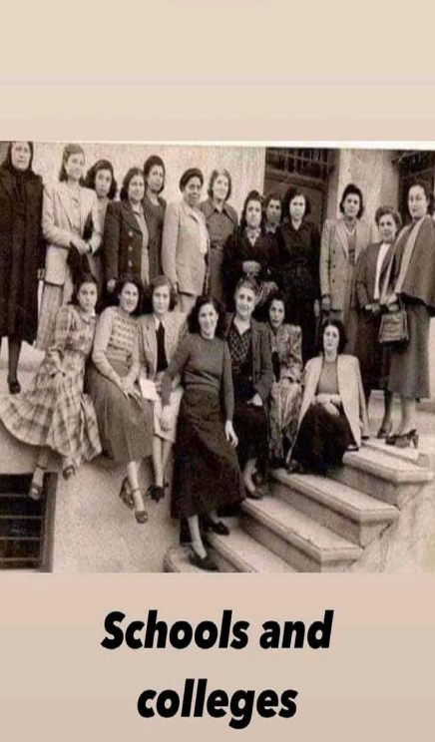

Slide 11
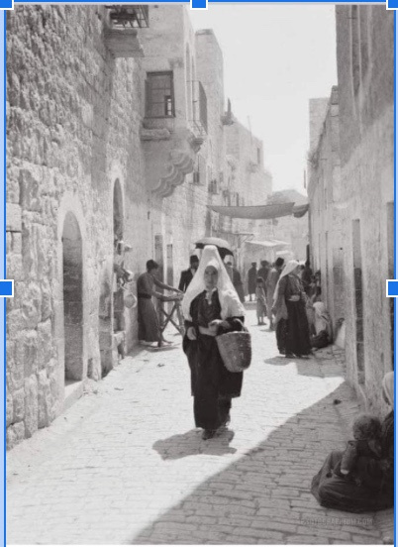
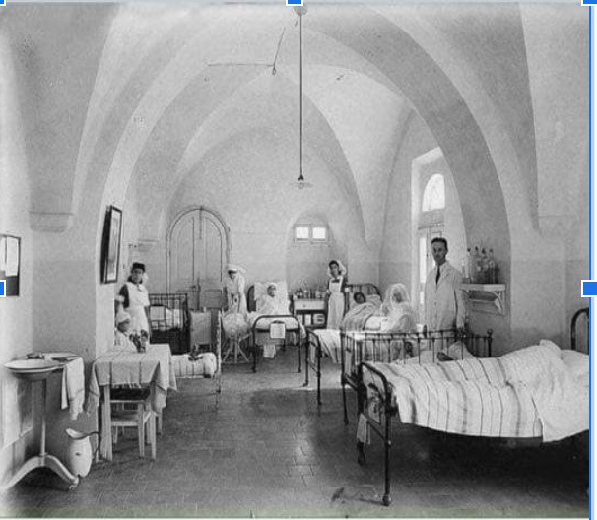
Beautiful and Clean Hospital Buildings
Clean Streets of Old Jerusalem

Slide 12
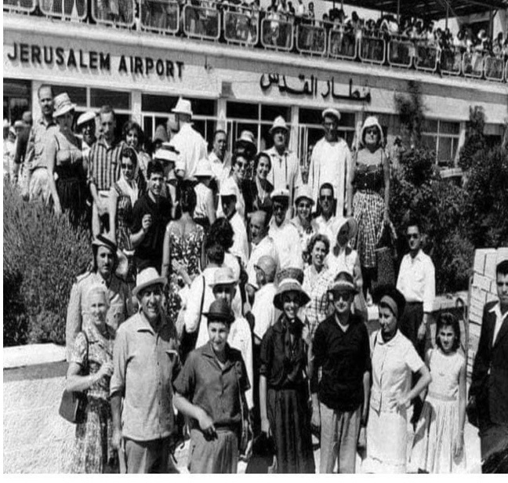
Jerusalem airport with tourists coming from all around the world!

Slide 13
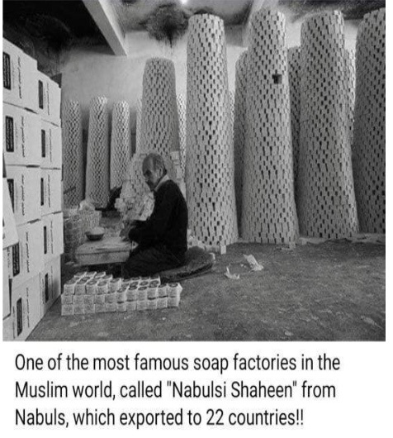
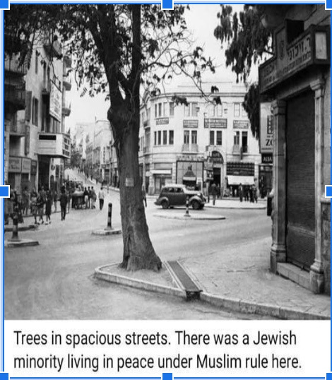

Slide 14
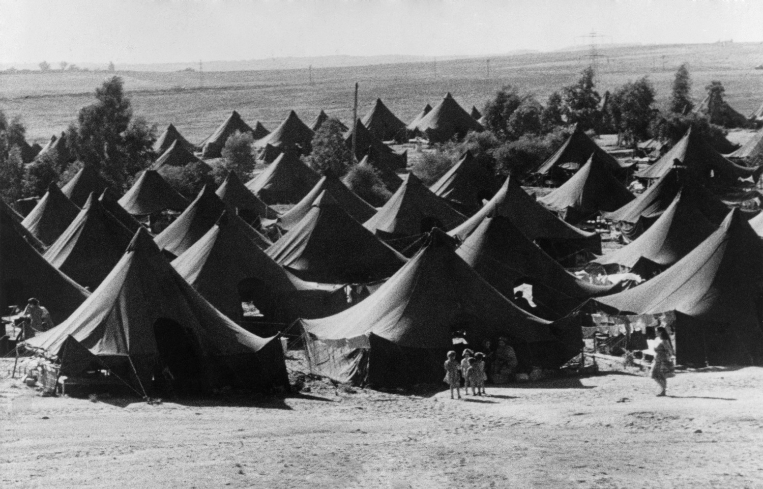
Zionist movement
before the Holocaust
  The Zionist movement began long before the Jewish Holocaust, with individuals and groups advocating the establishment of a Jewish homeland in Palestine.
  There were political interests and agendas among certain groups to settle Jews in Palestine long before the Holocaust.
  The idea of Jewish settlement in Palestine was driven by political, ideological and strategic motives.
  Various factors, including historical ties to the land, religious beliefs and geopolitical considerations, contributed to the early development of the Zionist movement.
  The roots of the Zionist movement can be traced back to the late 19th century, with the formalization of Zionist ideology by figures such as Theodor Herzl and the convening of the First Zionist Congress in 1897.

Slide 15
Timeline 1
  1799 - Napoleon offers Palestine to Jews.
  1885 - The term Zionist is coined.
  1896 - Theodor Herzl, calls for the creation of a Jewish state, becoming the father of Zionism.
  1897 - The first Zionist congress is held in Switzerland.
  1901 - Theodore Herzl asks Sultan Abdulhamid for Jews to buy land in Palestine and is refused.
  1907 - First visit to Palestine by Zionist leader Chaim Weizmann.
  1908 - Palestinian writer Najib Nassar publishes Al Karmel Newspaper and opposes the Zionist colonization.
  1909 - Sultan Abdulhamid is sent to exile by the Young Turks.
Notes:
The timeline is provided as a resource for teachers to utilize at their discretion.
https://remix.aljazeera.com/aje/PalestineRemix/timeline_main.html
Napoleon's brief military campaign in Palestine in 1799 ended in failure without significant repercussions. However, the military and cultural mobilization in response highlighted the autonomy in Palestine under Ottoman rule. Shaykh Yusuf Jarrar, the mutasallim of Jenin District, wrote a poem urging leaders in Jabal Nablus to unite against the French forces besieging Acre.

Slide 16
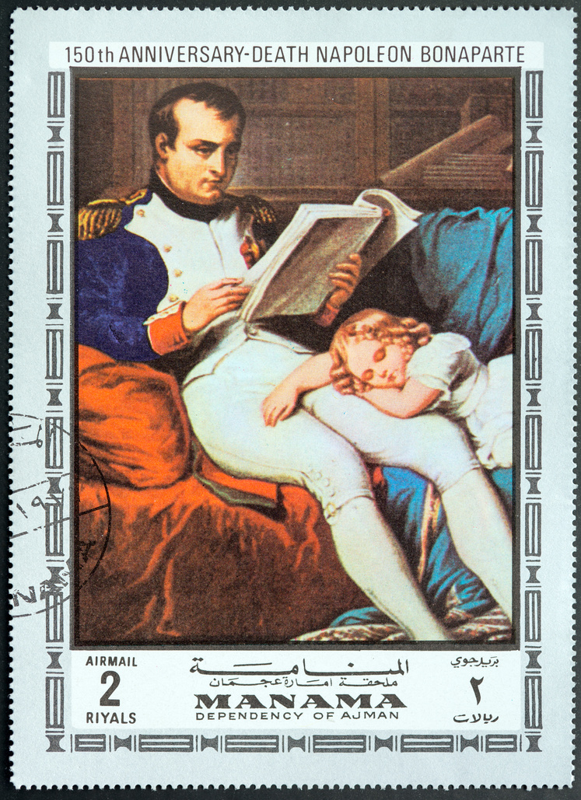
Roots of Zionism and
the First Zionist Settlements
  On 22 May 1799, the French newspaper National Gazette - La Monitor Universal reported Napoleon Bonaparte's appeal for Jewish help in recapturing Old Jerusalem during his campaign at the walls of Acre.
  Despite his defeat at Acre, Napoleon's strategic gesture of offering Palestine to the Jews for political gain was of concern.
  In 1840, British Foreign Secretary Palmerston expressed an interest in opening Palestine to Jewish settlement in an attempt to influence the Ottoman Sultan and his government
  From 1845 to 1934, the French Jewish banker Edmont James de Rothschild provided significant financial support for Zionist colonies in Palestine, establishing 30 colonies with an investment of over 14 million francs.
  Napoleon's brief military adventure in Palestine in 1799 ended in failure and had no significant repercussions. But the military and cultural mobilisation that took place in response reveals the importance of autonomy in Palestine in the context of Ottoman rule. In that year, Shaykh Yusuf Jarrar, the mutasallim of the Jenin district (sanjaq), wrote a poem urging his fellow leaders in Jabal Nablus to unite under one banner against the French forces then besieging Acre.

Slide 17
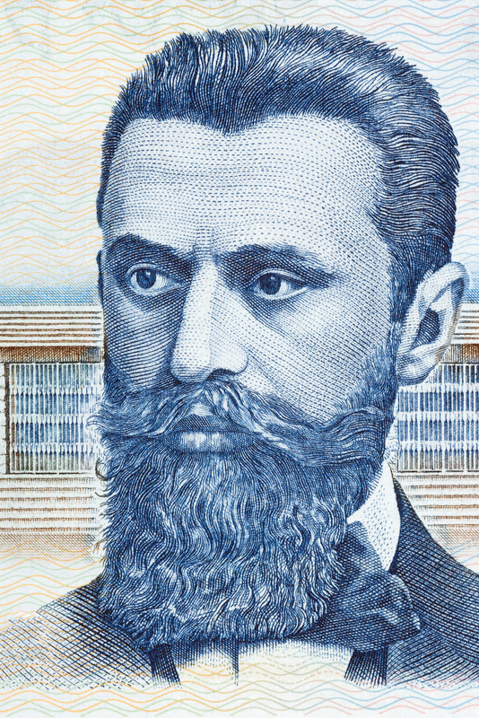
Roots of Zionism and
the First Zionist Settlements
  In 1885, the Israeli flag was raised in the Zionist colony of Rishon Lezion, 63 years before the Nakba.
  Also in 1885, the Israeli writer Natan Birnbaum introduced the term "Zionist movement", inspired by Mount Zion in Jerusalem.
  Originating in Europe, the Zionist movement did not have its roots in Palestine.
  In 1886, the Hungarian Jewish journalist Theodor Herzl outlined the practical framework of the Zionist project in his book "The Jewish State", and led the World Zionist Organisation until 1904, although he never visited Palestine or spoke Hebrew.
  41 years before the Nakba, 60,000 Palestinians were displaced when the Jewish National Fund purchased over 200,000 dunams of land from a Lebanese family in Europe, marking the beginning of Palestinian expulsion.
Notes:
This information can be given in the context that the Zionist movement is a Eurocentric settlement movement that began as a political movement towards the end of the 19th century.

Slide 18
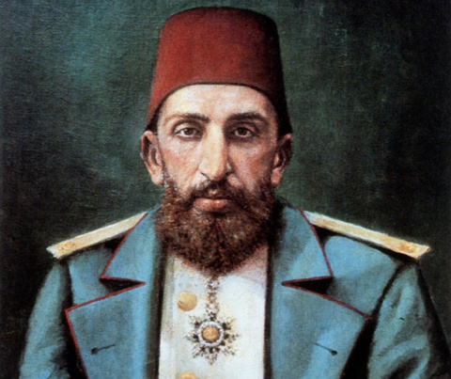
Sultan Abdulhamid
on Palestine
  The Ottoman government who was governing Palestine at the time, responded to the Zionist movement by declaring 80 percent of Palestine as state property in 1871.
  Sultan Abdulhamid II intensified measures against Jewish settlement in Palestine, including restrictions on land acquisition and taking control of strategic areas in 1883.
  Recognizing the Zionist agenda to take over Palestine by 1900, Sultan Abdülhamid II limited the stay of Jews in Palestine to 30 days and prohibited foreign Jews in the Ottoman Empire from acquiring land in Palestine.
  The Ottoman Empire was declared off-limits as a settlement area for European exiles.
Sultan Abdulhamid
Notes:
As leaders of the Muslim Ummah, the Ottoman sultans held the title of Khalifa, or vicegerent. This respected position gave them an important responsibility to uphold the rights of Muslims and to protect all people, regardless of faith, from injustice, oppression and exile.

Slide 19
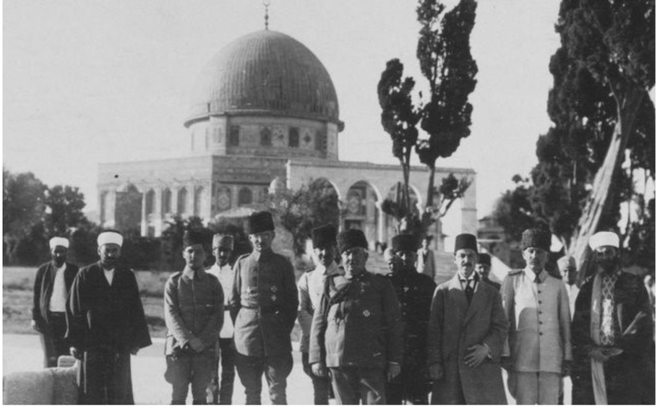
A group of Ottoman Statesmen and locals at
Al Aqsa Compound

Slide 20
Herzl's Offer to
Sultan Abdulhamid
  Theodor Herzl, leader of the Zionist movement, attempted to negotiate with Sultan Abdülhamid II to open Palestinian land for Jewish settlement.
  Herzl's proposal, made through an agent in 1901, involved paying off Ottoman debts and promoting the Sultan's image in Europe in exchange for the transfer of land and government to the Jewish people.
  The Sultan rejected the offer, he famously said, “I won't sell anything, not even an inch of this territory.”
  Despite Herzl's repeated attempts, including a second offer the following year, the Sultan maintained his refusal.

Slide 21
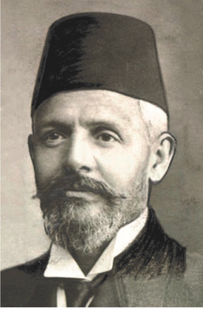
End of Ottoman
Protection of Palestine
  The Western backed political group, Young Turks, overthrew Sultan Abdülhamid II in 1909, exiled him to Thessaloniki and imprisoned him in the house of a Jewish banker named Allatini.
Emanuel Karasu
  Under the Young Turks, all the Sultan's lands were nationalised and Jews were allowed to settle in Palestine as part of their policy.
  The Jewish banker and Freemason Emmanuel Karasu (Carasso), played a key role in the dethronement of Sultan Abdülhamid II and organised Jewish Migration to Palestine.
  In 1917, the Young Turks struck a deal with British Foreign.
  Secretary Arthur Balfour that led to the Balfour Declaration and the British Empire's support for a Jewish state in Palestine.
  Signed in 1916 during World War I, the Sykes-Picot Agreement was a secret British-French agreement to divide the Middle East into spheres of influence.
  The Sykes-Picot Agreement, coupled with duplicitous promises made to Arab leaders by Britons such as McMahon, led to the Arab Revolt against the
  Ottomans and ultimately contributed to the collapse of the Ottoman Empire and the Khilafah.

Slide 22
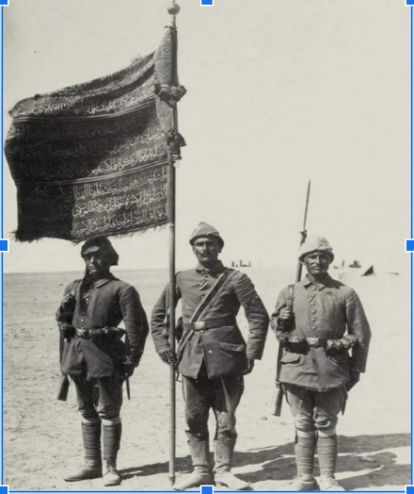
The 79th Ottoman
Regiment
The Ottoman standard of Gaza was given to the 79th Infantry Regiment, which defended Gaza in Ottoman Palestine during World War I around 1917.
The First Battle of Gaza took place on March 26, 1917. The Ottomans successfully defended the city.
The Second Battle of Gaza occurred from April 17-19, 1917, with the Ottomans again repelling the British assault.
However, the Ottomans lost Gaza after their defeat in the Third Battle of Gaza. On November 7, 1917, General Allenby's troops entered Gaza unopposed, marking a significant turning point in the campaign. This capture opened the way for the British advance into Palestine, leading to the capture of Jerusalem in December 1917.

Slide 23
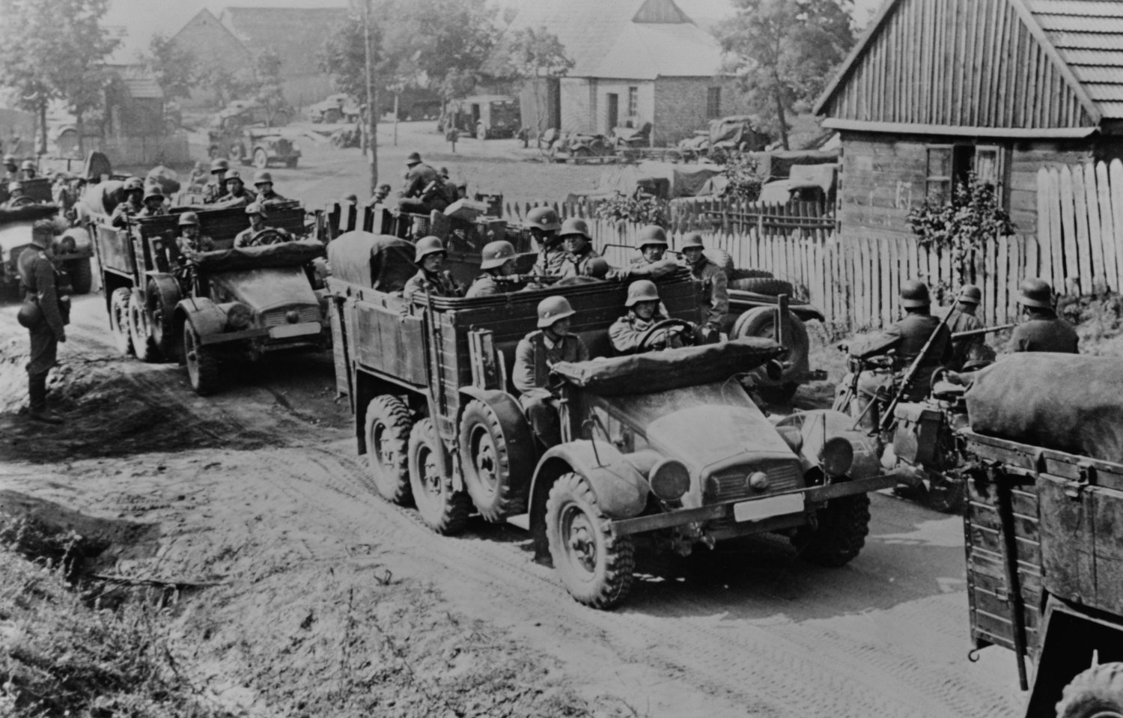
TIMELINE 2
1914
1916
1917
1918
1920
1922
1929
1920
Beginning of World War 1
Sykes Picot
Agreement divides the Middle East Between the French and the British
  Balfour Declaration
  End of Ottoman/ Islamic Rule over Palestine
End of World War 1
Beginning of the British Mandate of Palestine
The League of Nations the British Mandate for Palestine and its aim to help establish a Jewish state in Palestine
The first mass protest against rising Jewish immigration to Palestine
TIMELINE 3
1933
1936
1937
1938
1939
1945
1947
1920
Mass Protests Against Increased Jewish Immigration to Palestine
Six month long general strike throughout Palestine protesting the mass immigration of Jewish people
The Peels commission recommends partition and relocation of Palestinians
Zionist militia Irgun starts attacks against Palestinians
Britain smashes the 3 year long Arab revolt
End of WW2 -
United Nations is Established
Irgun bombs the King David Hotel in Jerusalem killing 91 people including British officers.

Slide 24
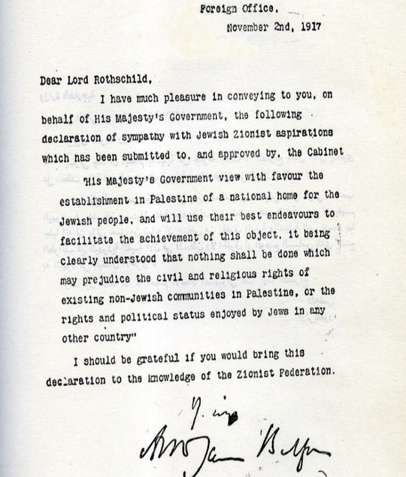
BALFOUR
DECLARATION
After political pressure from the Zionist movement, in November, 1917 the British Prime Minister, Lord Balfour, wrote a letter to Lord Rothschild, announcing their intention to establish a Jewish state in Palestine, the territories occupied by Great Britain (Palestine and Southern Iraq) since taking them from the Ottoman State.

Slide 25
BALFOUR
DECLARATION 1917
  Although it was not for the British to give away land that did not belong to them, they still wrote the Balfour Declaration:
  In 1917, Palestine wasn’t even under British Mandate.
  Lord Balfour wrote to Lord Rothschild, who was one of the most prominent Jewish families in the world.
  This led to waves of Jewish immigration to Palestine from Europe and elsewhere, causing widespread Arab unrest. There were many advertisements in many countries about this new "Promised Land" which attracted attention. Numerous advertisements in countries with Jewish communities attracted significant attention to the new “Promised Land”.
  Until the wave of mass Jewish immigration, Palestine consisted of an indigenous Arab population, mostly Muslim, with a small population of Christian and Jewish Arabs who lived in harmony.

Slide 26
Jewish Ethnicities:
Immigration to Israel
  Ashkenazi Jews: Originally from Central and Eastern Europe, Ashkenazi Jews are one of the largest Jewish ethnic groups. They settled in Israel mainly during the waves of immigration from Europe, especially before and after the Second World War. They were not accepted to the US or many countries in Europe.
  Mizrahi Jews: Mizrahi Jews come from Middle Eastern and North African countries such as Iraq, Iran, Yemen and Morocco. They immigrated to Israel mainly in the mid-20th century following the establishment of the state of Israel.
  Sephardic Jews: Sephardic Jews trace their origins to Spain and Portugal, but many migrated to North Africa, the Middle East and the Ottoman Empire after their expulsion from Spain in 1492. They settled in Israel at various times, including the early years of the state and later waves of immigration.
  Ethiopian Jews: Also known as Beta Israel, Ethiopian Jews have a unique history dating back to ancient times. They immigrated to Israel during two major waves of immigration in the 1980s and 1990s, known as Operation Moses and Operation Solomon, to increase the Jewish population in Israel.

Slide 27
Events Preceding
the Creation Israel
  The Jewish refugees fleeing Europe, having been refused to enter the USA, began to come to Palestine.
  Many Jewish families who had fled the war were welcomed by Palestinians who hosted them in their own homes.
  Many of these Jewish families kicked the Palestinians out of their homes and claimed them for themselves.
  The Ottoman rule ended after 402 year, 3 months and 6 days, exactly on December 9, 1917.
  Jews from Europe who had arrived began organised terrorist action, organizing militia and attacking Palestinian villages and British government offices.
  After the Jewish terrorist attacks targeted the British government, the British withdrew from Palestine. (A Jewish terrorist group was responsible for the King David Hotel massacre, killing 28 British soldiers)
  The Balfour Declaration coupled with uncontrolled illegal Jewish immigration, the creation of Jewish gangs and the desire of the Jewish state led to the Nakba.

Slide 28
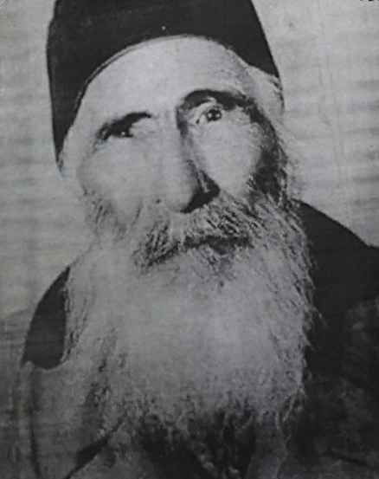
Corporal Hasan
The Ottoman Empire, which had protected Jerusalem for 401 years, was forced to withdraw in 1917. During the First World War, the Ottoman military, engaged in fierce fighting on the Suez Canal front, suffered defeat and had to retreat. The Ottomans left behind a small force to deter looting and possible public unrest. As a result, 53 soldiers from the army remained in the city, including Corporal Hasan from Iğdır in Türkiye. Corporal Hasan continued his guard duty in Jerusalem until his death in 1982.
Notes:
https://www.middleeastmonitor.com/20230412-the-ottoman-soldier-who-sacrificed-his-freedom-to-defend-al-aqsa-mosque/

Slide 29
SECTION 2
The Partition of Palestine 1948

Slide 30
TIMELINE 4
1948
1967
1973
1976
1978
1982
1987
1920
The Nakba – Ethnic cleansing of Palestine and
Creation of Israel
Israel occupies the rest of Palestine
Yom Kippur War between Arab States and Israel
Land Day: Israel takes over thousand of hectares of land from Palestinian citizens.
Egypt signs a peace deal with Israel at Camp David
Israel Invades Lebanon
The First Intifada is launched in the Occupied Territories
TIMELINE 5
1993
2002
2005
2008
2012
2014
2017
1920
Oslo Accords l
Israel occupies cities in West Bank
Israel moves out of Gaza and Makes it an open air prison
Israel attacks Gaza
Israel attacks Gaza
Israel attacks Gaza
Trump’s deal of the Century
Notes:
The timeline is provided as a resource for teachers to use at their discretion.
This slide illustrates Israel's consistent disregard for international law. It also highlights US efforts to normalise relations in order to create a sense of peace. The Oslo Accords are seen as a delaying tactic to hide the reality of peace and a two-state solution. The US has turned a blind eye to Israel's violations of these agreements, including its support for illegal settlements in the West Bank. In addition, Trump strengthened Israel's presence in the West Bank by moving the US embassy to Al-Quds/Jerusalem.

Slide 31
UNITED NATIONS
  The newly created United Nations (UN) accepted the partition of Palestine.
  With this United Nations Resolution, the British withdrew from the region on May 14th 1948.
Before the 1947 UN Resolution
Before the 1947 UN Resolution
6.5%
55%
Zionist ownership of
Palestinian land
Zionist ownership of
Palestinian land

Slide 32
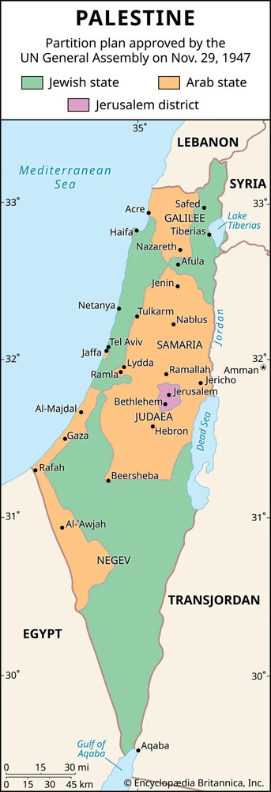
United Nations
Resolution
  Immediately after the WW2, United Nations was formed by the US.
  In 1947, the UN passed Resolution 181, known as the Partition Plan, to split Palestine into two states — a move that was rejected by Arabs.
  The UN wanted to allocate 43 per cent of Palestine to the Arabs and 56 per cent to the Jews.
  According the UN, Arabs made up at least 1.1 million of the population in 1945 while Jews were about 407,000.
Notes:
By the time the UN was established, the Jewish population in Palestine had increased through immigration.

Slide 33
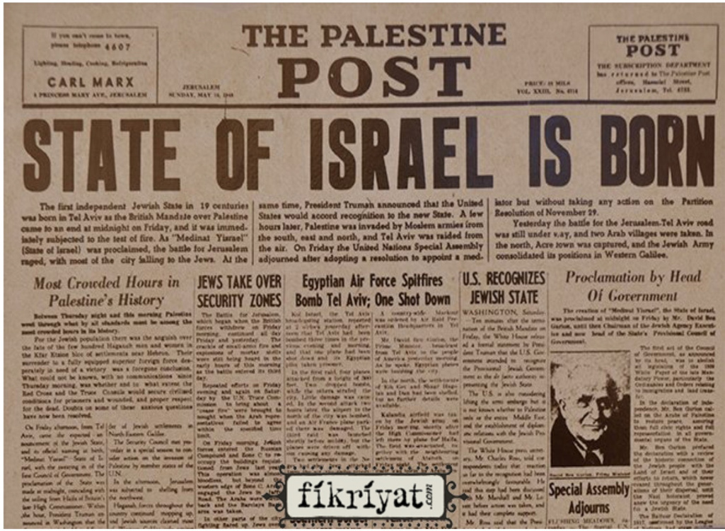
Notes:
Discuss what a Palestinian must have felt reading this newspaper?

Slide 34
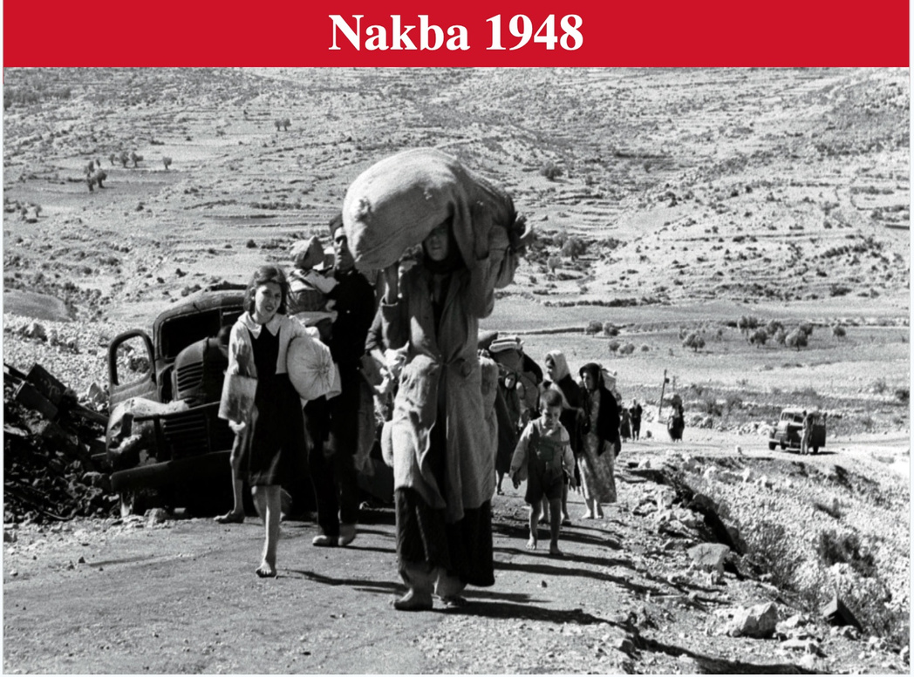
Nakba 1948

Slide 35
DEIR YASSIN MASSACRE
APRIL 1948
  Friday 9th April at 4:30 am: Zionists surrounded Deir Yassin and began murdering men, women and children.
  Among the victims there were twenty-five pregnant women and fifty-two children.
  The news spread to other villages in Palestine. Thousands of Palestinians fled for their lives and have not been allowed to return since.
250
Murdered
  The Deir Yassin Massacre was ONE of the 34 massacres which occurred during the Nakba.
  Deir Yassin is now occupied by Israeli settlers: The Palestinian cemetery and mosques have been destroyed. Today, a Jewish school and a psychiatric hospital have been built on the ruins of Palestinian houses.
  The Deir Yassin Massacre was ONE of the 34 massacres which occurred during the Nakba.

Slide 36
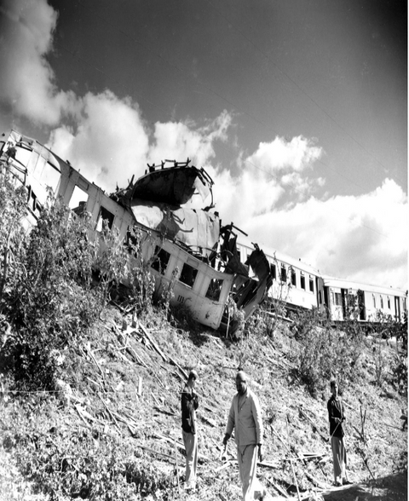
Winter 1948
  In November 1948, six months after the creation of the state of Israel, the new Israeli army went to Palestinian villages and told them to evacuate the area for security reasons, with the promise that they would be able to return once the army had completed its operations in the area.
  The areas were declared military zones, which meant that Palestinians were not allowed to return.
  Villages were destroyed and houses reduced to rubble.
Notes:
Between 1947 and 1949, at least 750,000 Palestinians out of a population of 1.9 million were displaced as refugees beyond the borders of the state. Zionist forces occupied over 78 per cent of historic Palestine, resulting in the ethnic cleansing and destruction of some 530 villages and towns. These actions resulted in the deaths of some 15,000 Palestinians in numerous mass atrocities, including over 70 massacres.

Slide 37
UNITED NATIONS
  Zionist gangs uprooted 60% of the Palestinian people (800,000 out of 1.4 million).
  530 of 580 Palestinian villages were destroyed
  34 massacres, killing 15,000 Palestinians
  By the time the ceasefire was announced, the Israelis had occupied 78% of Palestine.
WHAT WAS PROMISED
WHAT ACTUALLY HAPPENED
Dec 1948: UN passes Resolution 194. Refugees wishing to return to their homes should be allowed to do so at the earliest practical date. Compensation should be paid.
Law of Return 1950: The
Resolution was completely ignored by the Israelis, who instead granted automatic Israeli citizenship to all Jews in the world.

Slide 38
1967
The Six Day War
  The Six-Day War was a brief but bloody conflict fought in June 1967 between Israel and the Arab states of Egypt, Syria and Jordan. The war ended in a UN-brokered ceasefire that significantly altered the map of the Middle East and caused further geopolitical friction.
  With its claim to the West Bank and the Gaza Strip, the state of Israel also colonised more than a million Palestinian Arabs.
  Several hundred thousand Palestinians later fled Israeli rule. This exacerbated a refugee crisis that began during the first Arab-Israeli war in 1948.
  Since 1967, the lands captured by Israel in the Six-Day War have been the focus of international negotiations.

Slide 39
Fatah
and the PA
  Fatah, or the Palestine National Liberation Movement, was founded in the late 1950s by Palestinians in the diaspora after the Nakba of 1948, with the aim of liberating historic Palestine.
  Its founders included Yasser Arafat, Khalil al-Wazir, Salah Khalaf and Mahmoud Abbas, the current President of the Palestinian Authority.
  Initially focused on armed struggle against Israel, Fatah operated from Jordan and Lebanon from 1965.
  After becoming the dominant party in the PLO, the Palestine Liberation Organisation, which includes many Palestinian political parties, Fatah turned to negotiations with Israel in the 1970s and 1980s.
  This shift led to the signing of the Oslo Accords in the 1990s, which established the Palestinian Authority as an interim self-governing body.
  Today, the PA rejects armed resistance and is firmly committed to negotiations and cooperation with the Israeli government.

Slide 40
Intifada
1987
  After many years of struggle for liberation and generations of living under brutal occupation, Palestinians began to organize mass protests. The methods of protest and civil disobedience began to become widespread.
  This nonviolent resistance movement became known as the Intifada, which in Arabic means "to shake off", and was used to express the frustration of Palestinian youth with a life of blockade and imprisonment.
  During these protests, more than 1,000 Palestinians were killed by Israeli forces, including 237 children under the age of 17.
  Some 120,000 Palestinians were imprisoned by Israel and many are still behind bars.

Slide 41
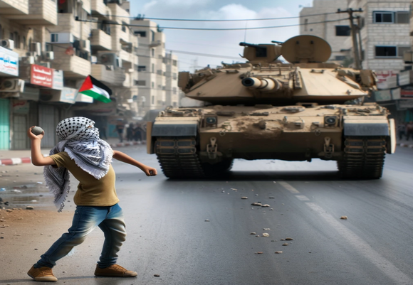
Intifada - 1987
  The Swedish branch of Save the Children estimates that in the first two years of the intifada alone, 29,900 children required medical treatment for injuries caused by beatings by Israeli soldiers. Almost a third of them were aged ten or under.
  Thousands of young children throwing stones at world-class tanks symbolised these protests. In return, these Palestinian
children were arrested by the Israeli army and their arms were broken on many occasions.
  Many resistance activities during the Intifada were not reported or covered by Israeli and Western mainstream media, making them less visible internationally.
  A key form of Palestinian resistance was the commercial strike.

Slide 42
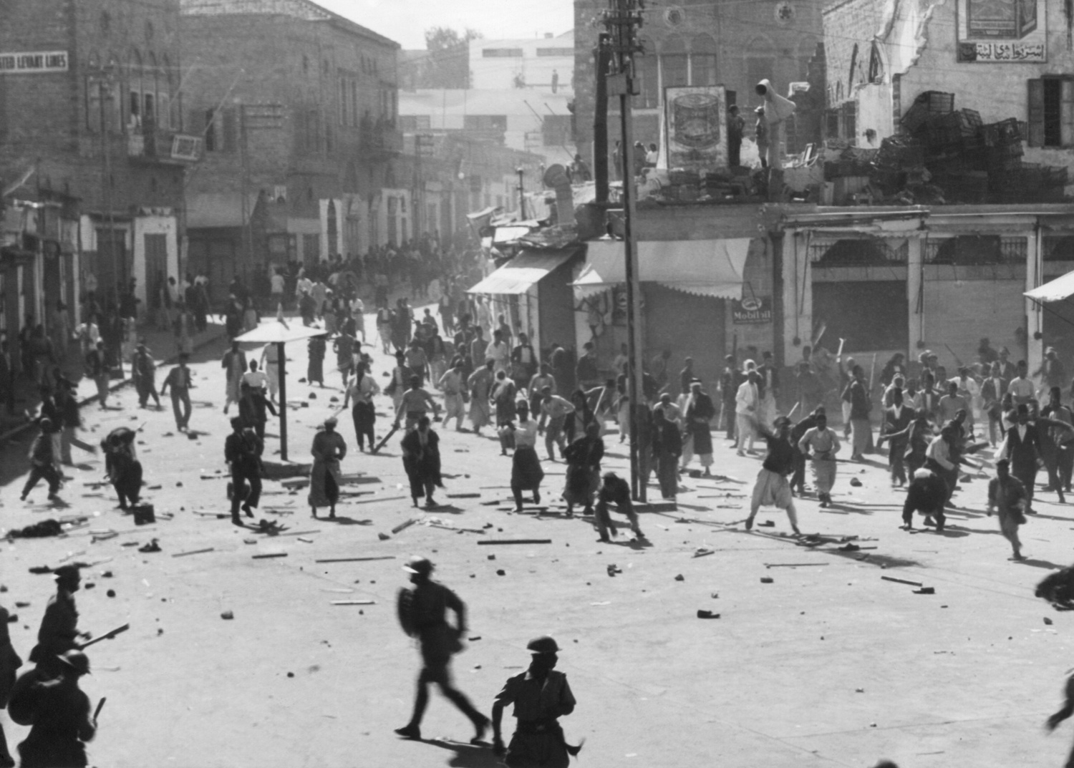
Hamas
(Harakat al-Muqawama al-Islamiya)
  After the 1970s, many Palestinian activists came together to set up schools, clinics and hospitals for the refugees in the occupied Gaza Strip and West Bank to alleviate the suffering of these people.
  After years of suffering and with no liberation in sight, some of these people came together and founded Hamas in 1987 during the first Intifada by the famous scholar and Muslim cleric Sheikh Ahmed Yassin.
  Hamas means 'zeal' and is an acronym for 'Islamic Resistance Movement'.
  Hamas carried out its first retaliatory attack in 1989, killing two Israeli soldiers. This led Israel to arrest Ahmed Yassin.
  Yassin was released in 1997 in exchange for Mossad agents caught trying to assassinate a Hamas leader, Khaled Meshal, in Jordan.
  In retaliation for Israel's brutal occupation and daily humiliation of Palestinians and attacks on Al-Aqsa, there have been many reprisals by Hamas and other Palestinian groups, some of whom have carried out suicide bombings against Israeli targets.
  Hamas entered politics in 2005 and won a major victory over its rival, Fatah. Israel has imposed extreme sanctions on the Gaza Strip and has been controlling everyone and everything that goes in and out of Gaza since Hamas won the elections.
  Hamas is the biggest excuse that Israel uses to justify its attacks on the Gaza Strip.
  Hamas has two wings:
  Political Wing: Handles political, social, and administrative functions, including governance and social services.
  Military Wing: Known as the Izz ad-Din al-Qassam Brigades, it conducts militant operations and defense activities.
Notes:
Discuss why some people choose resistance while others choose negotiation and cooperation. Students can look at the roots of resistance movements and how they have changed.

Slide 43
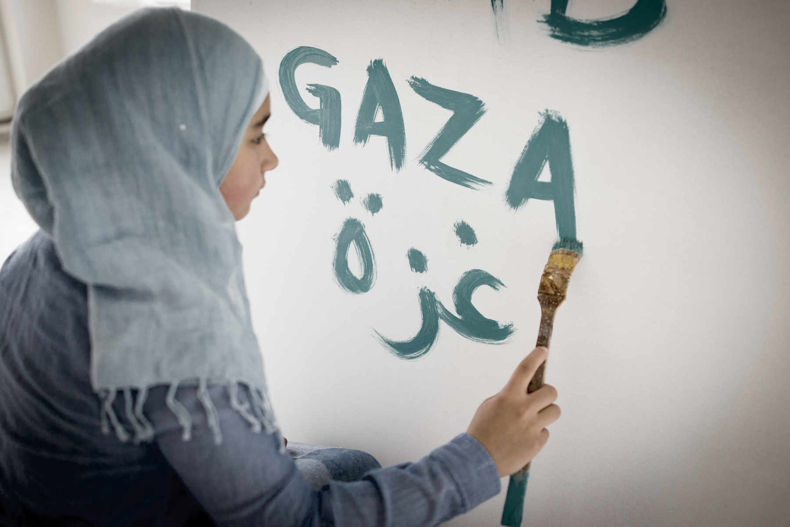
Second Intifada
2000
  The Second Intifada, also known as the Intifadat al Aqsa, began on 28 September 2000, when Likud opposition leader Ariel Sharon provocatively visited the Al-Aqsa Mosque compound and thousands of security forces were deployed around Jerusalem's Old City.
  Over two days, five Palestinians were killed and 200 injured in clashes between Palestinian demonstrators and Israeli forces.
  This led to massive peaceful protests across Palestine.

Slide 44
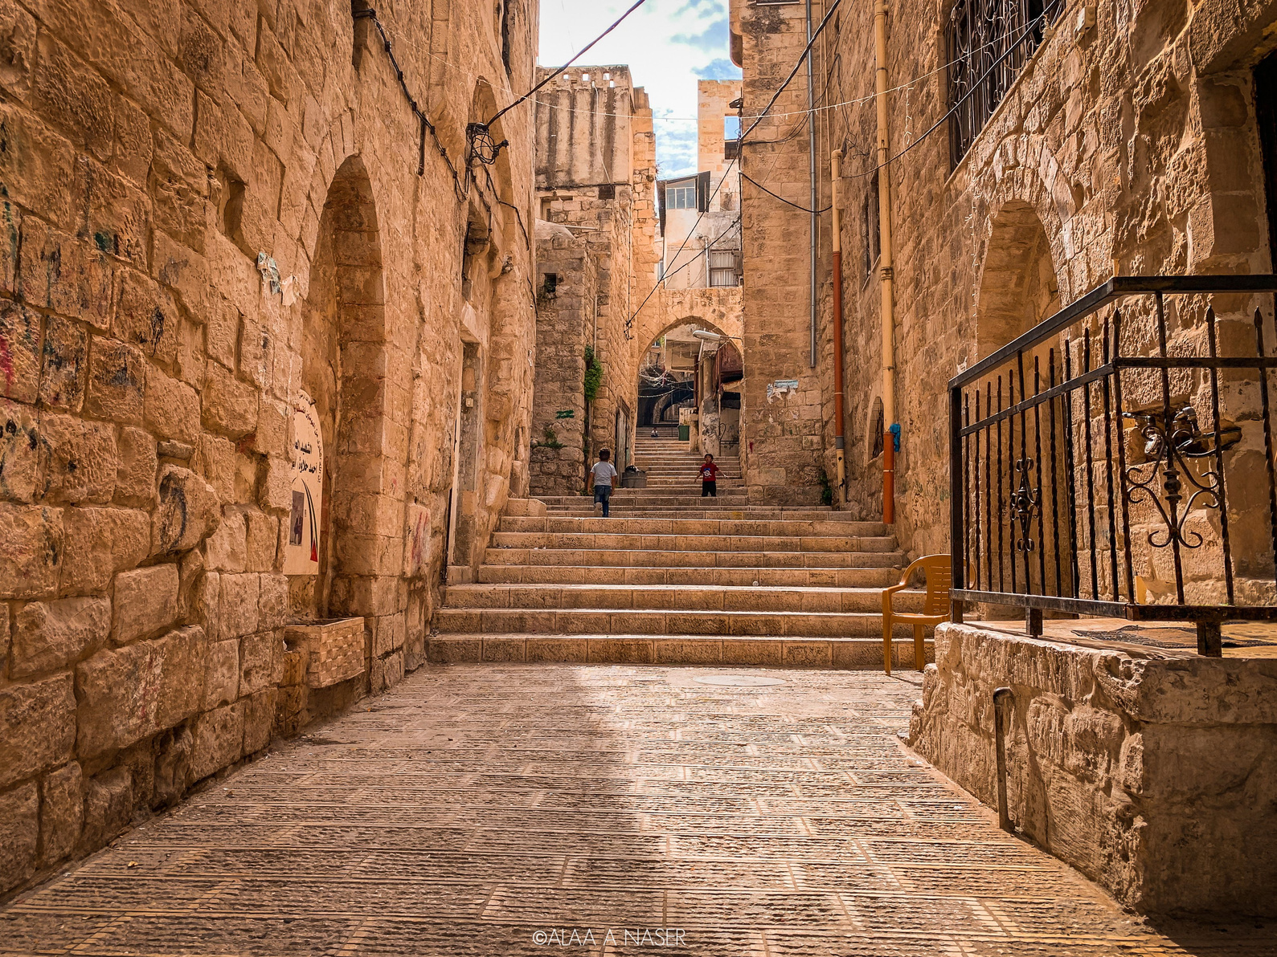
The Wall
  Israel re-occupied Palestinian Authority areas after the second intifada and built a separation wall.
  Built to divide Israeli and Palestinian territories, the wall became a symbol of segregation and apartheid
  Alongside rampant settlement construction, the wall has drastically altered Palestinian livelihoods and communities.
  Despite international illegality, hundreds of thousands of Jewish settlers have moved into settlements on Palestinian land.
  Settler-only roads and infrastructure further shrink Palestinian space in the occupied West Bank.
  The construction of the wall has fragmented Palestinian cities and towns, creating isolated enclaves reminiscent of South Africa's apartheid-era Bantustans.
  The wall is 708 km long and restricts the movement of 3m Palestinians.

Slide 45
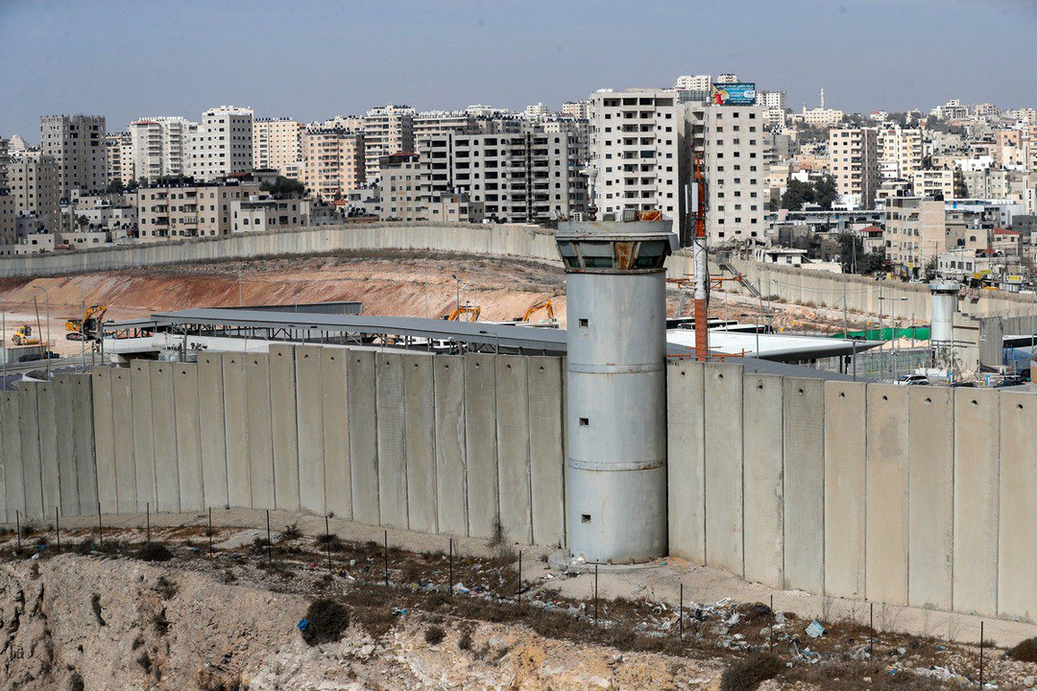
The Wall

Slide 46
SECTION 3
Palestine
Today

Slide 47
Gaza in Numbers Before
October 7, 2023
  Population of Gaza: Approximately 2.1 million people
  Area: 365 square kilometers
  Unemployment rate: 45%
  Food insecure households: 64%
  One of the most densely populated areas in the world
  Among the highest unemployment rates in the world, especially impacting rural households

Slide 48
Palestinian Casualties
Since 2006
  August 2005: Israeli forces withdraw from Gaza after 38 years of occupation, leaving it under Palestinian Authority control.
  January 2006: Hamas wins majority seats in Palestinian legislative elections.
  June 2006: Hamas captures Israeli soldier Gilad Shalit, prompting Israeli airstrikes and incursions. 662 Palestinian killed.
  December 2008: Israel launches a 22-day military offensive in response to rocket attacks from Gaza, resulting in significant casualties. Est. 871 Palestinian killed.
  November 2012: Israel kills Hamas military chief Ahmad Jabari, leading to eight days of airstrikes on Gaza. 257 Palestinian killed.
  July-August 2014: Kidnapping of three Israeli teenagers by Hamas sparks a seven-week war, resulting in 2285 Palestinian killed.
  March 2018: Palestinian peaceful protests at Gaza's border lead to deadly clashes with Israeli forces. 290 Palestinian killed.
  May 2021: Israeli army attacks worshippers at Al Aqsa Mosque in Ramadan to which Hamas responds and Israel attacks Gaza. 279 Palestinian killed.
  August 2022: Israeli airstrikes kill over 30 Palestinians, prompting rocket attacks from Palestinian Islamic Jihad. 215 Palestinian killed.

Slide 49
SINCE 2015
  November 2015 - Israel suspended contact with the EU, which was in talks with the Palestinians to label goods from Jewish settlements as coming from the settlements, not from Israel.
  December 2016, Israel broke ties with 12 countries voting for UN resolution condemning illegal settlement expansion. The US abstained for the first time instead of using its veto.
  2016 US aid package to Israel increased to $38 billion over 10 years.
  June 2017 saw the start of the first new Jewish settlement in the West Bank in 25 years. A law was passed to legalise dozens of Jewish settlements that were being built on privately owned Palestinian land in the West Bank.
  2017 Donald Trump recognize Jerusalem as Israel's capital, sparking Arab condemnation and prompting Western allies to condemn Trump.
  2018 Following a surge in bloodshed on the Gaza border, the UN and Egypt attempt to broker a long-term ceasefire between the Palestine and Israel.

Slide 50
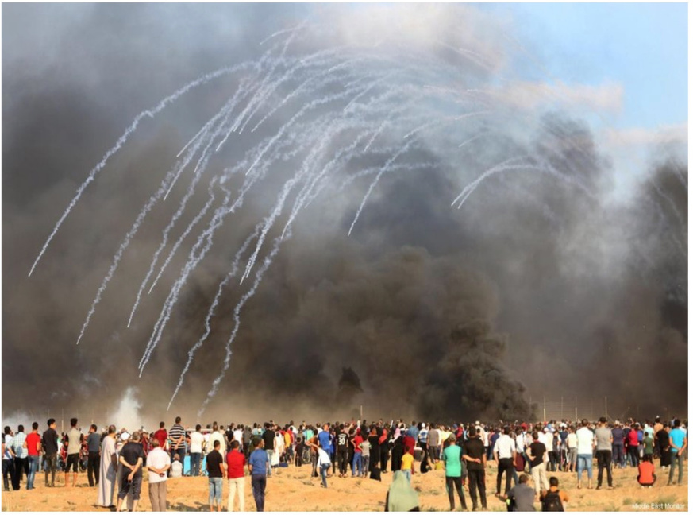
The Great
March of Return

Slide 51
The Great March of Return
March 2018 - December 2019
  January 2018: Palestinian journalist Ahmed Abu Artema's Facebook post sparks protest movement.
  Abu Artema calls for peaceful gatherings near the Israeli fence to demand the return of pre-1948 homes.
  Weekly Friday protests, dubbed the 'Great March of Return', follow.
  Israeli forces respond with tear gas, rubber bullets, live ammunition and sniper fire.
  Casualties:
  214 Palestinians killed, including 46 children.
  Over 36,100 injured, including almost 8,800 children.
  Israeli casualties: One soldier killed, Seven injured during demonstrations.

Slide 52
2021-2023
  Israeli forces frequently attacked worshippers at the Al-Aqsa compound. In the spring of 2021, Israeli police brutally attacked Muslim worshippers during Ramadan.
  Combined with many attacks in the West Bank and Jerusalem, tensions were heightened.
  In 2021, many Palestinian families faced eviction from the Sheikh Jarrah neighbourhood of Jerusalem, causing an international outcry.
  After clashes with Palestinian resistance, Israel began bombing Gaza, killing hundreds of innocent people, including children.
  In 2022, Israel attacked Gaza again after resistance from local Palestinian fighters, killing 49 people, 12 of them children.

Slide 53
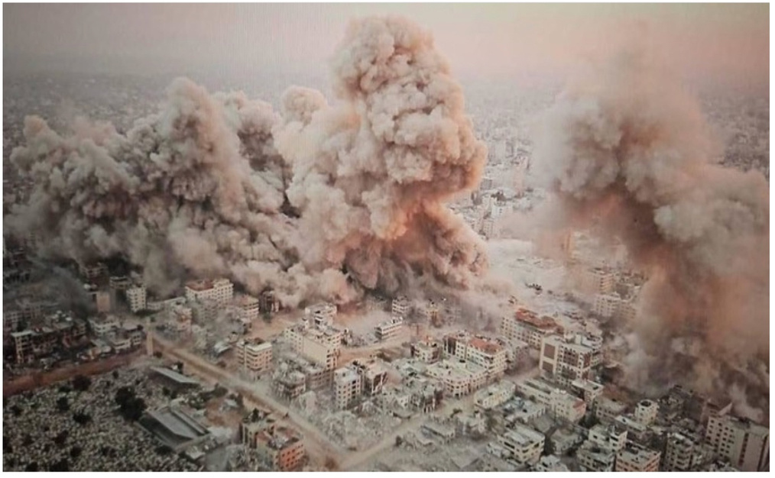
Picture by Bilal Khaled,
A Native Gazan

Slide 54
October 07, 2023
  An attack on Israel on October 7 by Hamas and other Palestinian armed groups was surprisingly not immediately responded to by the IDF, it breached security barriers,part of the Apartheid Wall and unleashed a barrage of rockets from Gaza. More than a thousand Israelis were killed in the attack. Many of them were military personnel and many were caught in the crossfire.
  During the attack, more than 200 Israelis were captured as prisoners of war, aiming to negotiate their exchange for thousands of Palestinian prisoners, prioritising women and children, who were held under administrative detention by Israel indefinitely.
  In response, the Israeli army launched an onslaught on Gaza, cutting off electricity, water, internet, food and all incoming aid.
  All border crossings, which were already tightly controlled, were sealed.

Slide 55
After October 2023
  The Israeli onslaught has displaced the entire population of Gaza - more than 2,000,000 civilians.
  Conservative estimates put the number of Palestinians killed as of 14 May 2024 at 35-40 thousand, including at least 14,500 children. More than 80,000 people are injured and tens of thousands are buried under the rubble. Almost all hospitals, schools, mosques, homes and relief centres in Gaza have been attacked.
  Many international aid organisations, the UN, Red Crescent, Amnesty, etc. have described the situation as catastrophic, warning of mass starvation, the spread of widespread diseases and the total collapse of the health system.

Slide 56
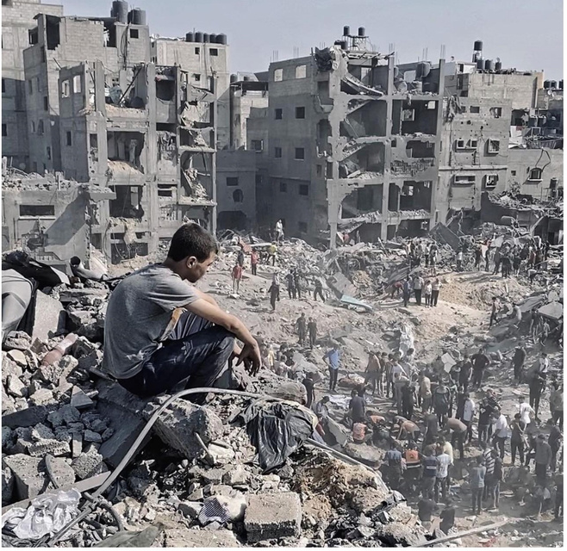
A photograph showing the extent of the destruction was taken by Abdullah Obead,
a Gazan journalist.

Slide 57
ICJ and ICC
International Court of Justice (ICJ):
  Main judicial organ of the United Nations.
  Settles legal disputes between countries.
  Decisions are binding and cannot be appealed.
  Does not prosecute individuals for crimes.
International Criminal Court (ICC):
  Independent international organization.
  Prosecutes individuals for genocide, war crimes, crimes against humanity, and aggression.
  Jurisdiction over individuals, not states.
  Operates on a complementarity principle, stepping in when national courts are unwilling or unable to prosecute.
Notes:
The Palestinian Authority referred Israel to the ICC for crimes committed during the 2015 attack on Israel. The court took no action until 2023. It didn't accept any of the requests to move the case forward. After the attack on Israel in 2023, the ICC prosecutor was in Israel within a short time at the invitation of the families of the Israeli hostages.

Slide 58
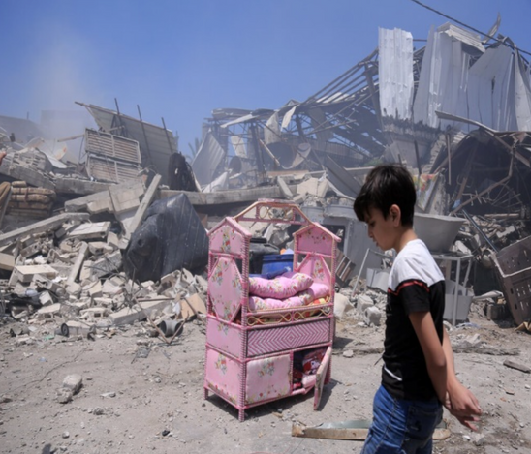
2024 - ICJ
  South Africa has submitted an 84-page document to the International Court of Justice (ICJ) stating that Israel has violated the 1948 Genocide Convention, which was drawn up in the aftermath of the Second World War and the Holocaust.
  In addition to countries, various advocacy and civil society groups around the world, such as Terreiro Pindorama in Brazil, Asociación Nacional de Amistad Italia-Cuba in Italy, and Collectif Judéo Arabe et Citoyen pour la Palestine in France, have also expressed support for South Africa's initiative.
Countries and organisations supporting South Africa's ICJ case against Israel include:
1. Organisation of Islamic Cooperation (OIC) - member countries including Saudi Arabia, Iran, Pakistan and Morocco.
2. Malaysia
3. Turkey
4. Jordan
5. Bolivia
6. Maldives
7. Namibia
8. Pakistan
9. Arab League
10. Colombia
11. Brazil

Slide 59
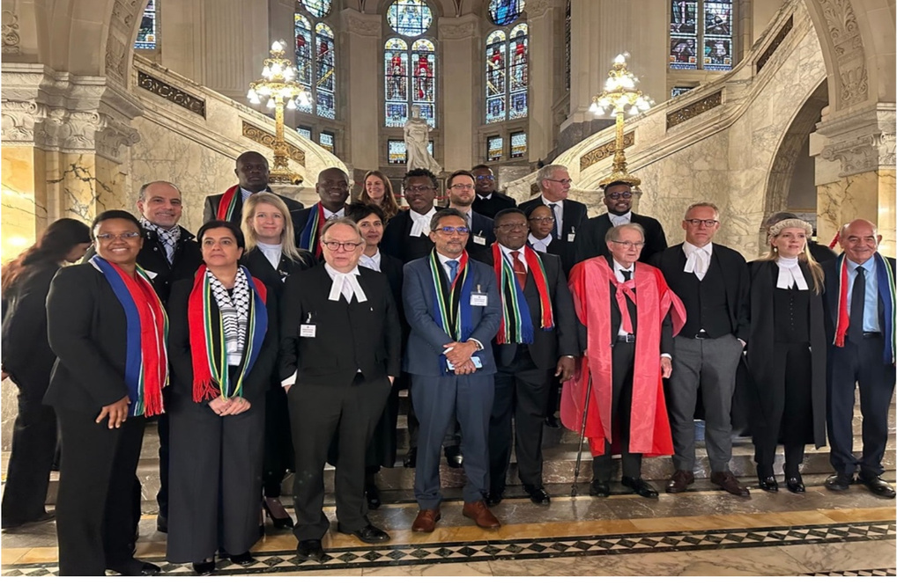
South African legal team
at the ICJ
Notes:
Discussion points:
What are the factors that have led to the loss of land from 1917 until today?
Gaza is now uninhabitable. The Zionists settlers may not leave. What will happen next?

Slide 60
As of
May 15, 2024
  100 journalists killed.
  60 journalists injured.
  More than 35,000 people killed.
  1.7 million Palestinians displaced.
  60 percent of residential buildings damaged.
  191 UN staff killed.
  Over 350 academics and teachers killed.
  Nearly 500 health workers killed.
  16 hospitals totally or partially destroyed.
  More than 80% of schools in Gaza are unusable.
  195 heritage sites, 227 mosques and 3 churches damaged or destroyed.

Slide 61
Double Standards
  In 2022 Russia invaded Ukraine.
  Russia's occupation of Ukraine and Israel's occupation of Gaza are both illegal under international law.
  The United Nations has condemned both occupations, but the response from the West has been very different.
  European countries have shown hospitality to Ukrainian refugees, but not to Palestinians fleeing Gaza.
  The Western response to the conflicts has included tough sanctions against Russia, but increased arms sales to and defence of Israel.
  Calls for boycotts and the cancellation of events have targeted Russia but not Israel.
  The Boycott, Divestment and Sanctions (BDS) movement against Israel is marginalised and even banned by Western countries.
  Western countries continue to supply arms to Israel, the occupier, and Ukraine, the occupied.
  Casualties and suffering in Gaza are rising to the level of genocide, yet there is no significant action or condemnation from the West.
  Western leaders have condemned the violence in Ukraine, but have been largely silent or complicit in the situation in Gaza.

Slide 62
2024 - Nakba Continues
  Despite international condemnation and extensive documentation of civilian casualties, including children and infants, the attacks on Gaza continue, destroying civilian and medical infrastructure.
  Condemnation by the International Criminal Court has failed to stop Israel's genocidal actions.
  Israel's allies continue to provide arms and aid despite the ongoing atrocities against civilians.
  The Arab and Muslim world remains largely silent on the ongoing genocide in Gaza.
  The US recently approved an additional $17 billion aid package to Israel, its largest foreign arms supplier. Germany, which provides about 30% of Israel's weapons, is another major contributor, along with countries such as Britain, Italy and Australia, although the extent of their involvement varies.

Slide 63
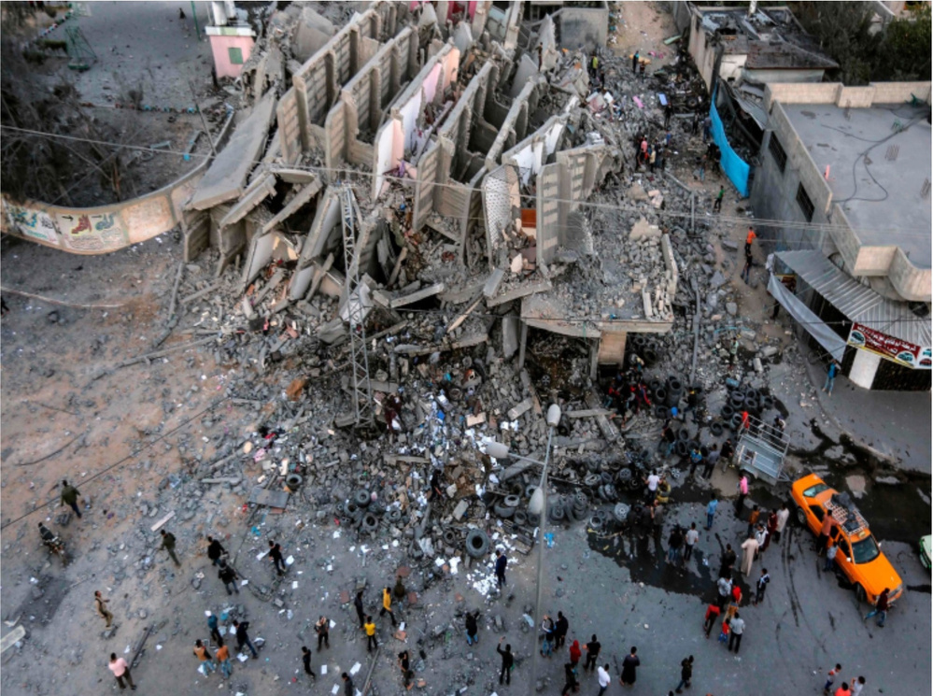
Israel hits a building during Ramadan,
killing 20 Palestinian civilians and a Hamas commander: www.arabnews.com/node/1492851/middle-east

Slide 64
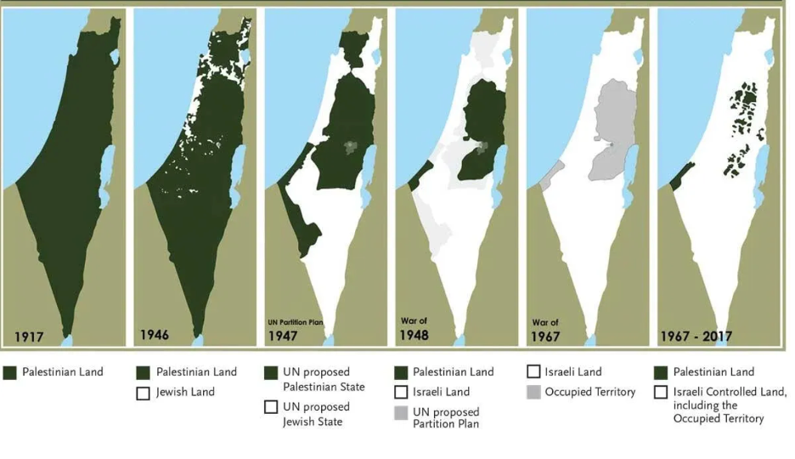
Loss of Land
Notes:
Discussion points:
What are the factors that have led to the loss of land from 1917 until today?
Gaza is now uninhabitable. The Zionists settlers may not leave. What will happen next?

Slide 65
Settlers
  Settlers are Israeli citizens living on private Palestinian land.
  There are more than 700,000 Israeli settlers. In 1993 there were 250,000 settlers.
  Settlements are authorized by the Israeli government whereas there are outposts are built without Israeli authorization.
  There are many financial incentives for Jews to live on the settlements.
  Israeli government funds settlements and aides settlers.
  There are special roads built for the settlers, connecting them to other settlements and main cities. Palestinians are not allowed to use these roads.
  All the settlements and outposts are illegal under international law, UN has issued may resolutions stating this.
  Many Jews from around the world can go to Israel and become a settler through a program called “birthright”.
  Palestinian homes and towns are attacked and demolished every day.
  There have been significant increase in settler violence where armed Israeli settlers kill or wound Palestinians, burn their olive trees and take over their land.

Slide 66
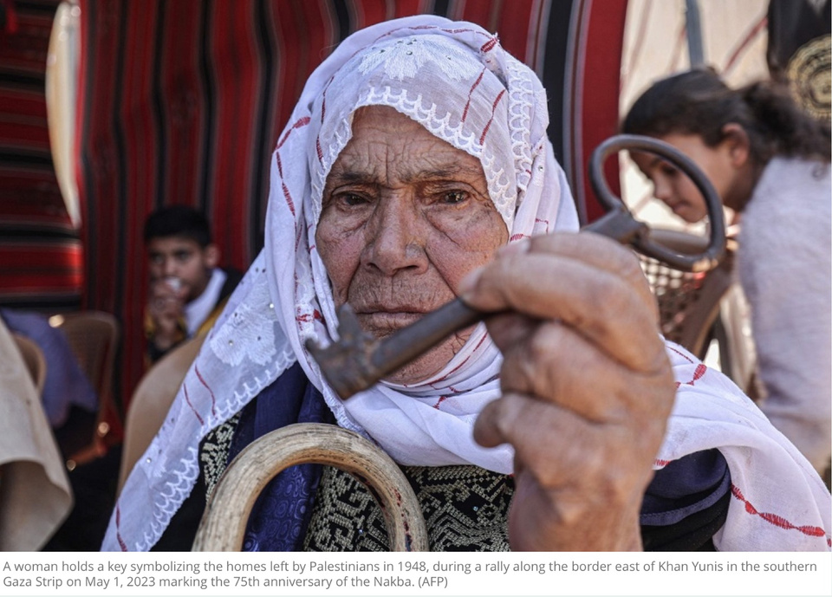
The Key
Many Palestinians left their homes expecting a temporary displacement, prompted by promises from Arab leaders of a swift return. Today, many still hold the keys to their homes, symbolizing their hope to return.

Slide 67
The Nakba
Never Ended
  750,000 to a million Palestinians were uprooted from their homes in 1948, creating a refugee crisis that is still unresolved. Its legacy remains one of the most critical issues in the ongoing peace negotiations.
  More than 7 million Palestinian refugees define themselves as those displaced in 1948 and their descendants.
  A core Palestinian demand in the peace negotiations for justice for refugees is the 'right of return' to the ancestral homes their families left in 1948.
  Today, more than two million Gazans are once again refugees with no where to go. The Nakba continues.

Slide 68
Last Words
  The ongoing oppression and occupation of the Palestinian people and the recent genocide have united the Ummah and the world to stand against hatred - oppression - occupation.
  Palestinians are teaching the whole world the importance of faith, patience, endurance, courage and steadfastness.
  Patience - The Prophet ﷺ said: "Verily, patience is at the first stroke of calamity" (Sahih al Bukhari)- the immediate response of the Palestinians is one of immense patience and courage, repeatedly saying "Alhamdulillah" despite the grave situations they face.
  Under such brutal conditions, the Palestinian people have not faltered, they continue to raise their hands and pray to the One who, Insha'Allah, will grant them victory.
  It's been narrated that the Prophet ﷺ said:
"There are three people whose prayers are never refused: The righteous leader, the fasting person when he breaks his fast, and the oppressed when he supplicates, whose supplications are raised above the clouds, and the gates of heaven are opened for them, and (to) whom Allah will say: 'This is what Allah wants;
By My glory! I will help you, even if it be after a while' (At-Tirmithi).

Slide 69
Disclaimer
Note on the use of resources:
  These resources should be used with discretion. They are provided as supplementary information and ICI accepts no responsibility for any external resources shared. These resources should be used with caution.
  If you plan to share these resources with students, please ensure that they are accurate, factual, consistent with the Palestinian narrative, and appropriate for your students and/or audience.

Slide 70
Additional Resources
Documentaries:
  Al-Nakba: The Palestinian catastrophe - Episode 1-4
https://www.youtube.com/watch?v=H7FML0wzJ6A&t=729s
https://www.youtube.com/watch?v=yI2D5Fsd9lg
https://www.youtube.com/watch?v=5SKECszemmA
https://www.youtube.com/watch?v=0m__A7MlDrk&t=13s
  1948: Creation & Catastrophe: https://www.youtube.com/watch?v=Bwy-Rf15UIs
  How the First World War Created the Middle East Conflicts : https://www.youtube.com/watch?v=tjnBmH8b0Ko&t=427s
  How Zionists Came to Palestine Under British Protection: https://www.youtube.com/watch?v=EtvqioF81BU

Slide 71
Additional Resources
  Origins and Evolution of the Palestine Problem: 1917-1947: https://www.un.org/unispal/history2/origins-and-evolution-of-the-palestine-problem/part-i-1917-1947/
  Demographic information of Historical Palestine prior to 1948: https://assets.nationbuilder.com/cjpme/pages/2116/attachments/original/1655220704/07-En-Demographics-Factsheet_v02.pdf?1655220704
  For middle school students: https://www.youtube.com/watch?v=zE8GCX1w3ys

Slide 72
Additional Resources
Books:
  The Woman from Tantoura: A Novel from Palestine (Hoopoe Fiction) Paperback – 18 December 2018 by Radwa Ashour (Author), Kay Heikkinen (Translator)
  The Hundred Years' War on Palestine: A History of Settler Colonialism and Resistance, 1917–2017
  The Ethnic Cleansing of Palestine by Ilan Pappé (2006): A groundbreaking work that offers a comprehensive and critical analysis of the events leading up to and following the establishment of the State of Israel in 1948,

Slide 73
Additional Resources
Books:
  The General’s Son: Journey of an Israeli in Palestine: A powerful account, by Israeli peace activist Miko Peled, of his transformation from a young man who'd grown up in the heart of Israel's elite and served proudly in its military into a fearless advocate of nonviolent struggle and equal rights for all Palestinians and Israelis.
  The Holocaust Industry: Reflection on the Exploitation of Jewish Suffering: In his interesting study, Norman G. Finkelstein examines the prominent role the Holocaust has come to play in global culture, particularly after the 1967 Arab-Israeli War, and critiques the exploitation of Holocaust memory for political and financial gain

